Slide 1
Requirements of Modern Wind Power Plants in the Iraq
By
Mr. Firas Thair Al-Maliky

Slide 2
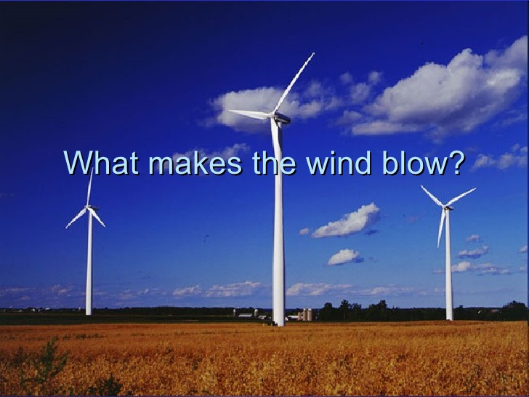

Slide 3
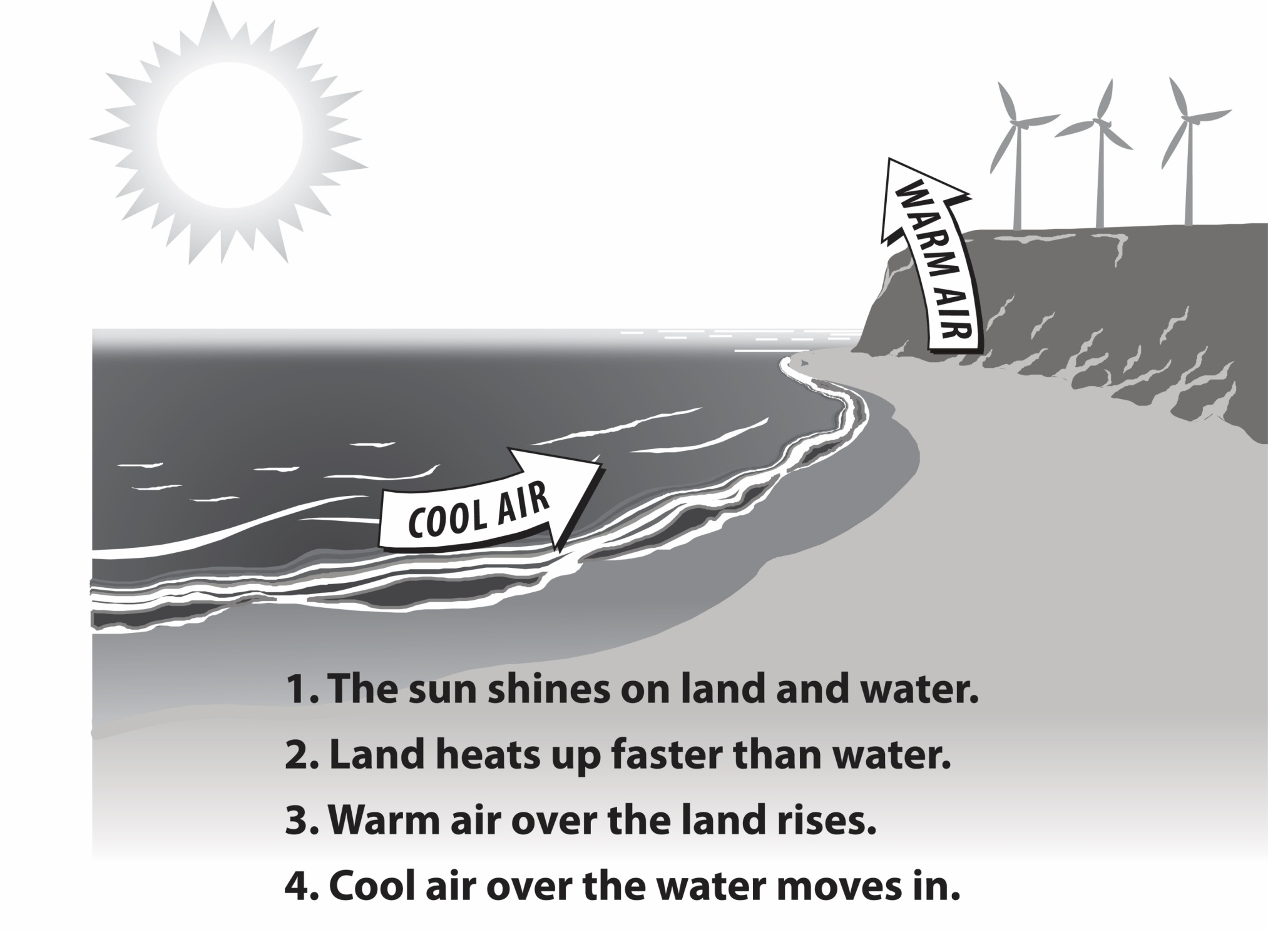

Slide 4
Wind Turbine
A wind turbine extracts energy from moving air by slowing the wind down, and transferring this energy into a spinning shaft, which usually turns a generator to produce electricity. The power in the wind that’s available for harvest depends on both the wind speed and the area that’s swept by the turbine blades.

Slide 5
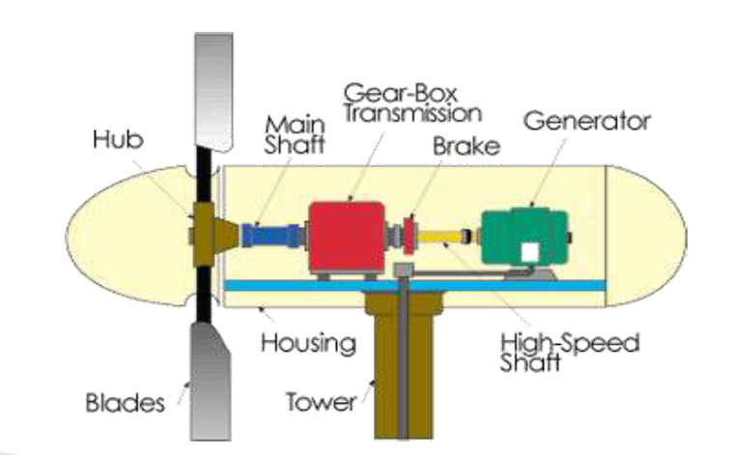
Main components of a Horizontal Axis Wind Turbine

Slide 6
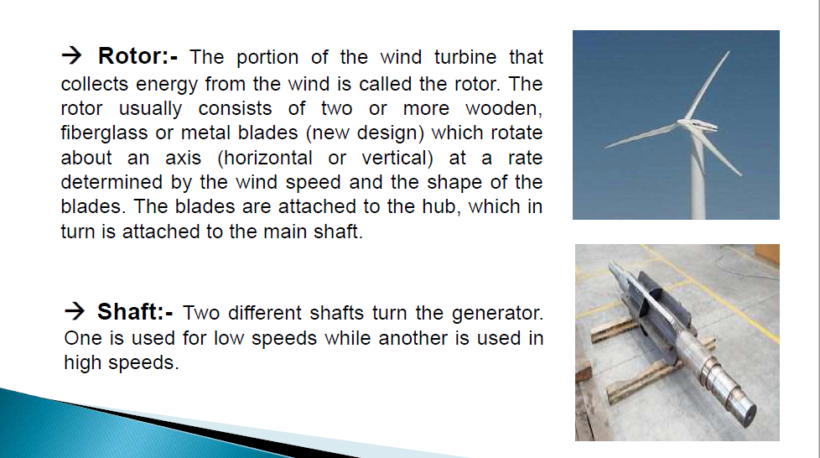

Slide 7
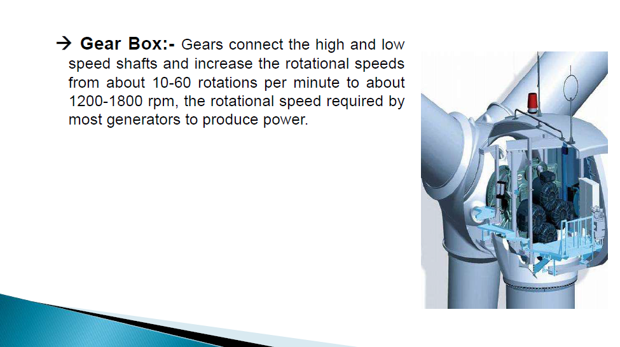

Slide 8
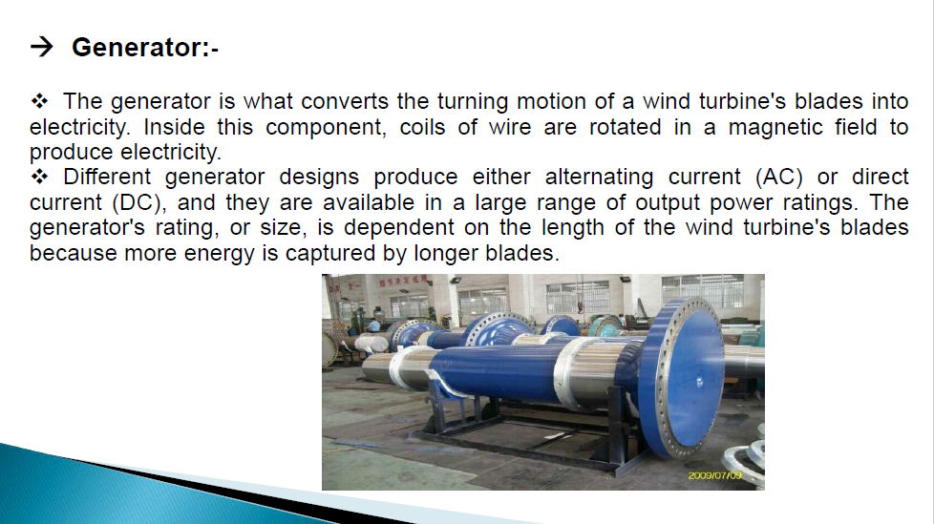

Slide 9
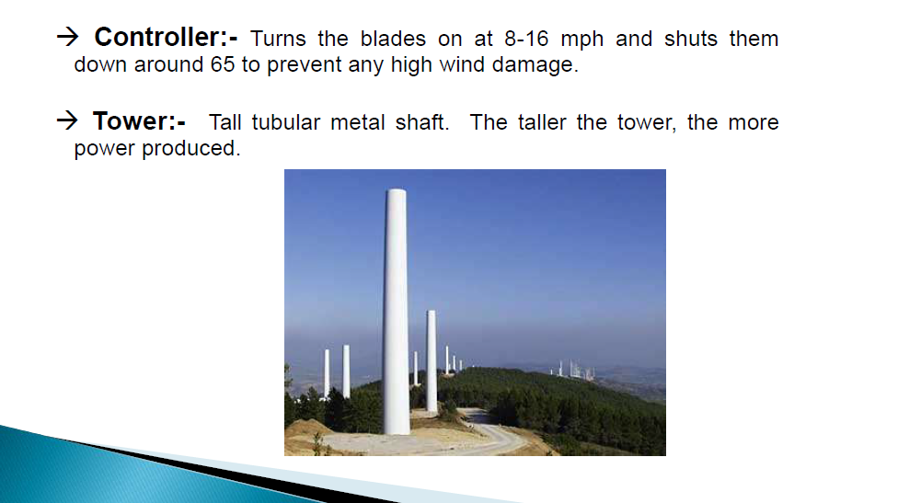

Slide 10
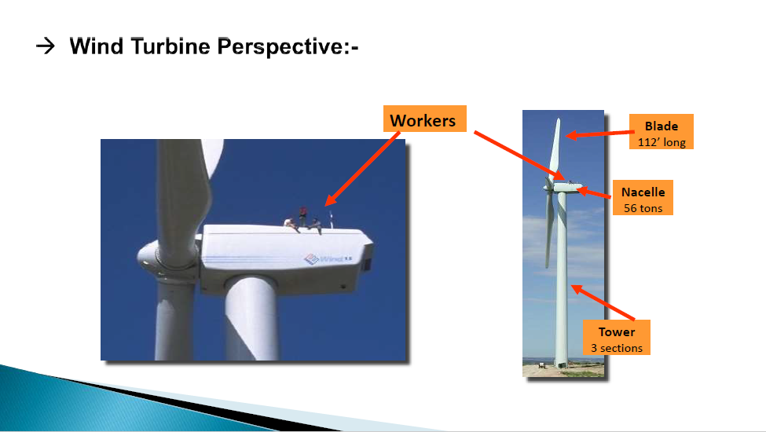

Slide 11
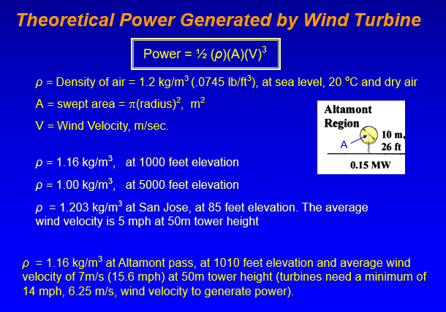

Slide 12
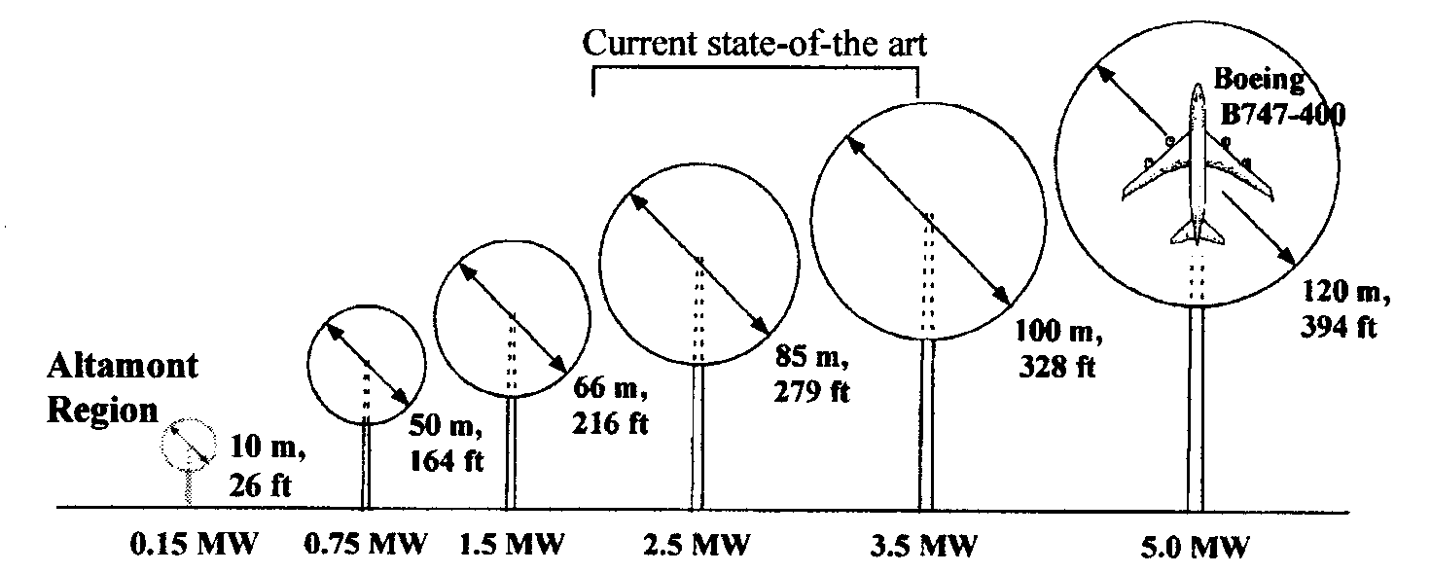
Power Generated by Wind Turbine

Slide 13
Rotor Blade Variables
Blade Length
Blade Number
Blade Pitch
Blade Shape (profile)
Blade Materials

Slide 14
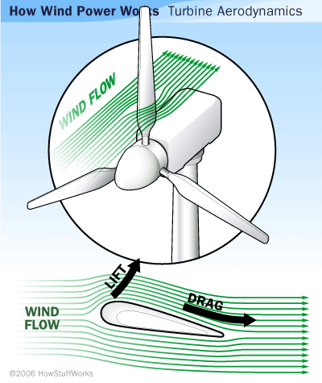
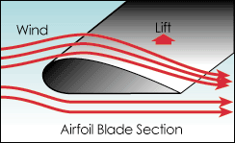
Lift Design
The lift blade design employs the same principle that enables airplanes, kites and birds to fly. The blade is essentially an airfoil, or wing. When air flows past the blade, a wind speed and pressure differential is created between the upper and lower blade surfaces. When blades are attached to a central axis, like a wind turbine rotor, the lift is translated into rotational motion. Lift-powered wind turbines have much higher rotational speeds than drag types and therefore are well suited for electricity generation.

Slide 15
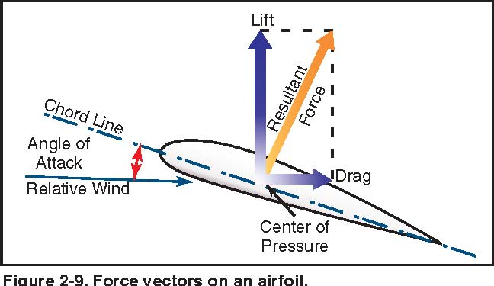

Slide 16
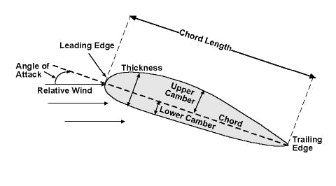
Wind Turbine – Blade Design
Wind Turbine – Blade Design
Angle of attack (blade angle)
The angle between the chord line of the airfoil and the flight direction is called the angle of attack. Angle of attack has a large effect on the lift generated by an airfoil. This is the propeller efficiency. Typically, numbers here can range from 1.0 to 15.0 degrees.

Slide 17
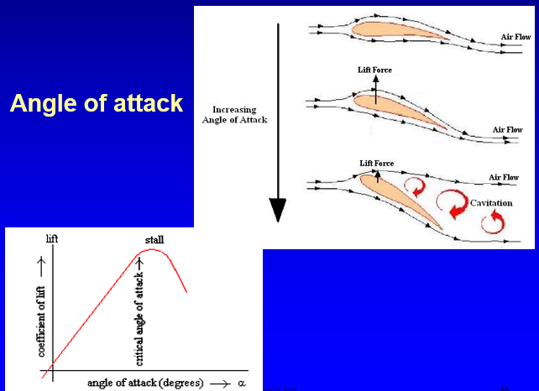

Slide 18
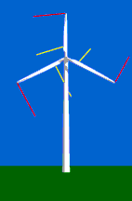
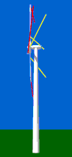
Wind Turbine – Blade Design (Shape)
Since most wind turbines have constant rotational speed, the speed with which the tip of the rotor blade moves through the air (the tip speed) is typically some 64 m/s, while at the center of the hub it is zero. 1/4 out from the hub, the speed will then be some 16 m/s.
The yellow ribbons close to the hub of the rotor will be blown more towards the back of the turbine than the red ribbons at the tips of the blades. This is because, at the tip of the blades, the speed is some 8 times higher than the speed of the wind hitting the front of the turbine.

Slide 19
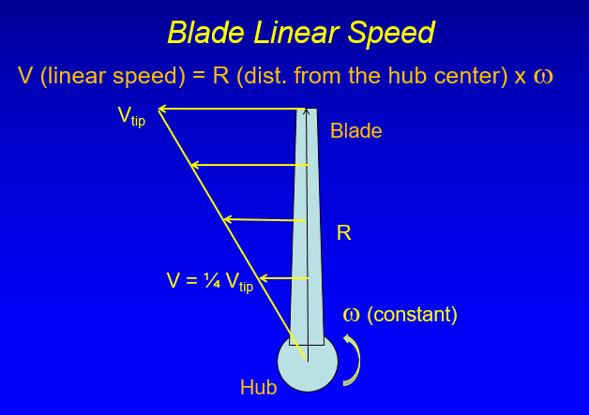

Slide 20
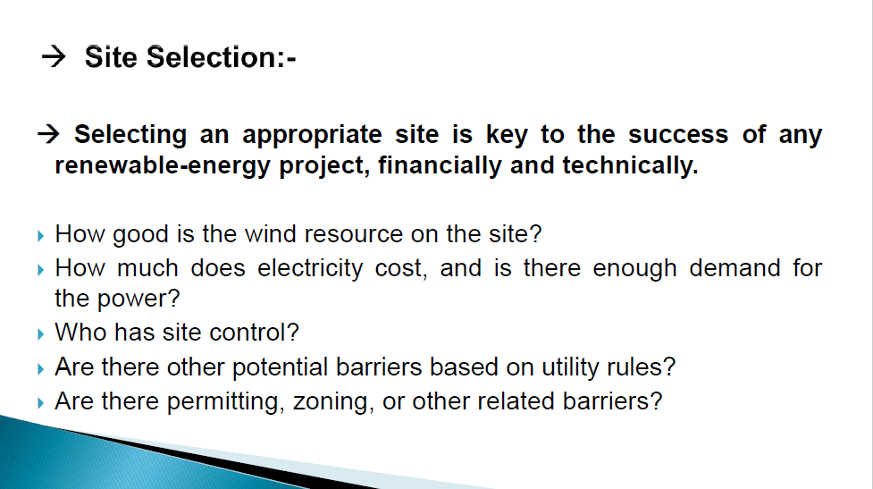

Slide 21
Studying Wind Speed in Iraq
Studying wind speed included the following steps:
Obtaining the annual wind speed data at least for several years in Iraq
Using logarithmic height formula to estimate the increasing in wind speed with altitude
The results that obtained from Iraqi Meteorological Center was measured from (10 m) altitude. This altitude is not suitable to produce high power in the cities of Iraq.

Slide 22
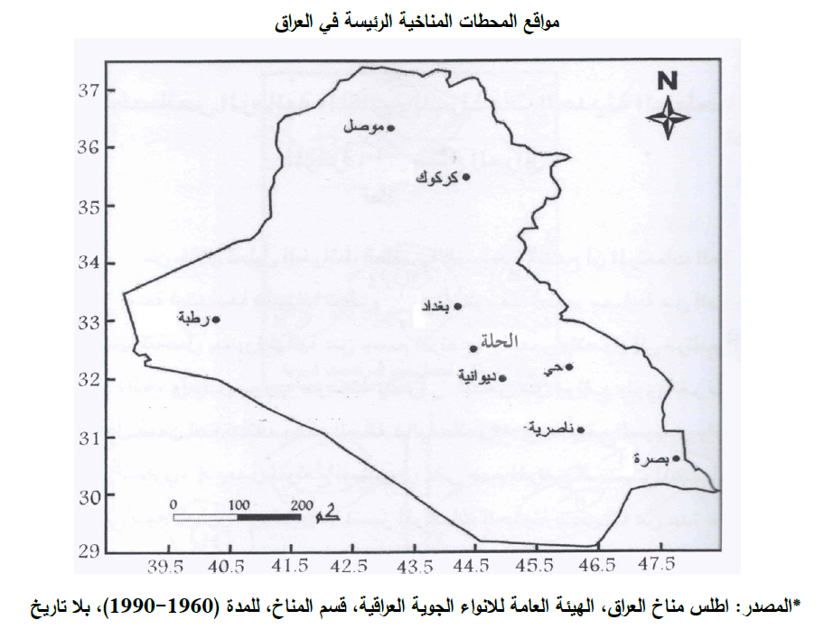

Slide 23
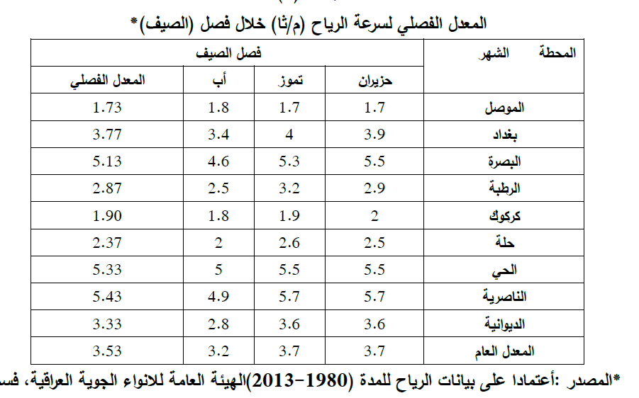

Slide 24
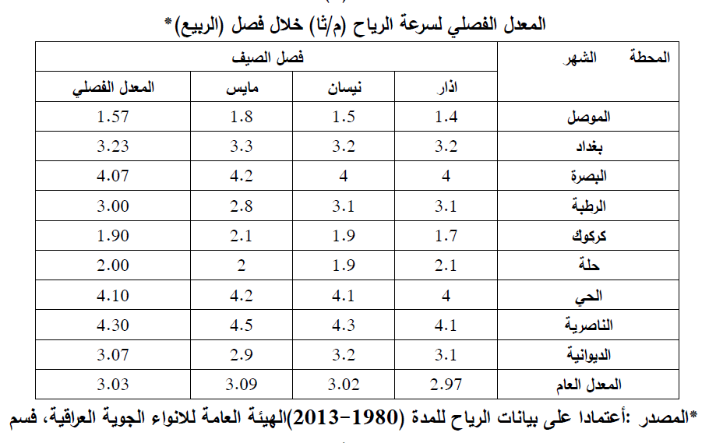

Slide 25
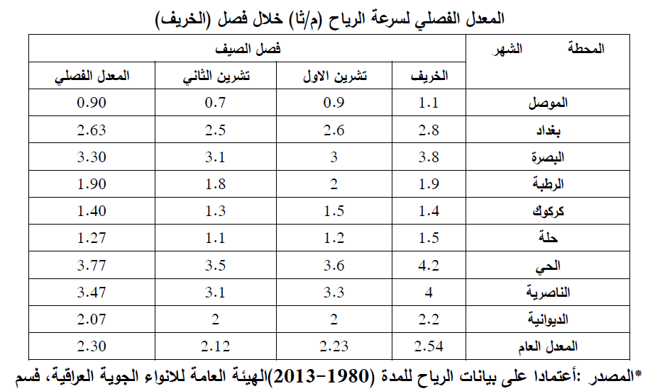

Slide 26
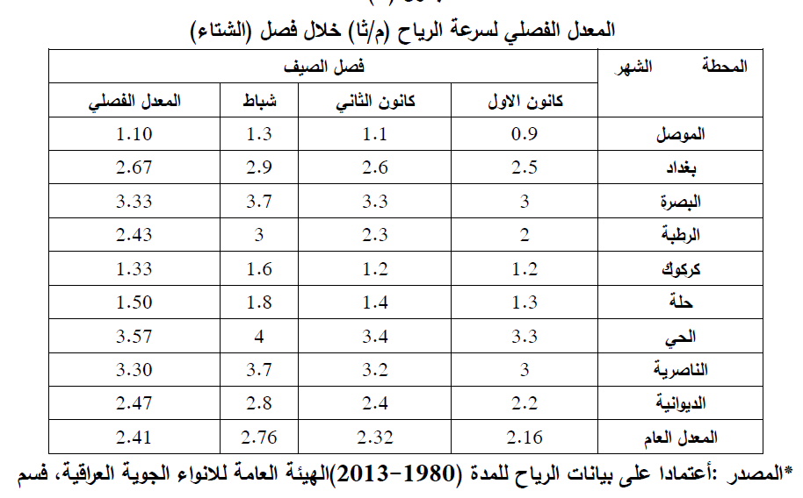

Slide 27
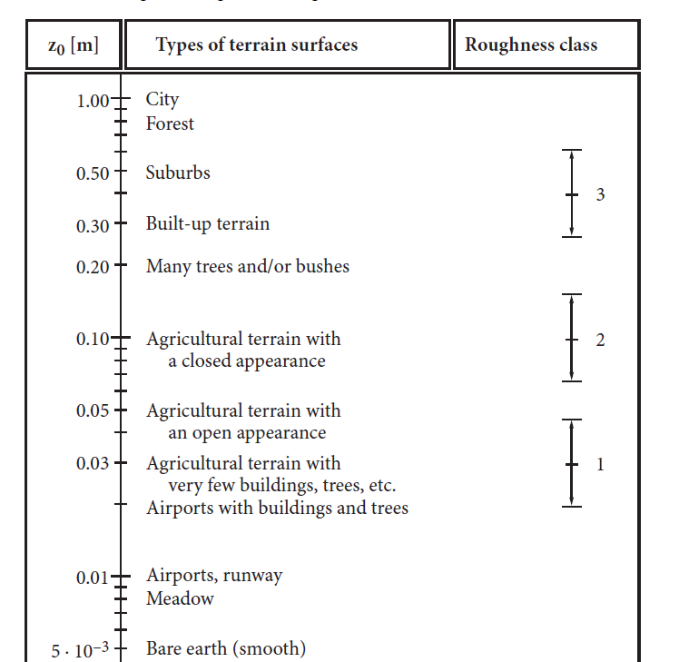
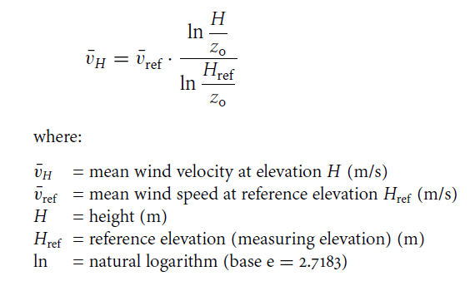

Slide 28


