Slide 1
Microcontroller Knee Joint
Mr. Firas Thair Al-Maliky

Slide 2
Microcontroller Knee Joint
Microprocessor-controlled knees (MCKs) do not utilize motors to power joint rotation, but they adjust damping in the knee to improve swing- and/or stance-phase control as appropriate for the user during gait

Slide 3
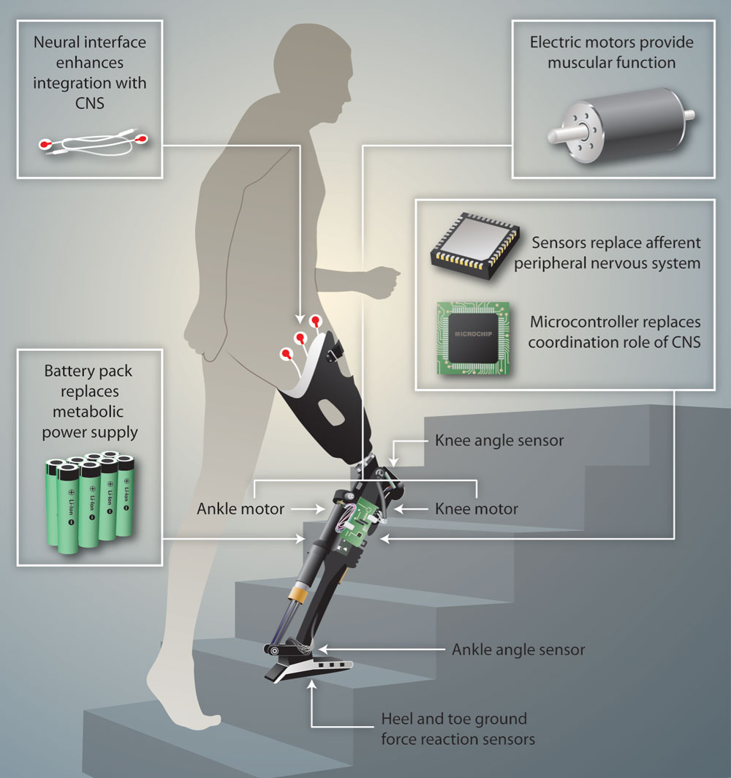

Slide 4
Microcontroller Knee Joint
Some of the newer microprocessor-controlled knees currently on the market utilize adaptive control to automatically adjust to a user’s gait over time, so less setup and fine-tuning of the device is required by the prosthetist. Emphasis, too, is being placed on developing knees that are less costly, less complex, and more dependable than earlier microprocessor-controlled designs

Slide 5
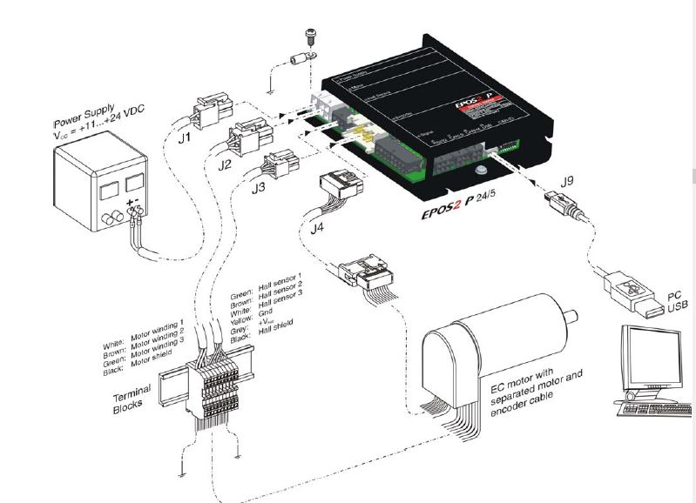

Slide 6
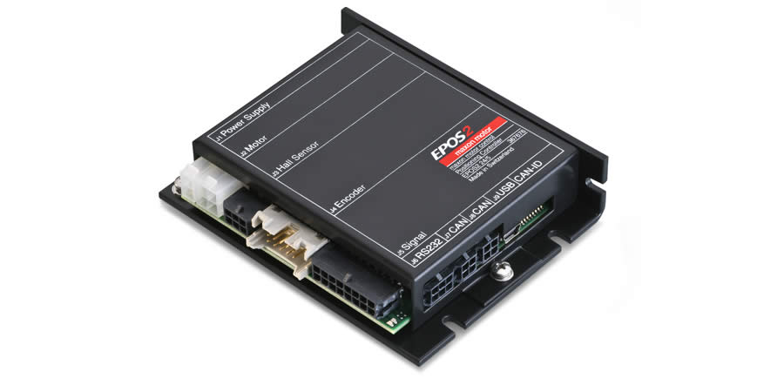

Slide 7
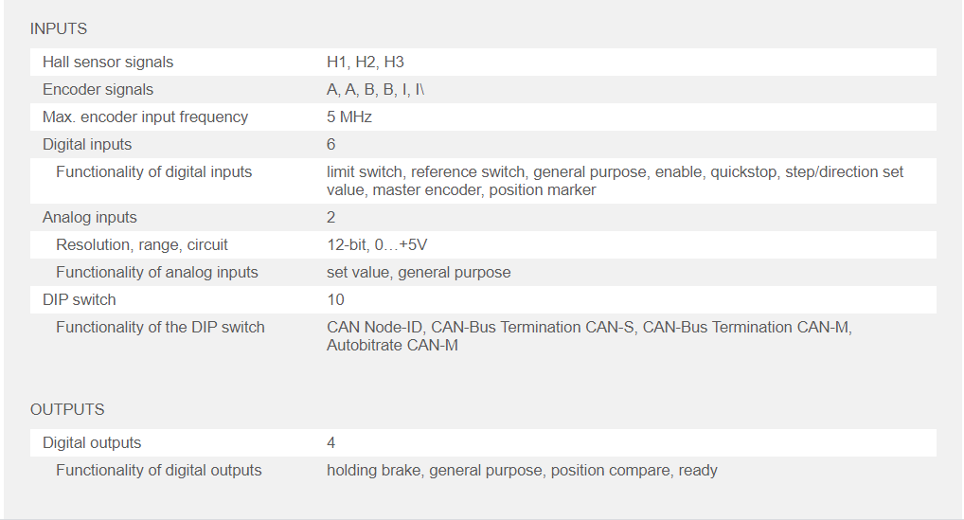

Slide 10
