Slide 1
Seminar
Feasible WIMAX Link Budget Calibration
المدرس المساعد محمد مهدي صالح
قسم هندسة تقنيات الحاسوب
كلية الهندسة التقنية
Thirty First of May - 2021

Slide 2
Aims
The lecture aims:
- Illustrate the WIMAX Technology
Antennas gains
WIMAX Link Budget
Link Impairments
Link Budget Calculation

Slide 3
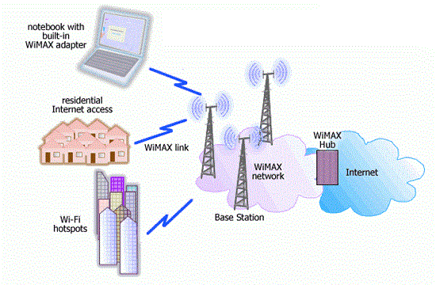
What is WIMAX Technology
WiMAX (Worldwide Interoperability for Microwave Access) is a family of wireless broadband communication standards based on the IEEE 802.16 set of standards, which provide multiple physical layer (PHY) and Media Access Control (MAC) options.

Slide 4
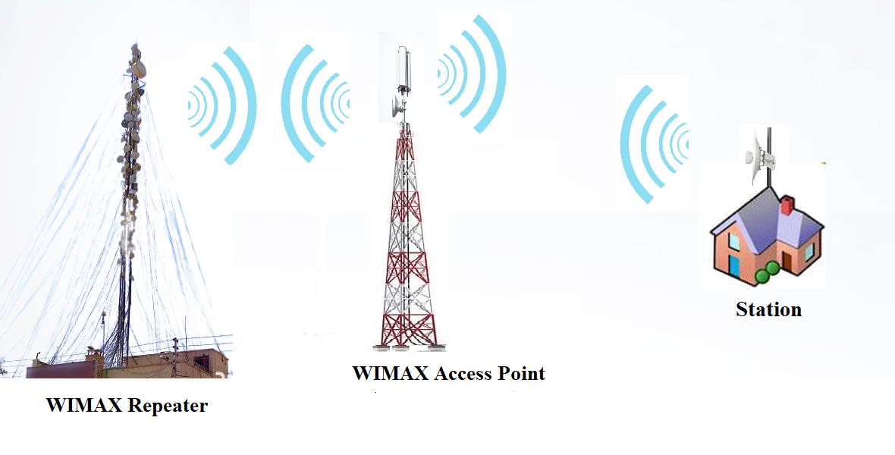
WIMAX Architecture in Iraq

Slide 5
Glimpse
A link budget is the accounting of all of the gains and losses from the transmitter, through the medium to the receiver in a telecommunication system.
A simple link budget equation looks like this:
Received Power (dBm) = Transmitted Power (dBm) + Gains (dBi) − Losses (dB)
Link budget
Notes:
اعلنت وزارة الاتصالات ،اليوم الثلاثاء، عن بدء المرحلة الثانية من المشروع الوطني للانترنت و المتضمن نصب الكابينات الخاصة بالكيبل الضوئي و التي ستشمل جميع مناطق العراق التي امتد فيها الكيبل الضوئي على طول 4500 كم .

Slide 6
Glimpse
Received Power (dBm) = Transmitted Power (dBm) + Gains (dBi) − Losses (dB)
Link budget
Gains = Transmitter (antenna) Gain + Receiver (antenna) Gain
Losses = Transmitter Cable losses + Receiver cable losses + Path Loss
Notes:
اعلنت وزارة الاتصالات ،اليوم الثلاثاء، عن بدء المرحلة الثانية من المشروع الوطني للانترنت و المتضمن نصب الكابينات الخاصة بالكيبل الضوئي و التي ستشمل جميع مناطق العراق التي امتد فيها الكيبل الضوئي على طول 4500 كم .

Slide 7
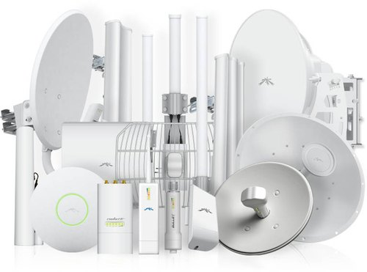
Antenna Gains
Gains = Transmitter Gain + Receiver Gain

Slide 8
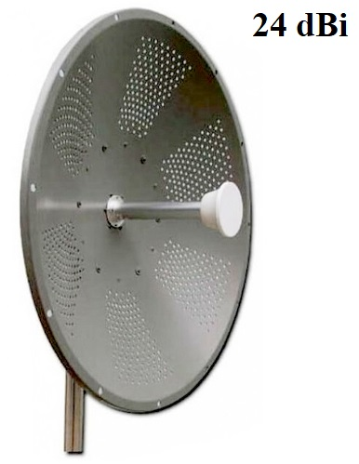
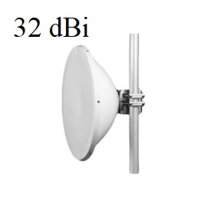
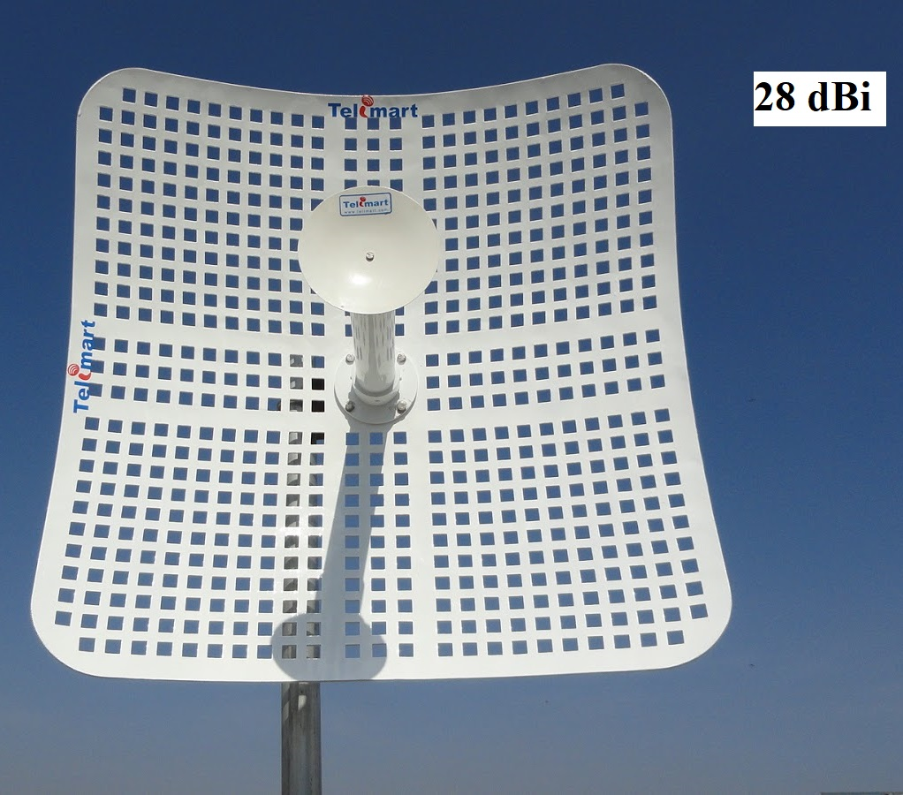
Examples of Antenna Gains

Slide 9
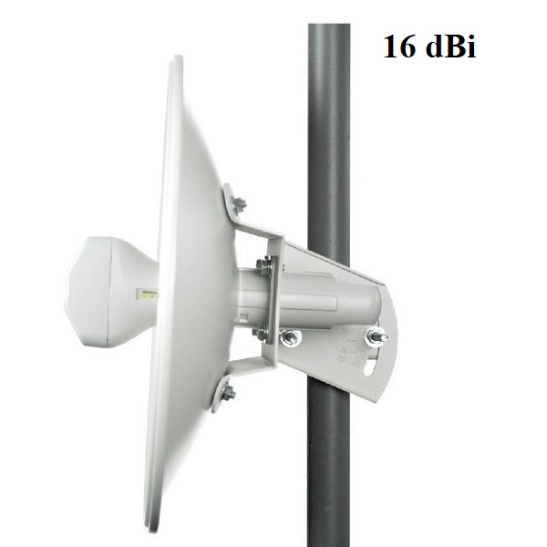
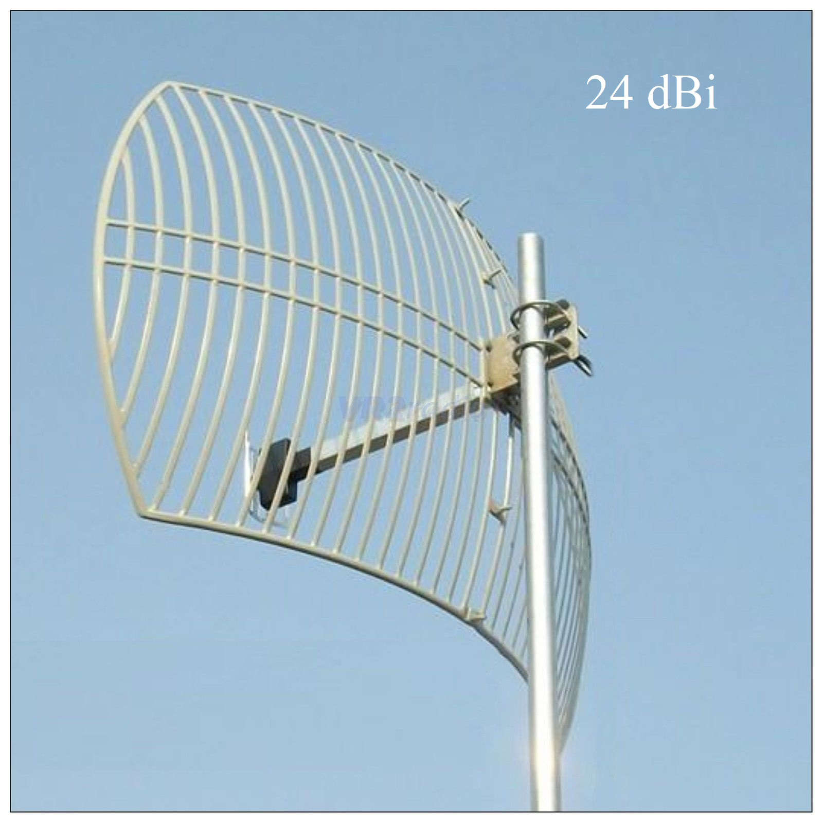
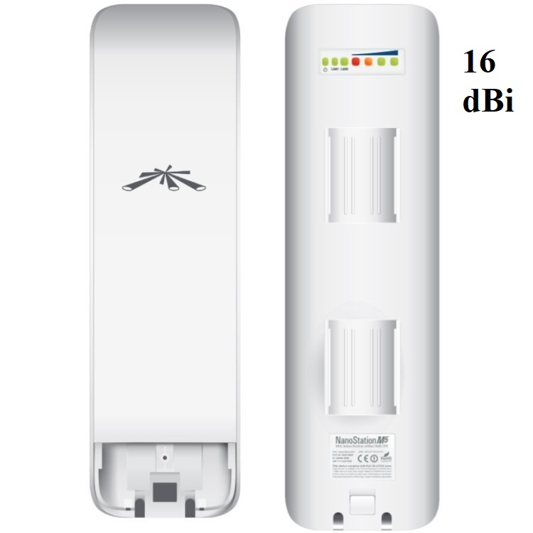
Examples of Antenna Gains

Slide 10
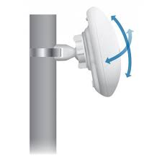
Antenna alignment

Slide 11
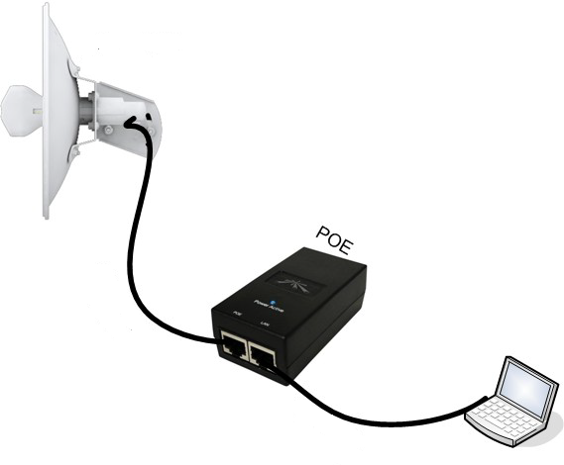
Losses
Losses = Transmitter Cable losses + Receiver cable losses + Path Loss

Slide 12
Cable Losses
Cable Losses
Some of the signal energy is lost in the cables, the connectors and other devices, going from the radios to the antennas.
The loss depends on the type of cable used and on its length, in the range of 2-3 dB. It is better to have cables as short as possible.

Slide 13
Path Loss
Path Loss represents the single greatest source of loss in a wireless system.
Path loss in wireless systems can be mainly returned to three sources:
- Free Space Path Loss
Signal power is diminished by geometric spreading of the wave front, commonly known as free space loss.
Path Loss

Slide 14
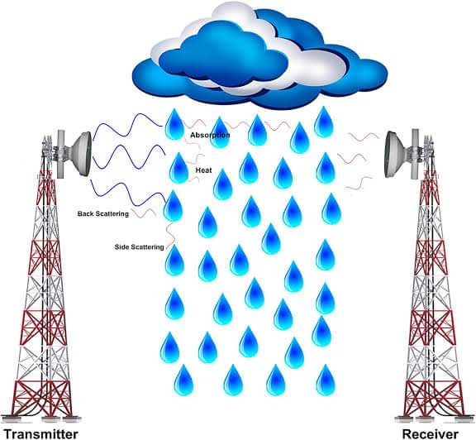
Path Loss

Slide 15
Free Space Path Loss
The formula for Free Space Path Loss LFS (in dB) is:
Where:
- λ is the signal wavelength (in meters).
- f is the signal frequency (in Hertz).
- d is the distance from the transmitter (in meters).
- c is the speed of light in a vacuum, 2.99792458 × 108 meters per second.

Slide 16
Attenuation
Attenuation
The second contribution to the path loss is given by attenuation. This takes place as some of the signal power is absorbed when the wave passes through solid objects such as trees, walls, windows and floors of buildings. Attenuation can vary greatly depending upon the structure of the object the signal is passing through, and it is very difficult to quantify. The most convenient way to express its contribution to the total loss is by adding an “allowed loss” to the free space.

Slide 17
Link Obstacles
Typical attenuations through the different obstacles are presented in the following table.

Slide 18
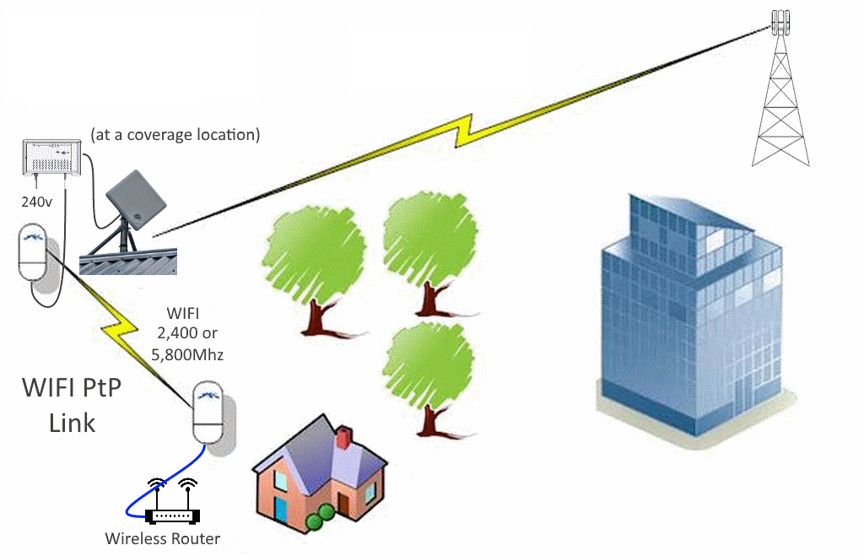
Link Obstacles

Slide 19
Scattering
Scattering
Practically, an exponent of 1.5 can be used in an outdoor environment with trees, while one of 2 can be used for an indoor environment.

Slide 20
Minimum Received Signal Level
The minimum RSL, or simply, the sensitivity of the receiver is always expressed as a negative dBm and is the lowest power of signal the radio can distinguish.
The minimum RSL will be typically in the range of -75 to -95 dBm.

Slide 21
Fade Margin
Fade Margin
To give some space for attenuation and multipath in the received radio signal, a margin of 15- 20 dB usually being safe enough. It is the amount of signal above the sensitivity of radio that should be received in order to ensure a stable, high quality radio link during bad weather and other atmospheric disturbances. So, if the resulting signal level is greater than the minimum RSL by at least magnitude of the fade margin, then the link is feasible.
NOTE: A link is said to be feasible if it is feasible in both directions.

Slide 22
Factual Example
EXAMPLE: A 350 m IEEE 802.11g link operates at 2.45 GHz frequency with one access point and one client radio.
The access point is connected to an omnidirectional antenna with 10 dBi gain, while the client is connected to a sectorial antenna with 14 dBi gain. The transmitting power of the AP is 100 mW and its sensitivity is -89 dBm. The transmitting power of the client is 30 mW and its sensitivity is -82 dBm. The cables are short, with a loss of 2 dB at each side. Estimate the feasibility of this link considering a fade margin of 15 dB.

Slide 23
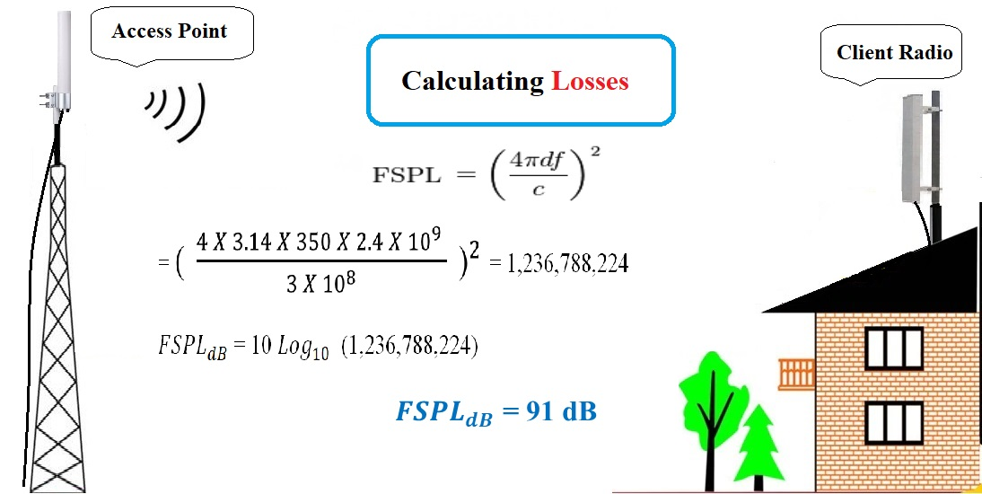

Slide 24
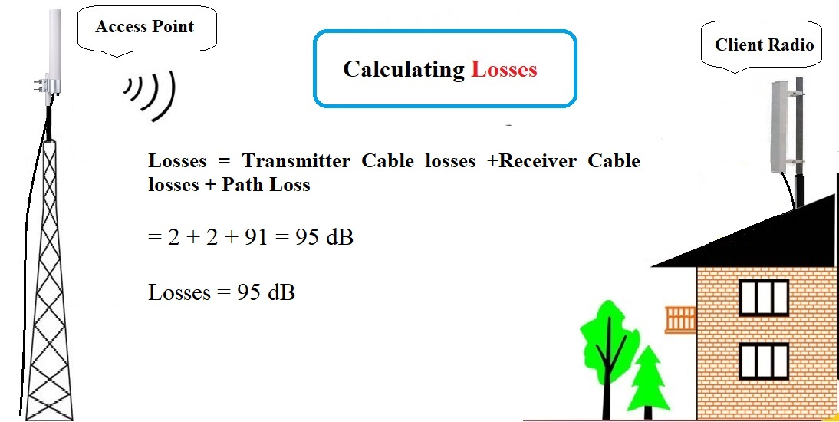

Slide 25
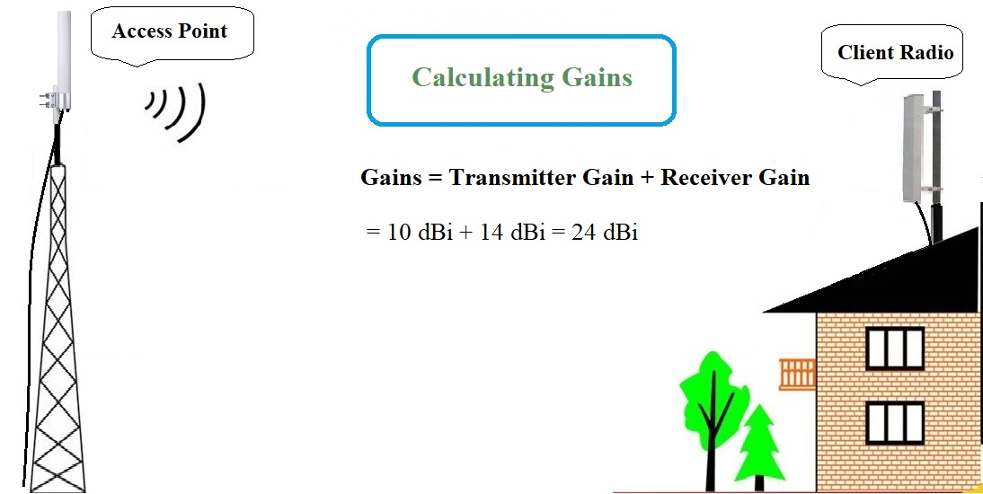

Slide 26
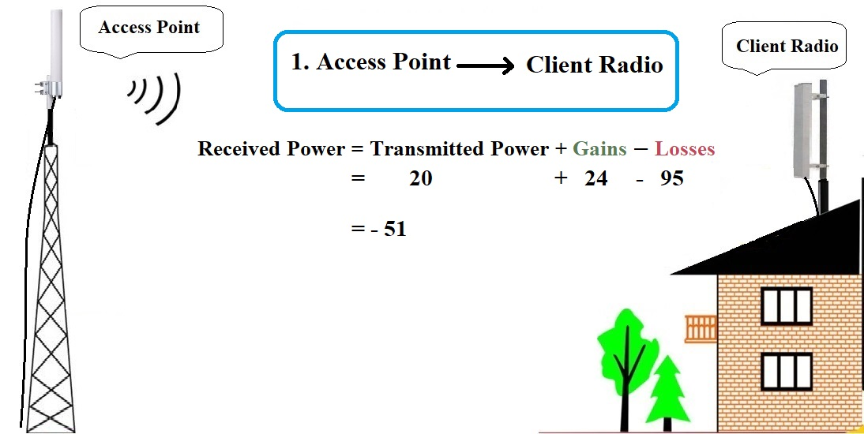

Slide 27
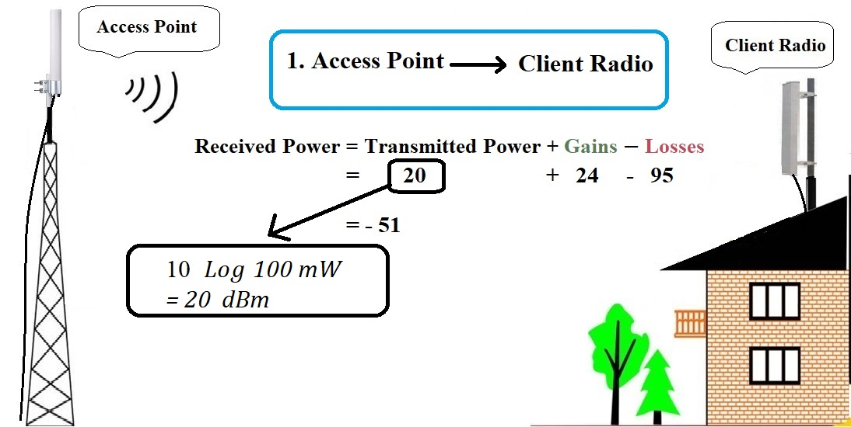

Slide 28
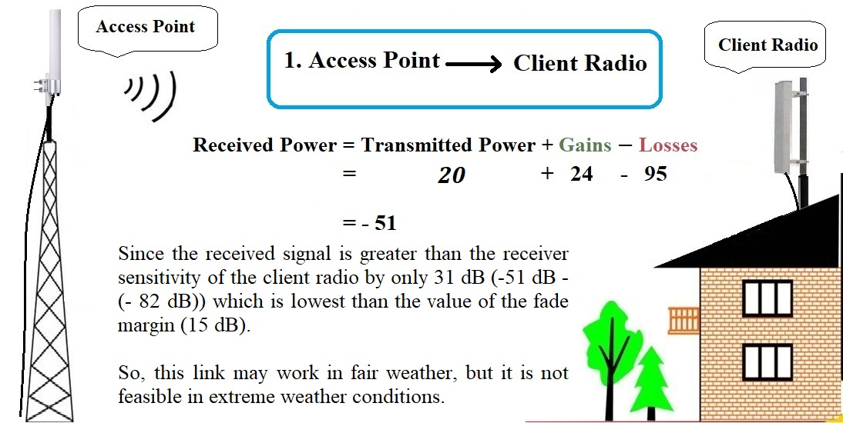

Slide 29
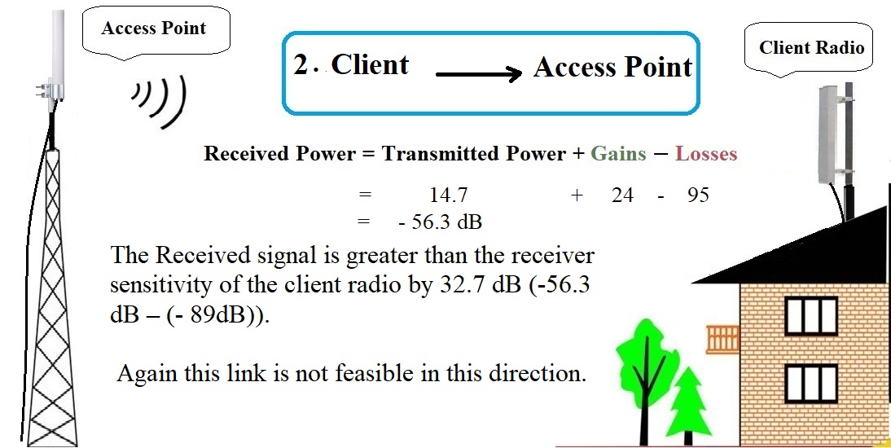

Slide 30
Recommendations
Recommended for home antenna configuration for robust WIMAX link.
Highly advisable shortening unnecessary cable length along with its quality periodic check.
Link budget patently clarifies pivotal originators of Link breakdown.

Slide 31
I appreciate your attendance
Any questionnaires ?

