Slide 1
Biomass & Biofuels as Alternative Energy Sources
الوقود الحيوي كمصدر بديل للطاقة
المحاضر
المدرس: محمد عبد الخالق هاشم الطيَار
قسم هندسة تقنيات الحاسوب // كلية الهندسة التقنية
الأربعاء : 9 / 6 / 2021

Slide 2
بسم الله الرحمن الرحيم
{وَهُوَ الَّذِى يُرْسِلُ الرِّيَاحَ بُشْراً بَيْنَ يَدَىْ رَحْمَتِهِ حَتَّى‏ إِذَا أَقَلَّتْ سَحَاباً ثِقَالًا سُقْنَاهُ لِبَلَدٍ مَّيِّتٍ فَأَنْزَلَنَا بِهِ الْمَاءَ فَأَخْرَجْنَا بِهِ مِنْ كُلِّ الَّثمَراتِ}
(الاعراف/ 57)
صَدَقَ اللهُ العَلِيُ العَظِيم

Slide 3
OUTLINES
What are fuel & biofuels?
classification of biofuels.
Managed Biomass Systems.
I BIO-DIESEL.
II BIO-ethanol.
III BIO-gas.

Slide 4
FUELS
Fuels are any materials that store potential energy in forms that can be practicably released and used as heat energy. • Fuels are required for a variety of purposes, but are utilized chiefly for:
          Transportation : Globally, transportation accounts for 25% of energy demand and nearly 62% of oil consumed.
          Power Generation: The generation of electricity is the single largest use of fuel in the world. • More than 60 % of power generated comes from fossil fuels.

Slide 5
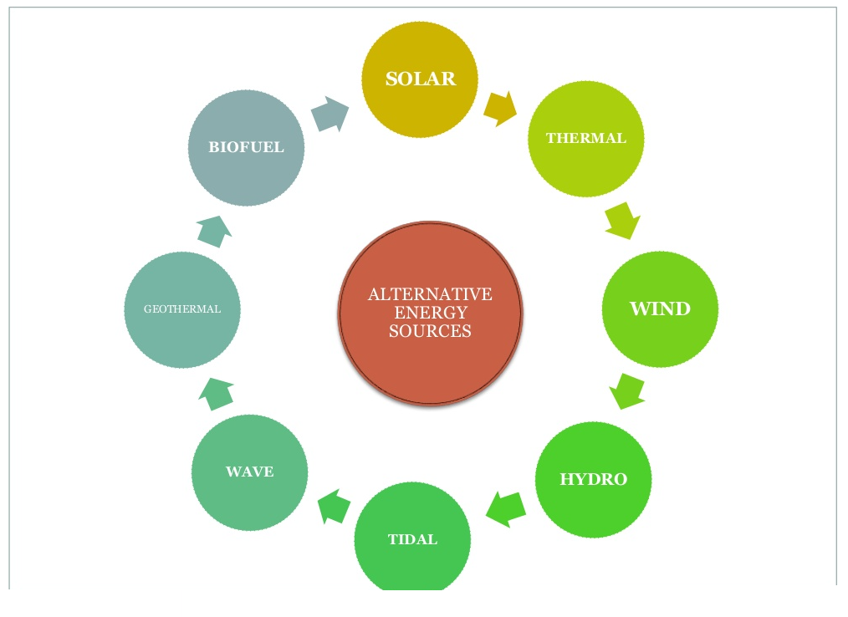

Slide 6
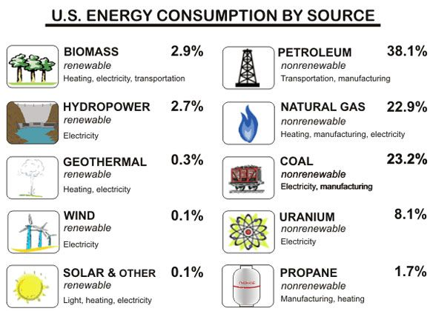

Slide 7
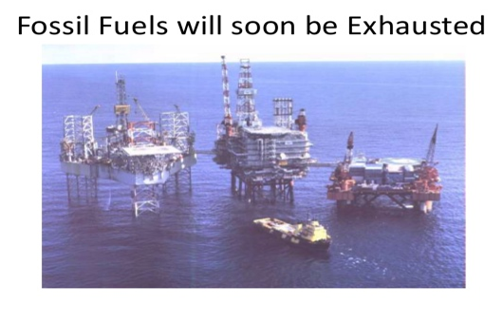

Slide 8
If we had replenish fuel sources, what direction should we go in? •
Electric cars
Solar power
Wind power
OR
Bio-fuels

Slide 9
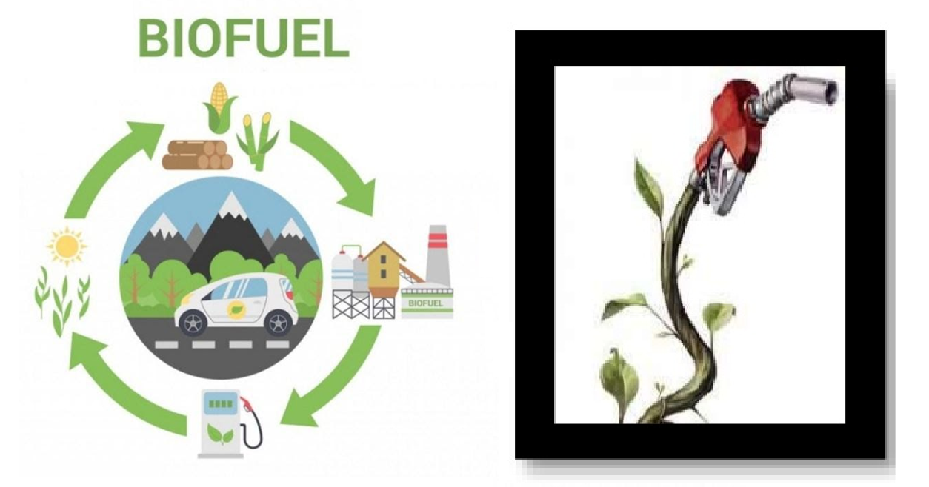

Slide 10
What are biofuels?
Any hydrocarbon fuel that is produced from organic matter (living or once living material) in a short period of time (days, weeks, or even months) is considered a Biofuel.

Slide 11
Biofuel versus Fossil Fuel
Fossil fuels are not renewable, which means they will run out at some point. As our ability to pump fossil fuels from the ground diminishes, the available supply will decrease, which will inevitably lead to an increase in price.
Biofuels can be looked upon as a way of energy security which stands as an alternative of fossil fuels that are limited in availability. Today, the use of biofuels has expanded throughout the globe.

Slide 12
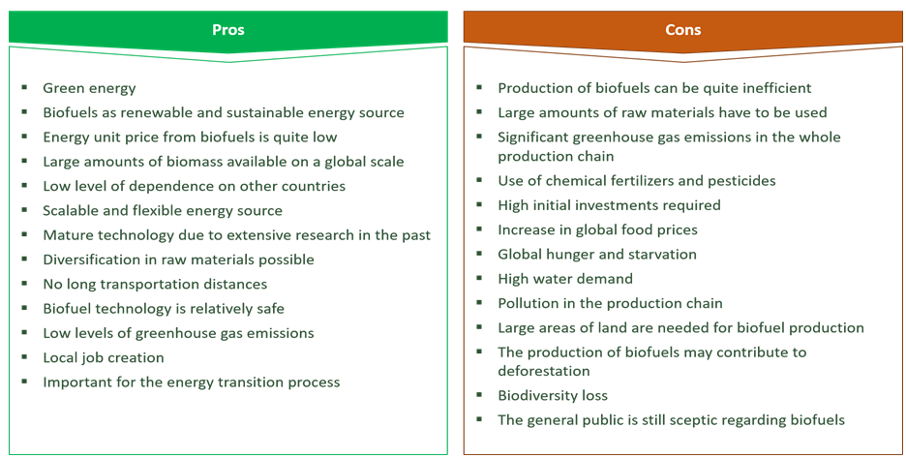

Slide 13
BIO-FUEL CLASSIFICATION

Slide 14
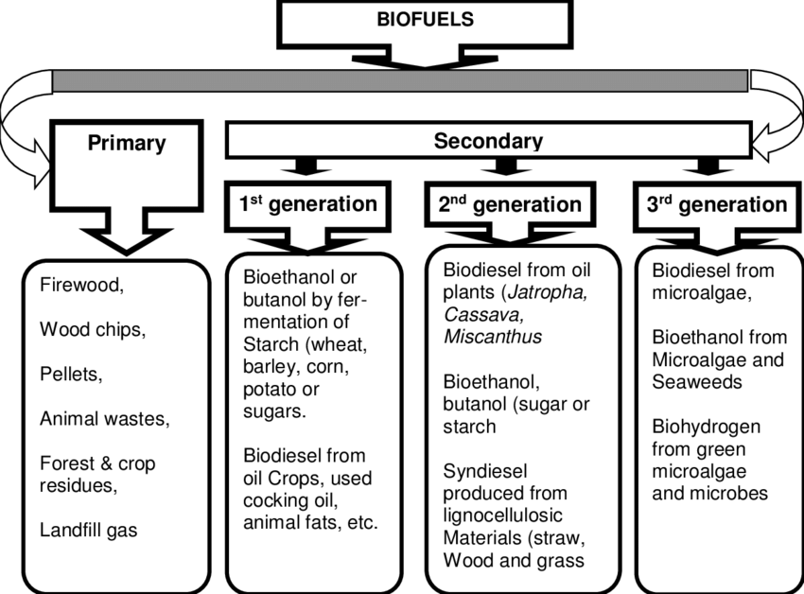

Slide 15
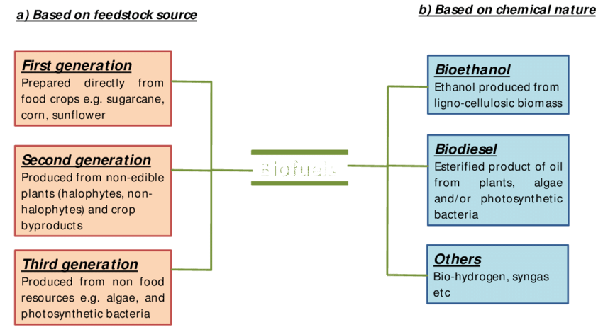

Slide 16
Natural and Managed Biomass Systems

Slide 17
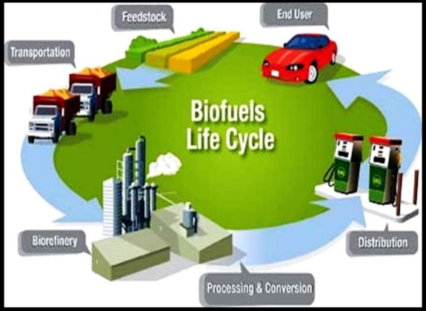
Natural and Managed Biomass Systems

Slide 18
I BIO- DIESEL
I BIO- DIESEL

Slide 19
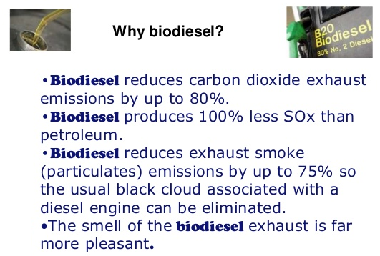
I BIO- DIESEL

Slide 20
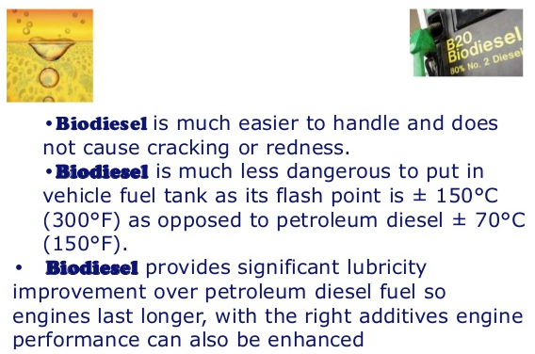
I BIO- DIESEL

Slide 21
BIODIESEL IS:
eco-friendly.
Biodiesel is clean burning alternative fuel.
Biodiesel contain no petroleum, but can be blended with conventional diesel fuel.
These fuel can be used in any diesel engine without any modification.
Biodiesel is degradable.
non toxic and free from sulphur and lead.

Slide 22
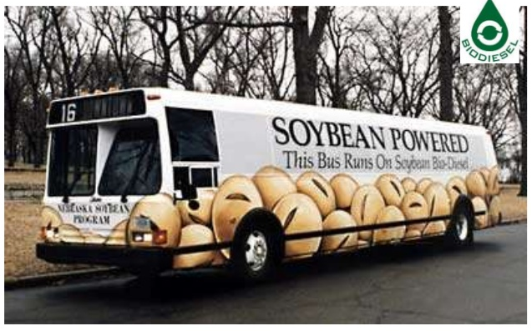

Slide 23
II BIO-ETHANOL

Slide 24
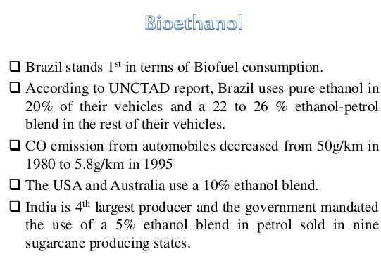
II BIOETHANOL

Slide 25
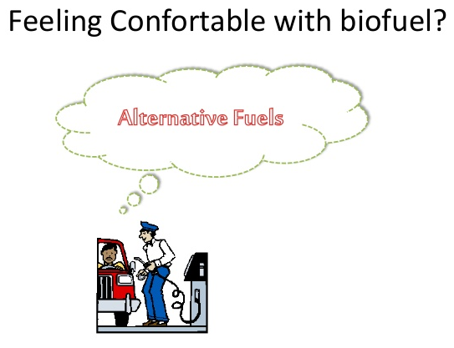
II BIOETHANOL

Slide 26
III BIO-GAS

Slide 27
III BIOGAS
What is a BIOGAS?
Biogas typically refers to a gas produced by the breakdown of organic matter in the absence of oxygen.
It is a renewable energy source, like solar and wind energy.
Furthermore, biogas can be produced from regionally available raw materials such as recycled waste.

Slide 28
III BIOGAS
Benefits
Biogas could potentially help reduce global climate change. Normally, manure that is left to decompose releases two main gases that cause global climate change:
Nitrogen dioxide and methane.
Nitrogen dioxide (NO2) warms the atmosphere 310 times more than carbon dioxide and methane 21 times more than CO2.
By converting cow manure (فضلات البقر) into methane biogas via anaerobic digestion, the millions of cows in the United States would be able to produce one hundred billion kilowatt hours of electricity, enough to power millions of homes across the United States.

Slide 29
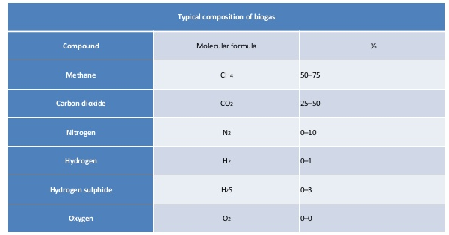
III BIOGAS

Slide 30
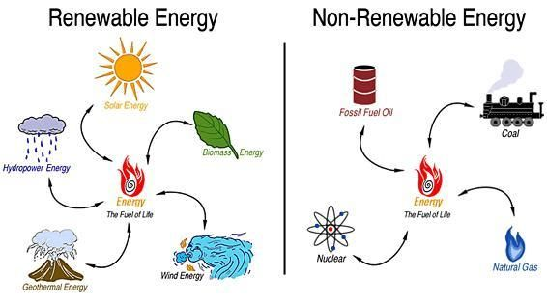

Slide 31


