Slide 1

NOVEL CORONAVIRUS-2
CELL CYCLE AND POSSIBLE THERAPEUTIC TARGETS
Prof Dr Falah A.MS
Presented to
ALKAFEL UNIVERSITY/NAJAF
5/5/21

Slide 2
Objective of the presentation
In this review will explore the collected data focusing on
Virus; Structure, Function, attachment and entry mechanism to the host
Enzymes and proteins involved in viral replication )
Host cellular machineries
Current and feature therapeutic compounds against SARS-CoV-2

Slide 3

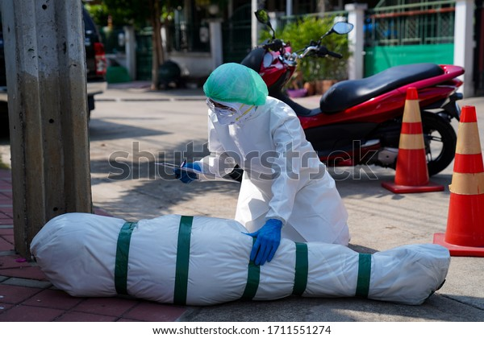

Slide 4
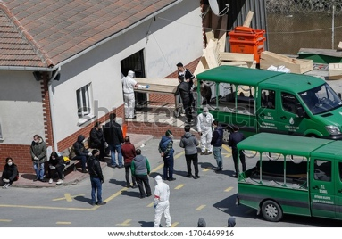

Slide 5
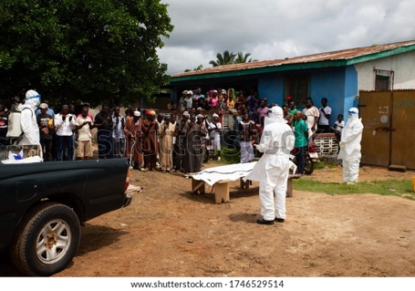
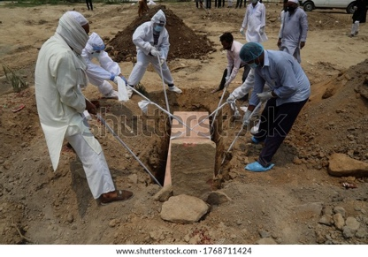

Slide 6
Transmission
https://www.youtube.com/watch?v=PSnSo9kYlH4
20m----60m animation

Slide 7


Slide 8
History and background:
Novel coronavirus appeared in Wuhan, Hubei province, China, where a pneumonia cases of unknown cause was detected in December 2019 considered as the cause of COVID-19.
On January 7, 2020, the Chinese administration announced the name of the new form; Coronavirus-2 (SARS-CoV-2) that belongs to the Coronaviridae family.
Patients infected with this virus suffer from potential damage to vital organs, such as gastrointestinal, cardiac, renal, respiratory and nervous systems…etc…

Slide 9
Country, Other | Total; Cases | New; Cases | Total; Deaths | New; Deaths | Total; Recovered
World | 152,025,280 | +26,087 | 3,193,937 | +728 | 129,894,306
Europe | 44,588,82 | +3,607 | 1,014,295 | +45 | 39,371,409
Asia | 39,532,414 | +17,397 | 520,960 | +203 | 33,831,702
WHO report on 2/5/21

Slide 10
Virus structure
SARS-CoV-2 is an enveloped, positive-sense, single-stranded RNA virus belongs to the genus Beta-coronavirus. The positive-sense genome can act as messenger RNA (mRNA) and directly translated into viral proteins by the host cell's ribosomes.

Slide 11
1. Envelope (E) protein: It has a crucial role in the viral multiplication through assembly, budding, envelope formation, and virulence to attach the normal cells.
2.Membrane (M) protein: It is involved in viral assembly due to its membrane-bending properties.
3. Spike S protein:. It is the main antigen and pathogenic component. It composed of two subunits, S1 and S2, S1 is mainly responsible for binding of the virus to the receptor, while the S2 domain related to virus fusion and intery to the host cell.

Slide 12
4. The genome and N-protein: Multifunctional protein that packages the viral RNA genome into a ribonucleoprotein complex called nucleocapsid.
The genome sequence of SARS-CoV-2 (size is 30000 neucleotides with 23 genes) is more closely related to that of SARS-CoV (79% identity) than with that of MERS-CoV (~50%).

Slide 13
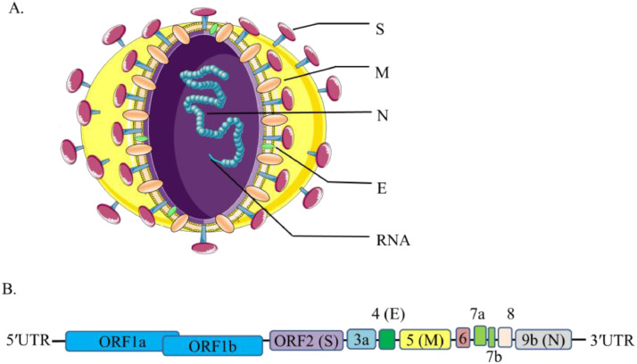

Slide 14
A. Spike (S) protein
It is a trimeric located on the surface of the virus.
It is coated with polysaccharide molecules to misleads the immune system to capture the virus
The S protein binds to ACE2 through the RBD region of the S1 subunit enhancing the entrance of the virus to the host cells.
NOTE: ACE2 found mainly in the lung, intestine, heart,
kidney and liver

Slide 15
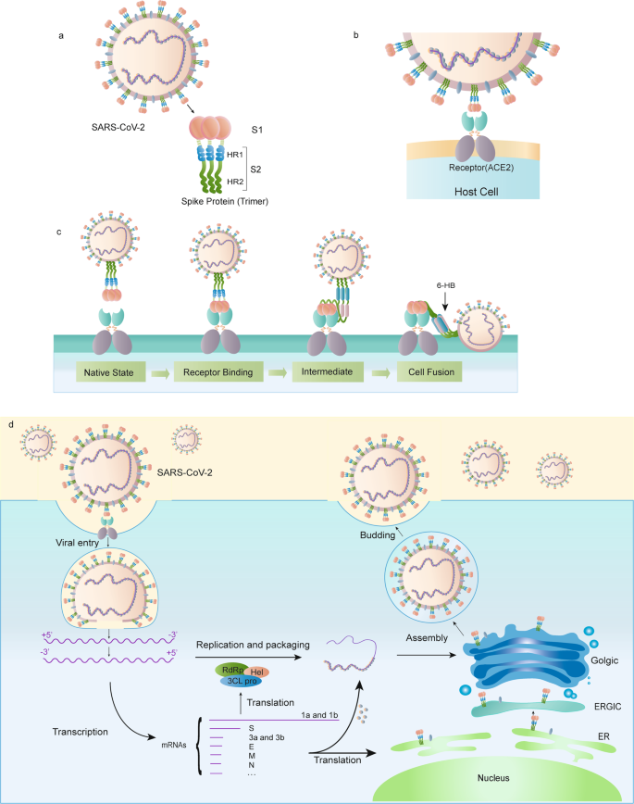

Slide 16
Basically, S-protein exists as inactive precursor, will be activated by cleavage to S1 and S2.
SARS-CoV-2 has a unique furin cleavage site at the S1/S2 boundary producing two protein units, S1 and S2

Slide 17
The cell surface proteases such as transmembrane protease serine 2 (TMPRSS2) and cathepsin L (Host proteases) facilitate the cleavage of the complex S1/S2-ACE2 and the entry into the host genome.

Slide 18
S1 subunit contains a receptor-binding domain that recognizes and binds to the host receptor, AEC2.
S2 subunit mediates viral cell membrane fusion and promote the formation of endosomes, which triggers viral fusion activity under low pH (chloroquine action to raise the pH)

Slide 19

FP, fusion peptide; HR, heptad repeat 1,
receptor-binding domain (RBD

Slide 20
POSSIBLE ATACHMENT AND ENTRANCE BLOCKERS

Slide 21
Chloroquine in endocytosis

Slide 22
https://video.search.yahoo.com/search/video?fr=aaplw&ei=UTF-8&p=mechansim+of+anti+covid-19+drugs+animation%2C+youtube#id=5&vid=f8c9c698299aa917e4e52ec0aeb39d6d&action=click
Chloroquine
3.5 m -last

Slide 23
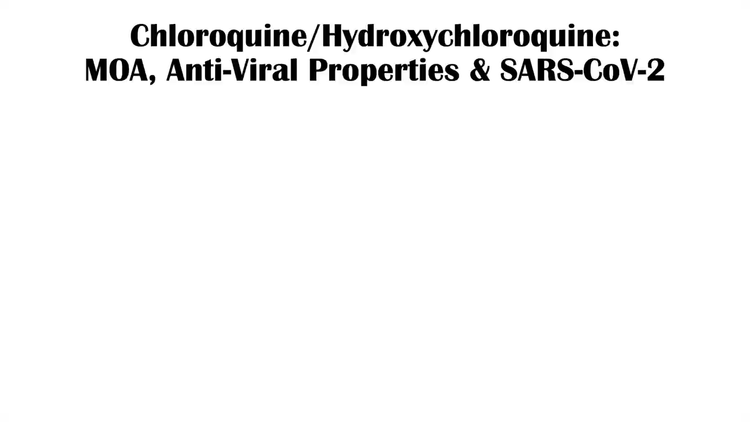

Slide 25
Camostat mesilate is a potent serine protease inhibitor of TMPRSS2.

Slide 26
Receptor mutation (which i am working on) consider as the most potential antiviral
Furin inhibitors can be used as a drug therapy for SARS-CoV-2

Slide 27
Role of calmodulin antagonists in regulating angiotensin-converting enzyme 2 (ACE2) gene expression. “ACE2 as a potential therapeutic target for Covid-19 infection”

Slide 29
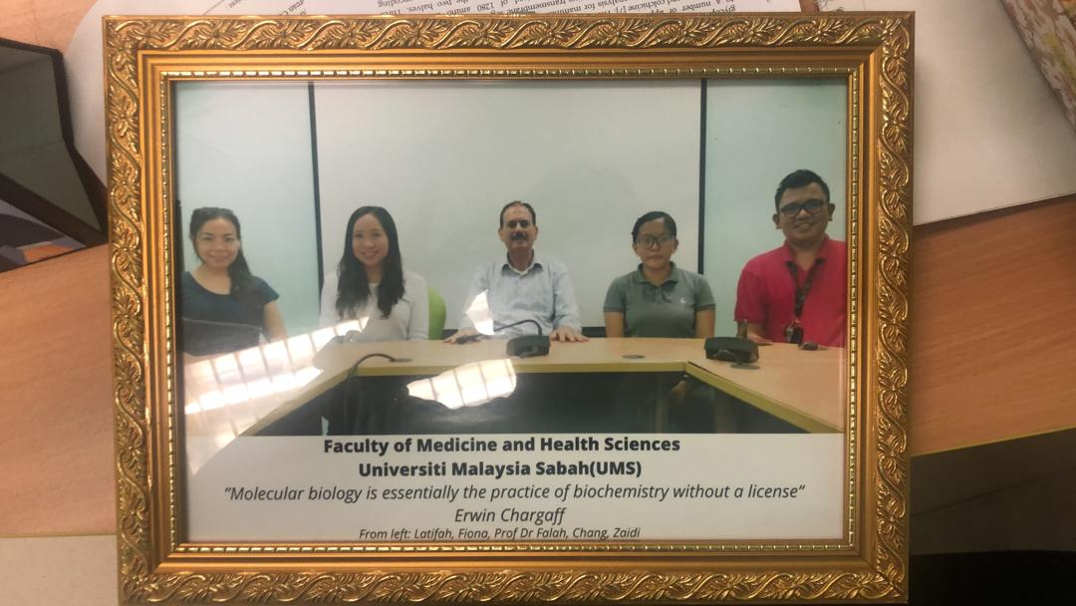

Slide 30
Cathepsins in lysosomes (enzymes that degrade proteins) are crucial for SARS-CoV entry via endocytosis.

Slide 31
Nelfinavir (protease inhibitors) inhibit the function of TMPRSS2 involved in activation of the S protein.

Slide 32
Nucleocapsid:
N-protein: Multifunctional protein that packages the viral RNA genome into a ribonucleoprotein complex called nucleocapsid. It protect the genome and has important functions in the viral life cycle

Slide 33
N-protein is highly immunogenic and is being considered as a potential vaccine target and for the development of COVID-19 diagnostic methods.

Slide 34
INFECTION AND CELL CYCLE
PATHWAY OF ENTRANCE

Slide 35
Binding of the virus to the host receptors ACE2
Cleavage and activation S protein ( to S1, S2) by the host transmembrane serine protease 2 (TMPRSS2)
Entry of the virus into the host cells by membrane fusion or endocytosis,
Release of virus particles within the host cell
Replication and biosynthesis of viral proteins,
Budding/release of new virus to attach new cells

Slide 36
The virus enters the cell via acidification- receptor-mediated endocytosis-dependent manner.
Chloroquine neutralize the acidity making the process difficult
The lysosomotropic drugs blocked the ACE2 receptor considered as potential drug target

Slide 37
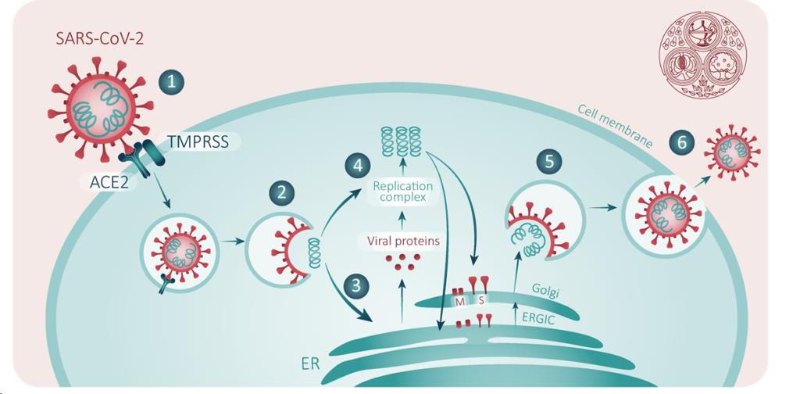
[1] Spike protein on the virion binds to ACE2, a cell-surface protein. TMPRSS2, an enzyme, helps the virion enter
[2] The virion releases its RNA
[3] Some RNA is translated into proteins by the cell’s
machinery
[4] Some of these proteins form a replication complex to make more RNA
[5] Proteins and
RNA are assembled into a new virion in the Golgi and
[6] released. Sources

Slide 38
All the proteases, proteins binding molecules and pathways could represent possible and valuable targets for effective antiviral therapies and drug discoveries

Slide 39
VIRAL GENOME AND CELL CYCLE

Slide 40
The genomes: It is the main pharmacological target due to its critical function in viral RNA transcription and replication.
After the genome entry into the cell translation to structural and non-structure proteins.

Slide 41
the production of open reading frames (ORFs), these ORFs can serve as a template for the biosynthesis of sub-genomic mRNAs.

Slide 42
ORF1a and ORF1ab are translated to produce polyproteins pp1a and pp1ab, which are further cleaved by the proteases that are encoded by ORF1a to yield non-structural proteins.

Slide 43
The polymerase generates a series of subgenomic mRNAs by discontinuous transcription and finally translated into appropriate viral proteins.

Slide 44
ORF1a and ORF1b encode for virus transcription and replication. Other to spike (S), membrane (M), envelope (E) and nucleocapsid (N), and other vital proteins.

Slide 45
Viral proteins and genome RNA are subsequently assembled into virions in the ER and Golgi body and then transported via vesicles and released out of the cell.

Slide 46
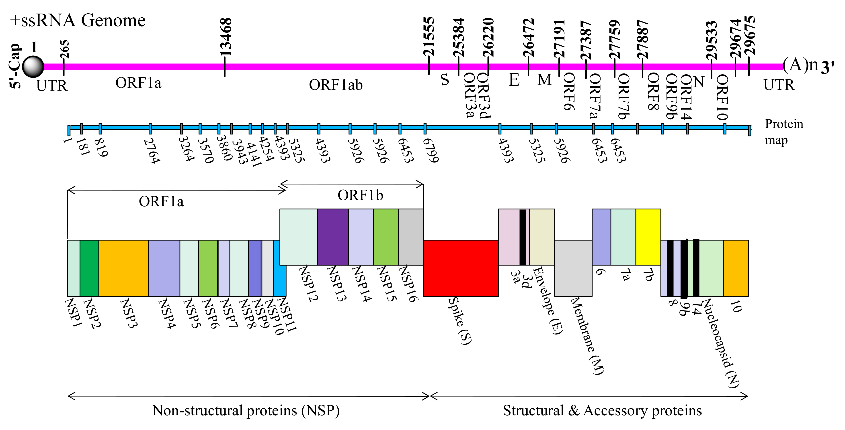

Slide 47
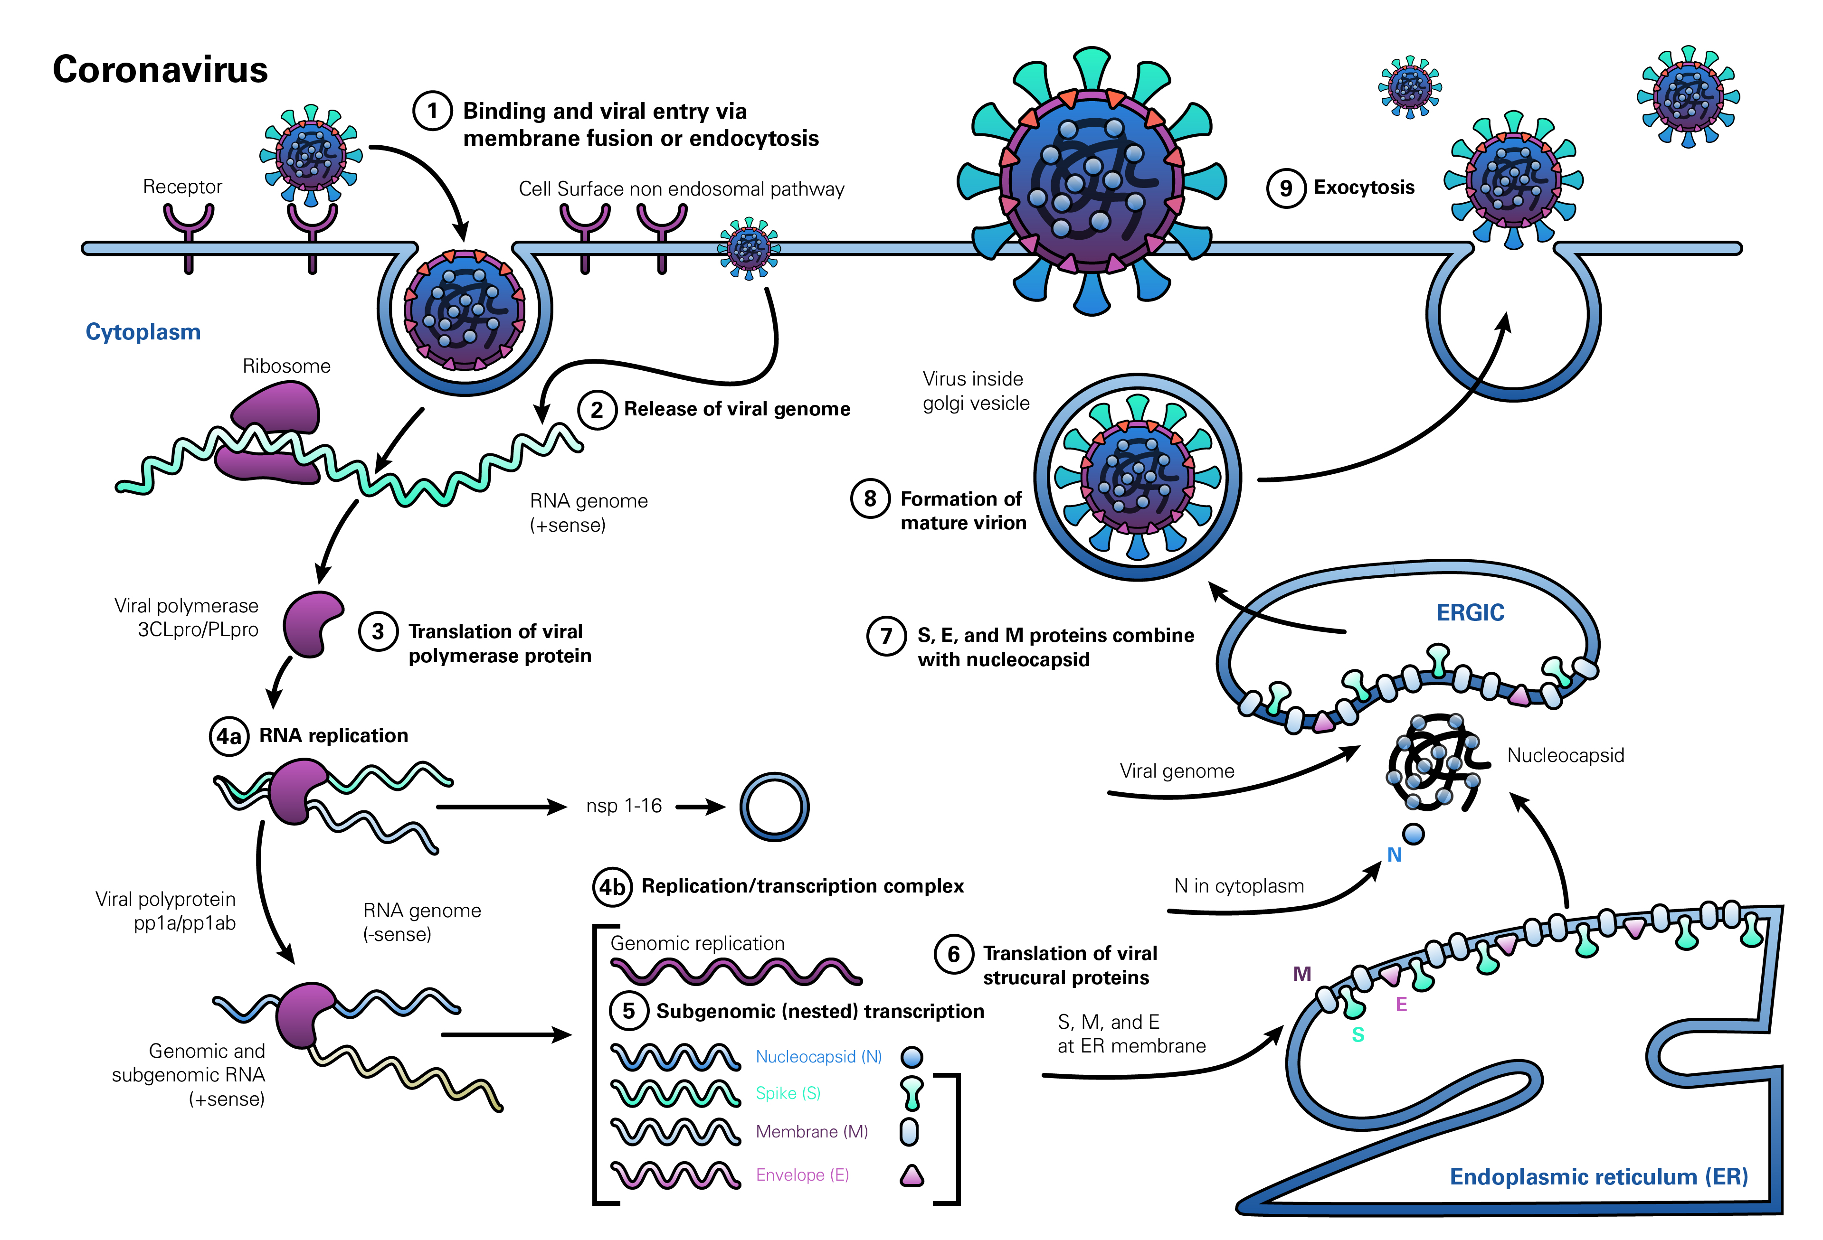

Slide 48
https://www.youtube.com/watch?v=zvuYJTL90J8
Summary, animation

Slide 49
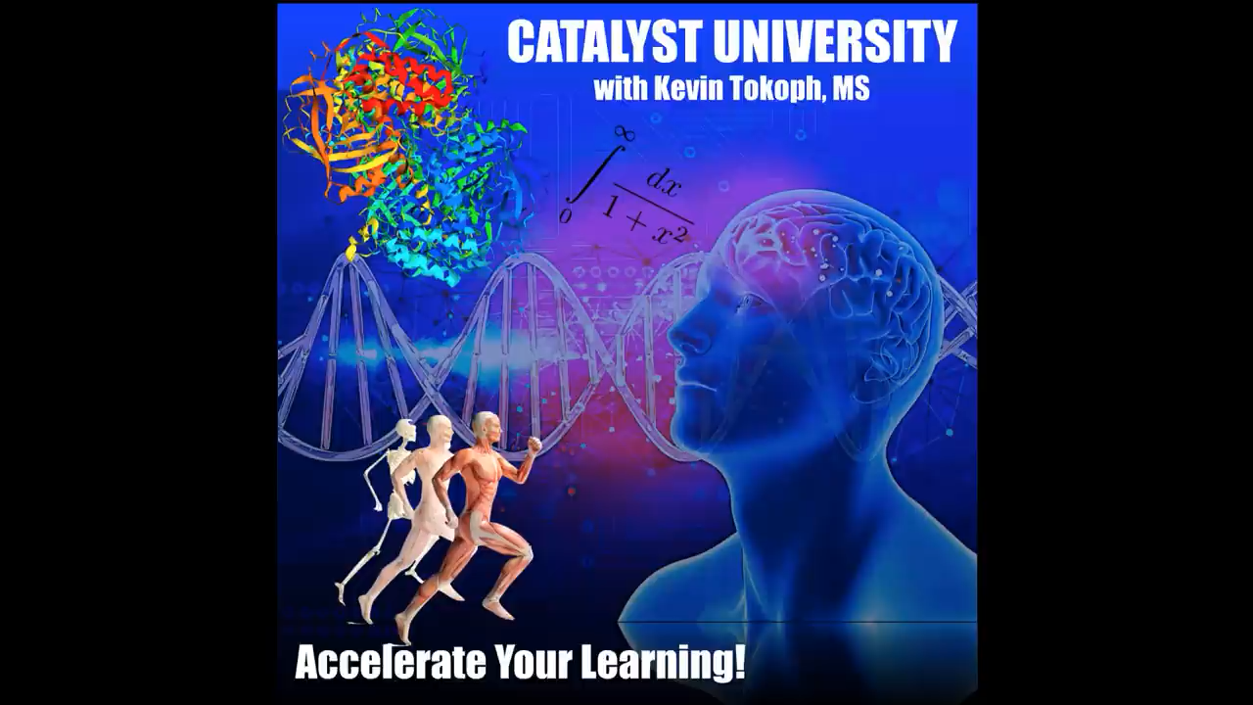

Slide 50
life cycle of coronavirus, multiple stages as potential druggable targets, and drugs working like S protein inhibitors, like
RNA dependent RNA polymerase inhibitors (remdesivir, fivipiravir, galidesivir, ribavirin),
.

Slide 51
Protease inhibitors (Lopinavir, Ritonavir, Nafamostat).
Drugs altering the endosomal pH (chloroquine, hydroxychloroquine).

Slide 52
Current and possible Antivirus therapy
NOTE: Antiviral therapies would have the greatest effect early in the course of the disease, while immunosuppressive/anti-inflammatory therapies are likely to be more beneficial in the later stages of COVID-19

Slide 53
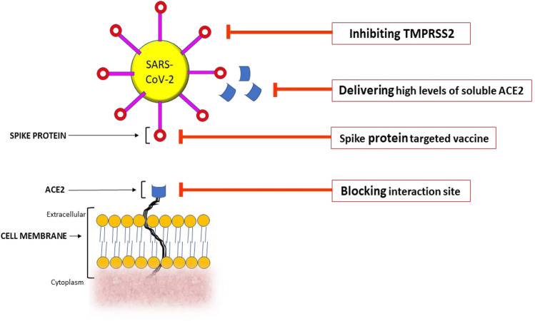

Slide 54
Remdesivr is the only Food and Drug Administration-approved drug for the treatment of COVID-19.

Slide 55
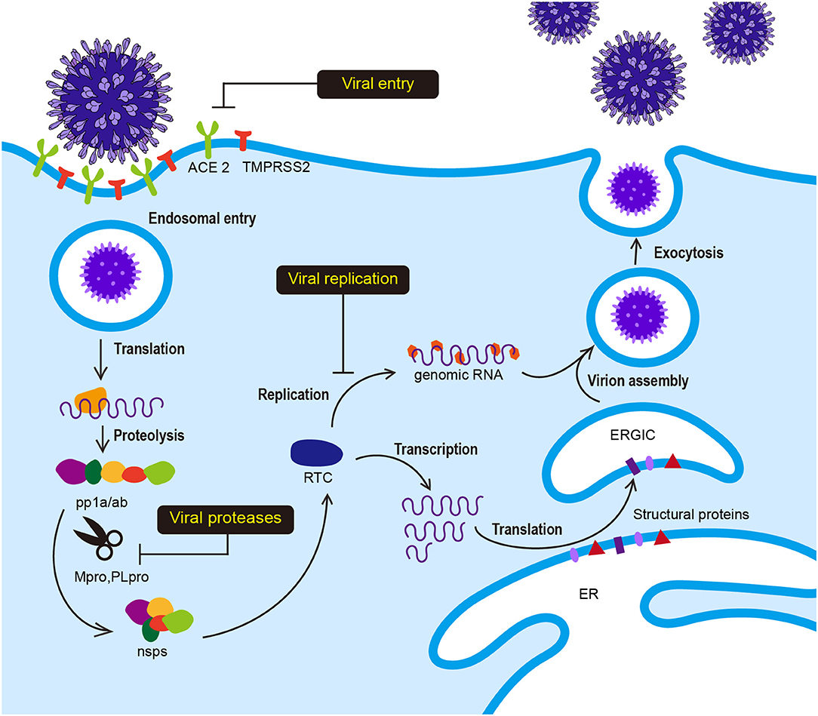

Slide 56
https://www.youtube.com/watch?v=GZucJzAmYhM animation ## remdisvir
https://www.youtube.com/watch?v=-E_Okc_Fp3w ####### animation remdisvir,, favibra, hesbiridin, chloroquine

Slide 57


Slide 58


Slide 59
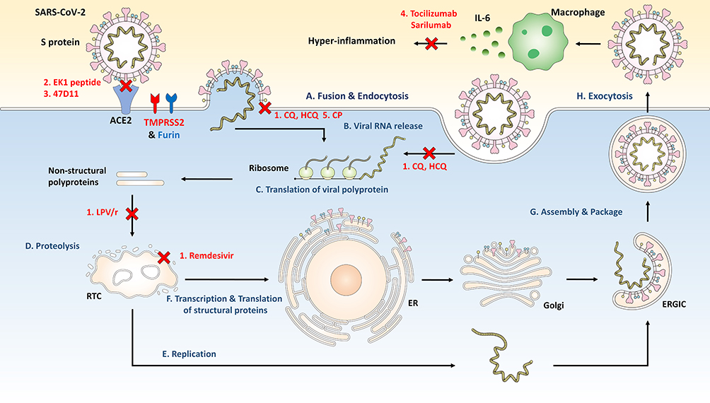

Slide 60
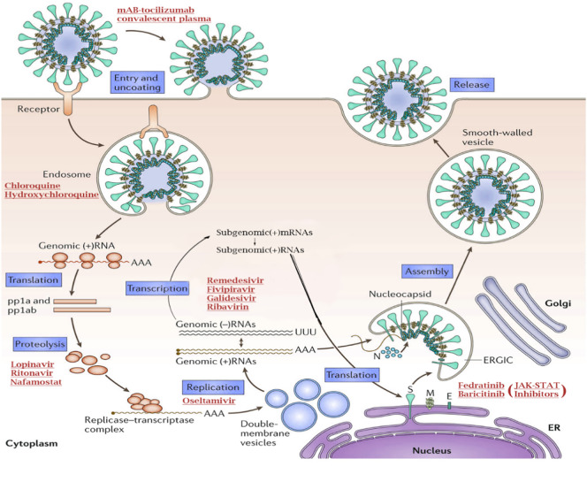

Slide 61
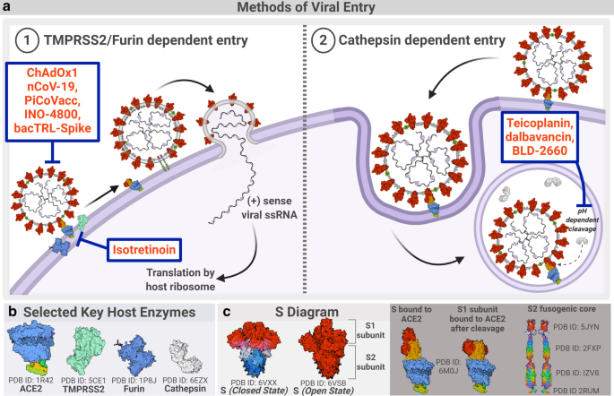

Slide 62
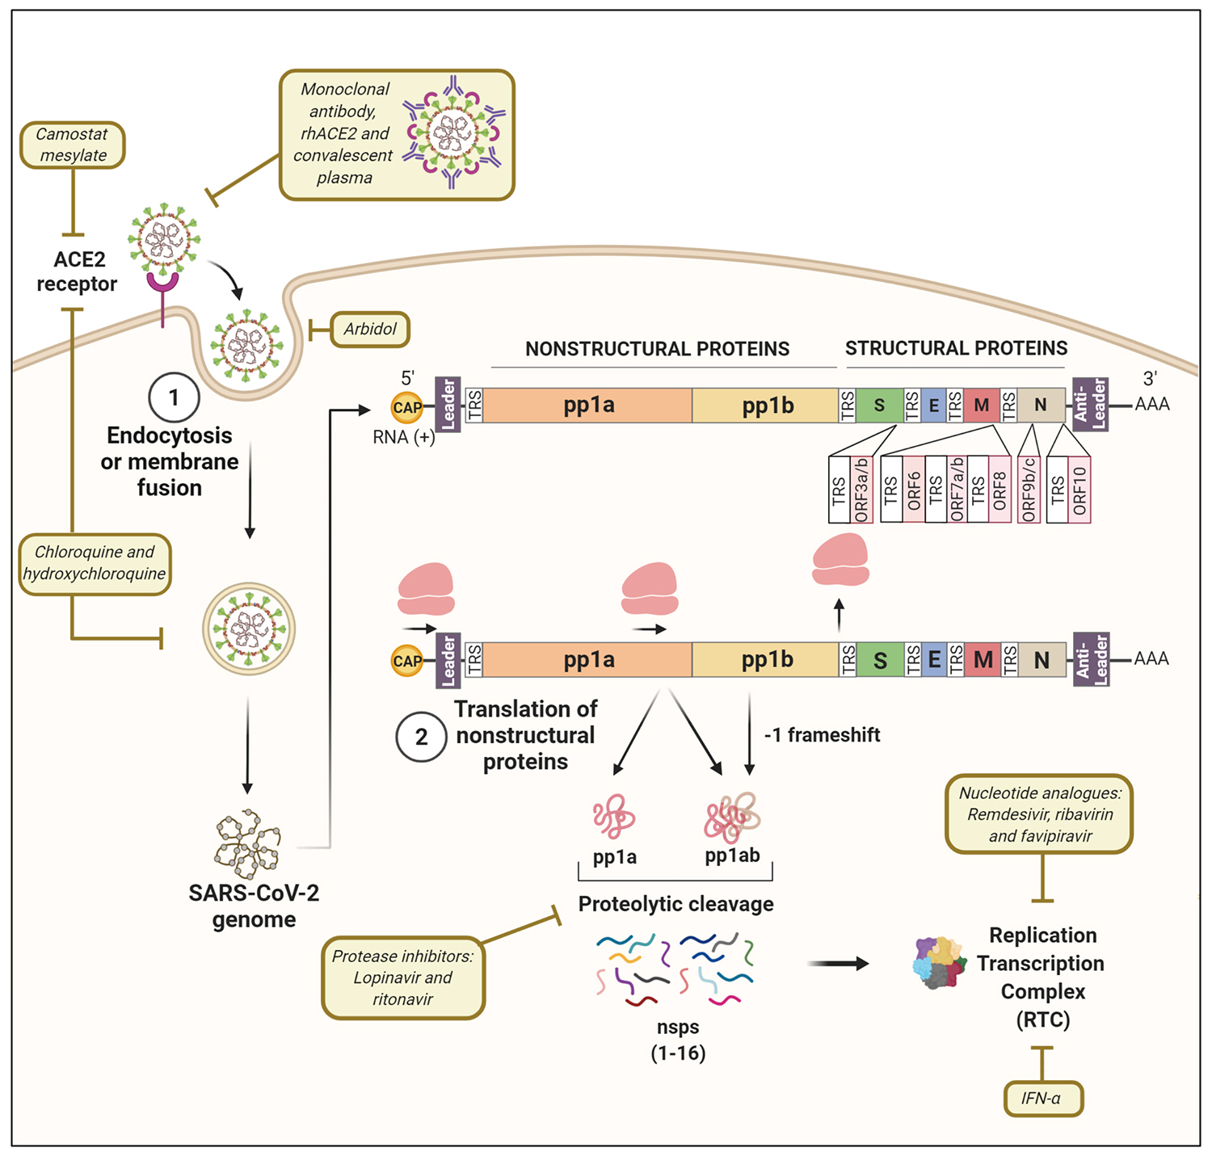

Slide 63
Possible potential drug targets in the cell cycle are, S protein inhibitors, RNA dependent RNA polymerase inhibitors (remdesivir, fivipiravir, galidesivir, ribavirin), protease inhibitors (lopinavir, ritonavir, nafamostat), drugs altering the endosomal pH (chloroquine, hydroxychloroquine), JAK-STAT inhibitors (fedratinib, baricitinib), monoclonal antibodies (tocilizumab).

Slide 64
List of drugs that have been found to have clinical effectiveness in COVID-19 therapy.
S. No | Drug | Target | Impact
1. | Remdesivir | Abroad-spectrum antiviral inhibits RdRP of RNA viruses, including SARS-CoV and MERS-CoV. | Adenosine analog, which incorporates into the nascent viral RNA chains during synthesis and causes premature termination.
2. | Chloroquine | Anti-malarial drug. Works at entry and post-entry stages of viral infection. | Increases endosomal pH required for virus/cell fusion. Interferes with the glycosylation of cellular receptors of SARS-CoV2.
3. | Fedratinib | JAK2 and FMS-like tyrosine kinase 3 | Inhibition of JAK2 inhibits phosphorylation of STAT 3 and 5, which prevents cell division and induces apoptosis.
4. | Lopinavir | Protease inhibitor have in vitro antiviral activity against SARS associated coronavirus | Inhibition of coronavirus main proteinase interferes in the processing of polypeptide translation products.
5. | Oseltamivir | Neuraminidase inhibitor | Inhibits the neuraminidase activity of the virus subsequently prevents viral replication.
6. | Fivipiravir | RNA-dependent RNA polymerase | A guanine analog inhibits the RdRP activity of several RNA viruses (influenza, Ebola, Yellow fever and Chikungunya)
7. | Ribavirin | Nucleoside inhibitor An approved of HCV and RSV patients with SARS and MERS. | A nucleoside inhibitor that interferes with viral RNA synthesis and mRNA capping.
8. | Galidesivir | RNA polymerase | Disrupts RNA polymerase activity causes premature termination of the elongating viral RNA strand
9. | Nafamostat | Serine proteases inhibitor | Prevents membrane fusion by reducing the release of cathepsin B.
10. | Lianhuaqingwen | Herbal medicine commonly used for the prevention and treatment of viral influenza in China. | Chinese patent herbal medicine composed of 13different herbs played significant roles in the treatment of COVID-19.
11. | Baricitinib | Janus kinase (JAK) inhibitor | May block viral entry by inhibiting adaptor-associated protein kinase 1 and cyclin G-associated kinase
12. | Tocilizumab(mAB) | IL-6 inhibitor | Inhibition of IL-6 may attenuate pulmonary inflammation by controlling cytokine storm.
13. | Anti TNF alpha agents | TNF alpha | TNF-α promotes the production of other chemokine and cytokines, controls endotoxin-induced septic shock

Slide 65
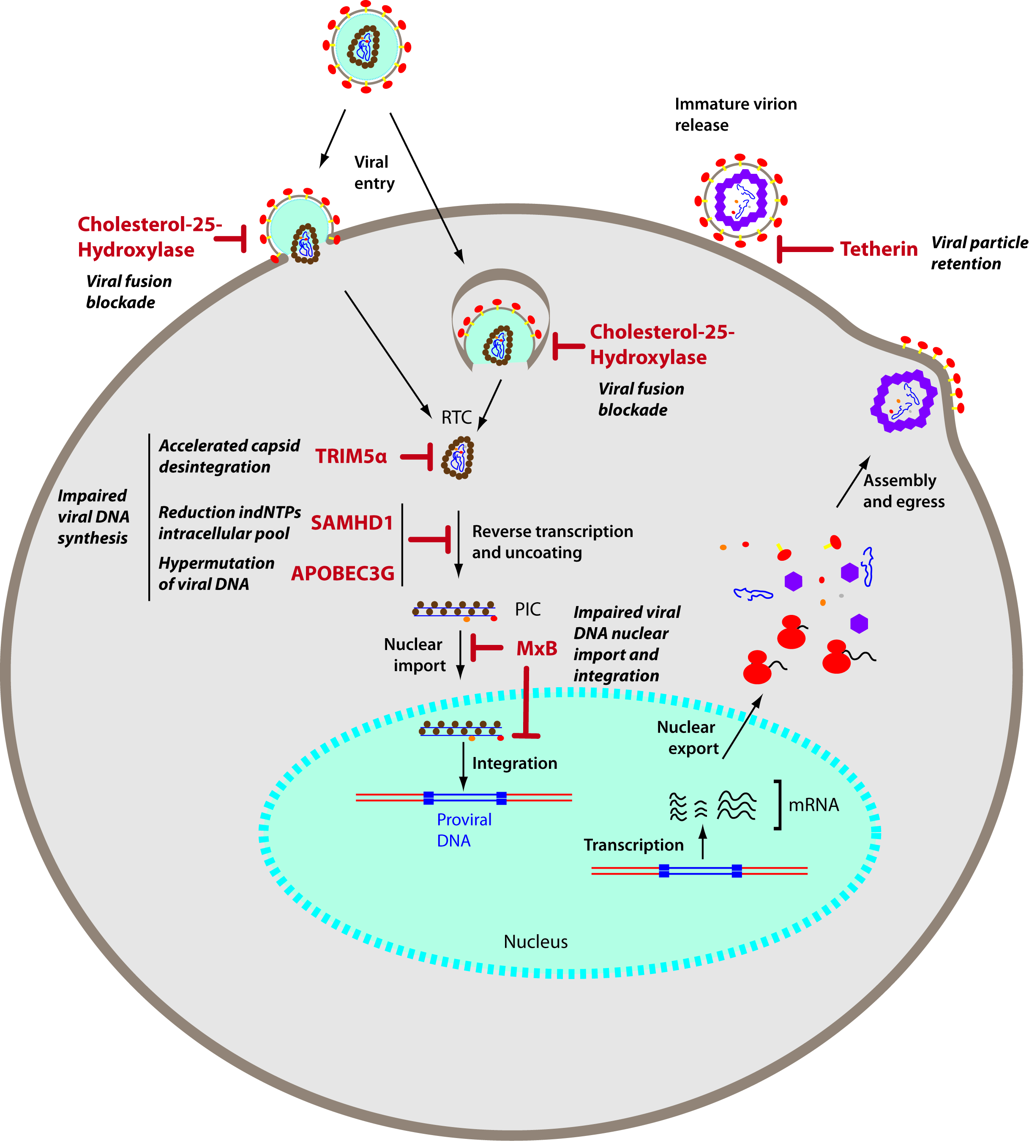
HIV cell cycle

Slide 66
Soluble ACE2
the S protein of SARS-CoV-2 bind to free circulating sACE2, can neutralize and inactivate the coronavirus which uses ACE2 as a critical receptor to host cells

Slide 67
Convalescent plasma therapy (CPT)
Plasma therapy is effective for patients with a disease course exceeding three weeks and whose virus nucleic acid tests continuously to show positive from respiratory tracts specimen.
Plasma will be taken from people after two weeks of healing.

Slide 68
COVID‑19: candidate drug treatments in Phase III–IV trials
Drug candidate | Description | Existing disease approval | Trial sponsor(s) | Location(s) | Expected results
Remdesivir | antiviral; adenosinenucleotide analoginhibiting RNAsynthesis in coronaviruses | investigational^{[34]} | Gilead, WHO, INSERM, NIAID | China, Japan initially; extended internationally in Global Solidarity and Discovery Trials, and US NIAID ACTT Trial | Mid-2020 (Chinese, Japanese trials)
Hydroxychloroquineor chloroquine | antiparasitic and antirheumatic; generic made by many manufacturers | malaria, rheumatoid arthritis, lupus(International)^{[42][43]} | CEPI, WHO, INSERM | Multiple sites in China; global Solidarity and Discovery Trials | June 2020 (discontinued by WHO)
Favipiravir | antiviral against influenza | influenza (China)^{[46]} | Fujifilm | China | April 2020
Lopinavir/ritonavirwithout or with interferon beta-1a | antiviral, immune suppression | investigational combination; lopinavir/ritonavir approved^{[48]} | CEPI, WHO, UK Government, Univ. of Oxford, INSERM | Global Solidarity and Discovery Trials, multiple countries | mid-2020
Sarilumab | human monoclonal antibody against interleukin-6 receptor | rheumatoid arthritis(US, Europe)^{[49]} | Regeneron-Sanofi | Multiple countries | Spring 2020
ASC-09 + ritonavir | antiviral | combination not approved; ritonavir approved for HIV^{[48]} | Ascletis Pharma | Multiple sites in China | Spring 2020
Tocilizumab | human monoclonal antibody against interleukin-6 receptor | immunosuppression, rheumatoid arthritis (US, Europe)^{[52]} | Genentech-Hoffmann-La Roche | Multiple countries | mid-2020
Lenzilumab | humanized monoclonal antibody for relieving pneumonia | new drug candidate | Humanigen, Inc. | Multiple sites in the United States | September 2020
Dapagliflozin | sodium-glucose cotransporter 2 inhibitor | hypoglycemiaagent^{[56]} | Saint Luke's Mid America Heart Institute, AstraZeneca | Multiple countries | December 2020
CD24Fc | antiviral immunomodulatoragainst inflammatory response | new drug candidate | OncoImmune, Inc. | Multiple sites in the United States | 2021

Slide 69
SUMMARY
Many scientists believe in a few years, SARS-CoV-2 may be no more virulent than the common cold, and do not cause severe illness
I believe
The COVID-19 remain as global severe disease.
Procurations are required to minimize the pandemic.

Slide 70
VACCINE

Slide 71
Viral vector vaccines for COVID-19
The University of Oxford/AstraZeneca vaccine uses this technology to protect against COVID-19

Slide 72
Genetic vaccines for COVID-19
The Moderna and Pfizer/BioNTech COVID-19 vaccines use this type of technology to train the immune system.

Slide 73
Inactivated vaccines for COVID-19
This type of vaccine contains the killed SARS-CoV-2 virus, which is recognised by the immune system to trigger a response without causing COVID-19 illness. This response builds immune memory, so your body can fight off SARS-CoV-2 in future.

Slide 74
Attenuated vaccines for COVID-19
This type of vaccine contains the weakened SARS-CoV-2 virus, which is recognised by the immune system to trigger a response without causing COVID-19 illness. This response builds immune memory, so your body can fight off SARS-CoV-2 in future.

Slide 75
Protein vaccines for COVID-19
This type of vaccine contains proteins from the SARS-CoV-2 virus, which are recognised by the immune system to trigger a response. This response builds immune memory, so your body can fight off SARS-CoV-2 in future

Slide 76
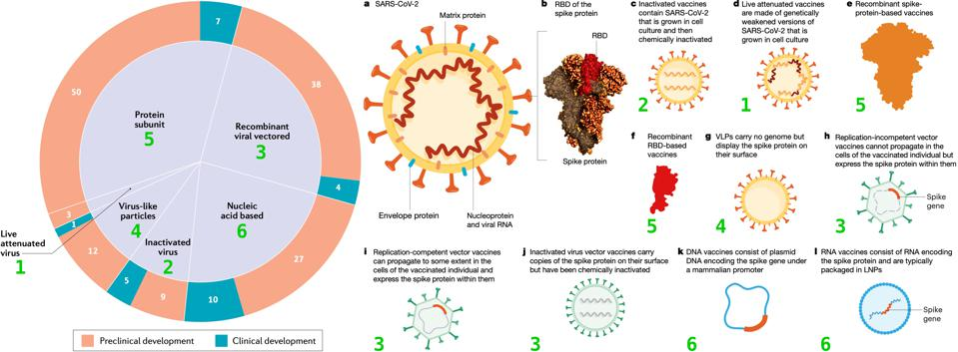

Slide 77
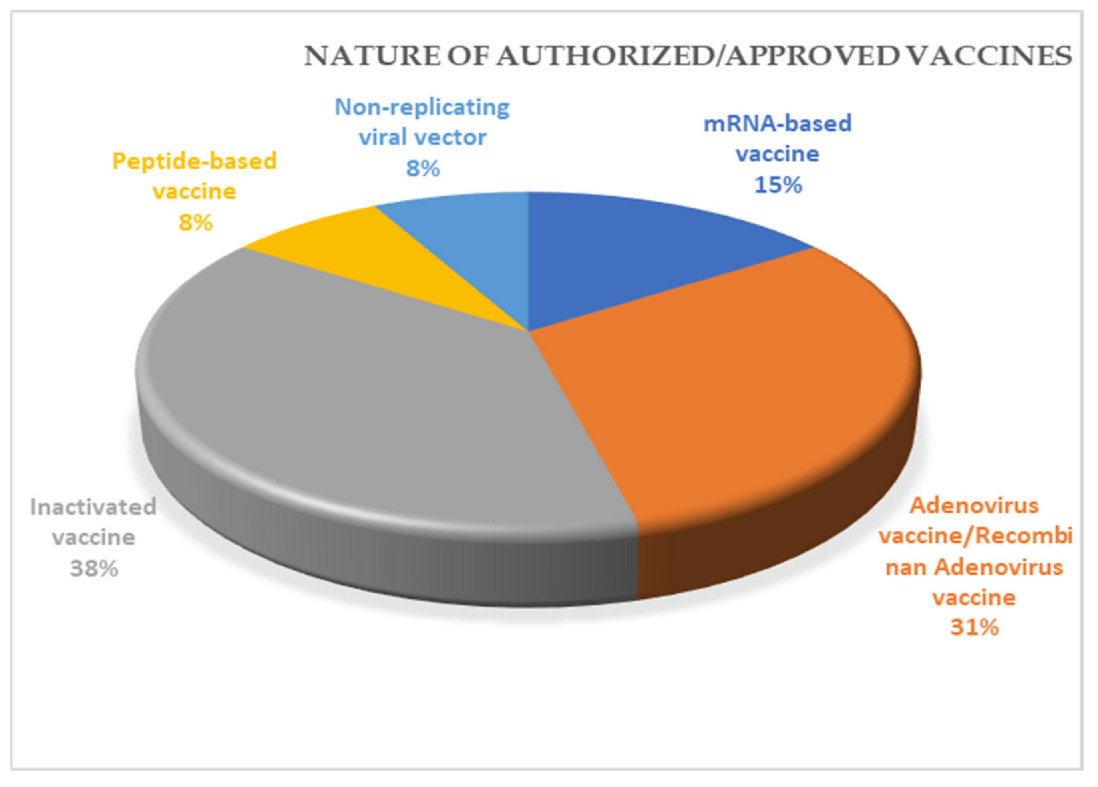

Slide 78
All Types of COVID-19 Vaccines, How They Work, Animation. 2m
https://youtu.be/osRo-yz1VQ8

Slide 79
WILL COVID-19 BE ELIMINATED OR ERADICATED?

Slide 80


