Slide 1
الطاقة المتجددة
Renewable energy
Ass.proff.
Dr. Mohamad Jaafar AlBermani

Slide 2
contents
1.Introduction
2.Solar water heating
3.Hydropower systems
4.Geothermal power system
5..Wind power system
6 Biomass
7.
8Solar radiation in Iraq

Slide 3
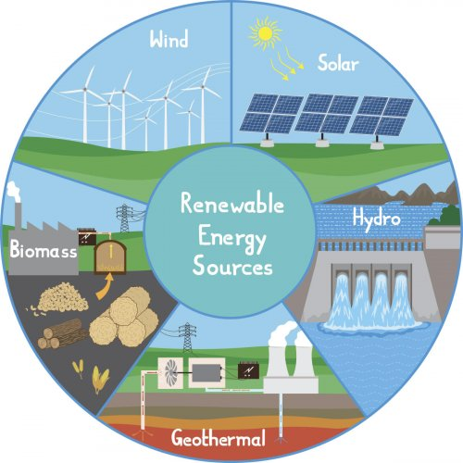
مصادر الطاقة المتجد\دة

Slide 4
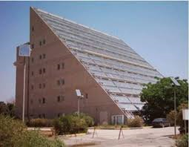
بحوث الطاقة الشمسية في العراق

Slide 5
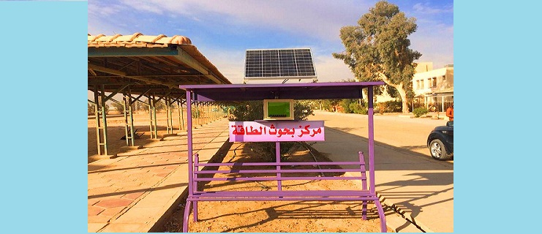
مركز بحوث الطاقة المتجددة في الانبار

Slide 6
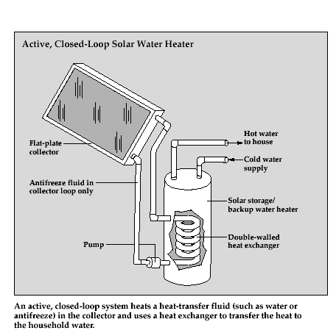
Solar Water Heating
Solar water heating is a very cost effective way to produce hot water in any climate, and the fuel they use is free (sun shine).
Solar water heating systems include solar collectors and storage tanks, and they are two types:
  Active systems (have a circulating pump and control).
  Passive systems which works on natural convection.
Active solar heating systems
They are two types;
Pump circulates household water through the collectors and into the home (open loop),
Pump circulates the heat transfer fluid through the collectors and a heat exchanger (closed loop). This heats the water that flows into the home.

Slide 7
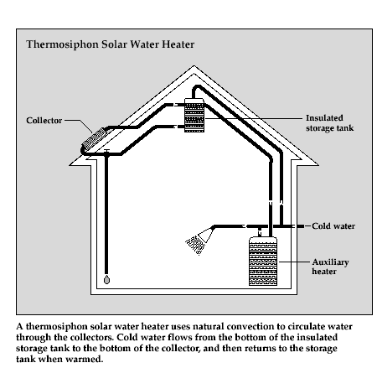
Thermosyphon systems
Water flows through the system when warm water rises as cooler water sinks.
The collector must be installed below the storage tank so that warm water will rise into the tank.

Slide 8
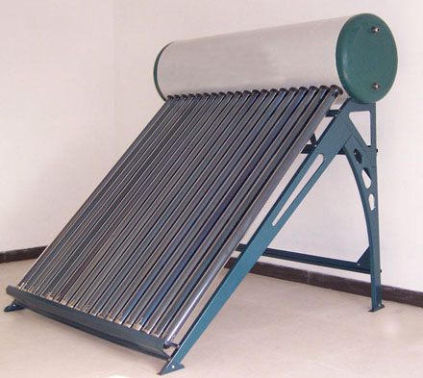
Solar water heater (Thermosyphon system)

Slide 9
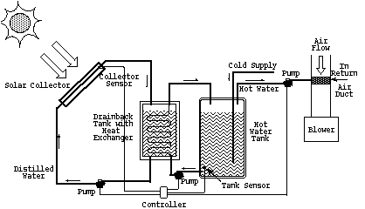
Solar Space Heating Systems
There are two basic types of active solar heating systems based on the type of fluid that is heated in the solar energy collectors.
Liquid-based systems which heat water in a liquid collector.
Air-based systems which heat air in an air collector.

Slide 10
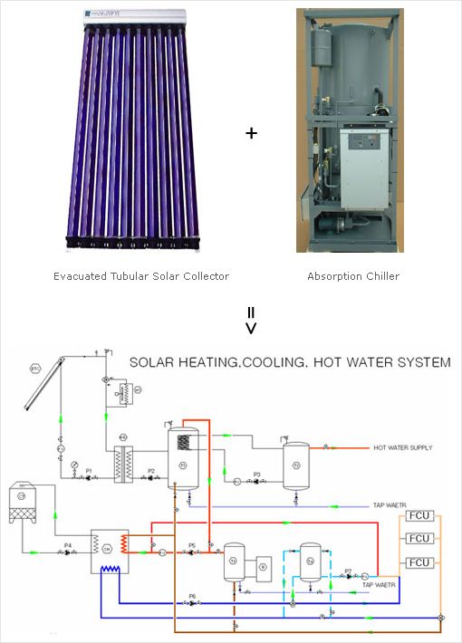
Solar space cooling
A solar thermal cooling system consists of:
-Solar collectors.
-Storage tank.
-Control unit, pipes and pumps.
-Thermally driven chiller.

Slide 11
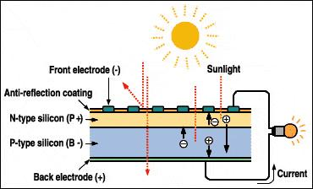
Solar power production
Photovoltaic systems
Photovoltaic (PV) (photo=light, voltaic=electricity) is a semiconductor-based technology which converts light energy directly into an electric current that can either be used immediately or stored, such as in a battery, for later use.
Solar cell
PV cell consist of two or more thin layers of semi conducting material most commonly silicon. A silicon cell is a wafer of P-type silicon doped with a small amount of impurity (usually boron) and a thin layer of N-type silicon dopes with a small amount of impurity (usually phosphorous).
When the cell exposed to the light, electrical charges are generated and this can be connected a way by metal contacts as direct current.

Slide 12
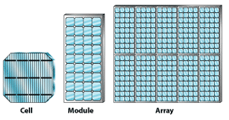
Solar panel model
Solar panel (Module)
Consist of solar cells connected in series and parallel.
Solar Array
Consist of different solar panels connected in series and parallel.
Types of Solar Cells
The performance of a solar or photovoltaic (PV) cell is measured in terms of its efficiency at converting sunlight into electricity. There are a variety of solar cell materials available, which vary in conversion efficiency.
Mono crystalline silicon
Manufactured by saw- cut from a single cylindrical crystal of silicon.
Most efficient (around 15%) and most expensive.
Poly crystalline silicon
Manufactured by cut from an ingot of melted and re-crystallized silicon.
Less efficient and cheaper than mono-crystalline.
Amorphous silicon
Manufactured as a thin film of deposit silicon on substrates.
less efficient than crystalline silicon and cheaper.
Other Thin Films
They have higher efficiency than amorphous silicon cell and can be produced cheaper.
Cadmium telluride (CdTe).
Copper Indian Deselenide (CIS)
Gallium Arsenide (GaAs).

Slide 13
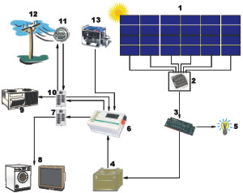
Complete battery backup system
Complete battery backup system configuration with options
 | 1 - Solar array
 | 2 - Fused array combiner and/or ground fault protection.
 | 3 - Solar regulator
 | 4 - System storage battery
 | 5 - DC load equipment
 | 6 - DC/AC inverter
 | 7 - AC load equipment load panel
 | 8 - AC load equipment operating from solar system
 | 9 - AC load equipment operating from utility
 | 10 - AC utility panel
 | 11 - Utility meter
 | 12 - Utility power
 | 13 - Backup generator

Slide 14
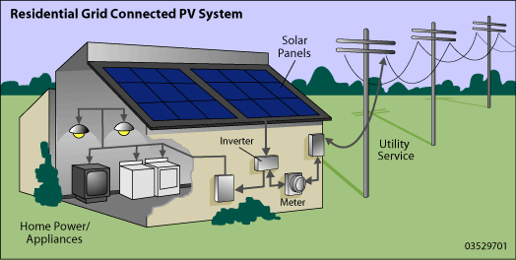

Slide 15
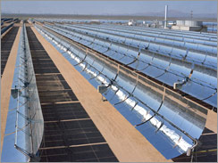
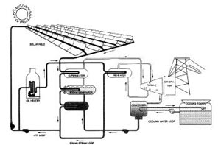
Solar thermal power
Technology works by converting sun energy to heat, which is usually used to produce steam for driving a turbine and a generator. This technology is more efficient (15%) than PV (around 10%) and less expensive when the system is very large in MW.
Three types of systems
Parabolic trough
The system works by concentrating the sun rays through long rectangular, curved (U-shaped) mirrors, focusing the sunlight on a pipe that runs down the center of the trough.
The temperature of the fluid flow inside the pipe (usually oil) could reach 400°C

Slide 16
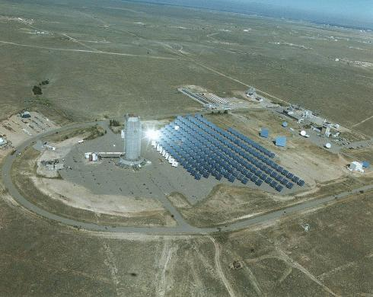
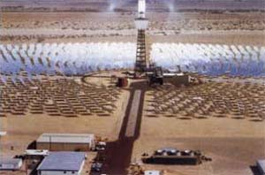
Central receiver system
It uses a large number of mirrors and heliostats that track the sun and reflect sunlight to the top of a tower, where the receiver sits.
The system operates at temperatures between 500°C and 1500°.

Slide 17
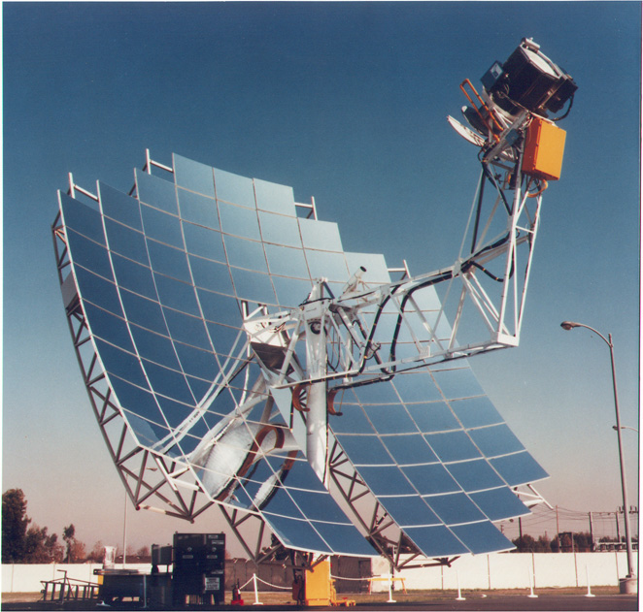
Parabolic Dish System
Mirror dish that reflects and concentrate sunlight to a receiver which absorbs the heat and transfer it to fluid within the engine.
Engines types are: Rankine engine, Brigton engine and stirling engine.
Striling engine is the most efficient one (30%).

Slide 18
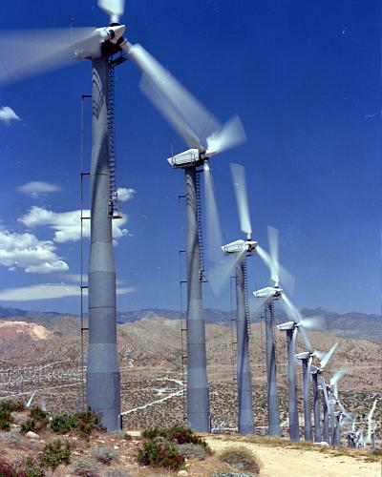
Wind Energy
Wind turbines capture the kinetic energy in the wind using propeller-like blades mounted on a shaft. When the wind makes the blades turn, the shaft spins a generator to produce electricity.
Small wind turbines can be used to pump water or provide power to a home, for example.
Larger turbines can be used to a power an entire community or to provide power to the electricity grid.
Wind-generated electricity is the least expensive form of renewable power, and is becoming one of the cheapest forms of electricity — from any source. In some locations, the cost of electricity from wind is comparable to that from conventional fossil-fueled power plants.

Slide 19
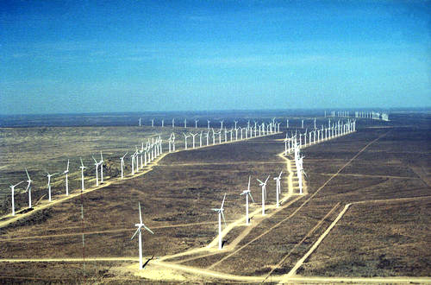

Slide 20
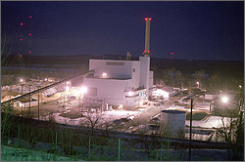
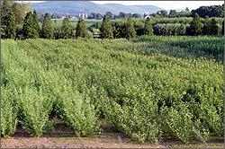
Biomass Energy
Biomass is any organic material derived from plants or animals — essentially all energy originally captured by photosynthesis.
Domestic biomass resources include agricultural and forestry residues, municipal solid wastes, industrial wastes, and terrestrial and aquatic "energy crops" grown solely for energy purposes.
Biomass power
Biomass power is electricity produced from plant materials and animal products.
Biomass power technologies convert renewable biomass fuels into electricity (and heat) using modern boilers, gasifiers, turbines, generators, and fuel cells.
Biomass fuels include residues from the wood and paper products industries, residues from food production and processing, trees and grasses grown specifically as energy crops, and gaseous fuels produced from solid biomass, animal wastes, and landfills.
Wood chips made from energy crops, such as hybrid willows (upper), provide raw material for a new gasifier at the McNeil Generating Station (lower). 50-MW wood-fired power plant located in Vermont.

Slide 21
Hydrogen Energy & Fuel Cell
Hydrogen can be found in many organic compounds, as well as water. It's the most abundant element on the Earth. But it doesn't occur naturally as a gas. It's always combined with other elements, such as with oxygen to make water. Once separated from another element, hydrogen can be burned as a fuel or converted into electricity.
Hydrogen can be produced from:
Solar Thermal Water Splitting
Concentrated solar energy can also be used to generate temperatures of several hundred to over 2,000 degrees at which thermo chemical reaction cycles can be used to produce hydrogen. Such high-temperature, high-flux solar driven thermo chemical processes offer a novel approach for the environmentally benign production of hydrogen.
Renewable Electrolysis
Renewable energy sources such as photovoltaic, wind, biomass, hydro, and geothermal can provide clean and sustainable electricity to produce hydrogen through the electrolysis—splitting with an electric current—of water and to use that hydrogen in a fuel cell to produce electricity during times of low power production or peak demand, or to use the hydrogen in fuel cell vehicles.

Slide 22
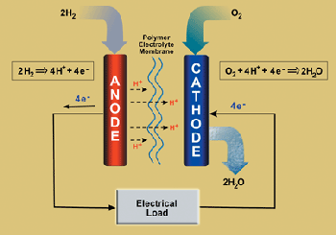
Fuel Cell
fuel cell is an electrochemical energy conversion device. It produces electricity from external supplies of fuel (on the anode side) and oxidant (on the side). These react in the presence of an electrolyte. Generally, the reactants flow in and reaction products flow out while the electrolyte remains in the cell. Fuel cells cacathode n operate virtually continuously as long as the necessary flows are maintained.
Fuel cells differ from batteries in that they consume reactants, which must be replenished, while batteries store electrical energy chemically in a closed system. Additionally, while the electrodes within a battery react and change as a battery is charged or discharged, a fuel cell's electrodes are catalytic and relatively stable.
Two electrodes; one positively charged and one negatively charged & a substance that conduct electricity (electrolyte) sandwiched between them.

Slide 23
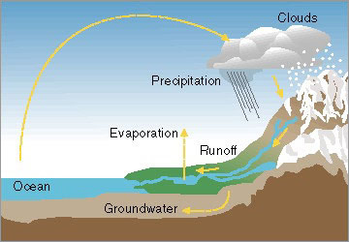
Hydropower Energy
Water constantly moves through a vast global cycle, evaporating from lakes and oceans, forming clouds, precipitating as rain or snow, then flowing back down to the ocean. The energy of this water cycle, which is driven by the sun, can be tapped to produce electricity.

Slide 24
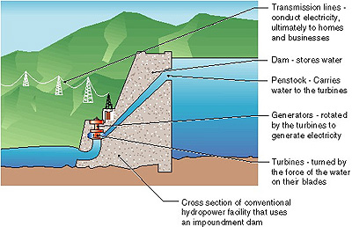
Hydropower facilities
There are three types of hydropower facilities:
  Impoundment( usually large).
  Diversion( usually small).
  Pumped storage.
Some hydropower plants use dams and some do not.
Hydropower plants range in size from small systems for a home or a village to large plants producing electricity for utilities.
Impoundment (Large) power plant
It is typically a large hydropower system, uses a dam to store river water in a reservoir. Water released from the reservoir flows through a turbine, spinning it, which in turn activates a generator to produce electricity. The water may be released either to meet changing electricity needs or to maintain a constant reservoir level.
An impoundment hydropower plant dams water in a reservoir.

Slide 25
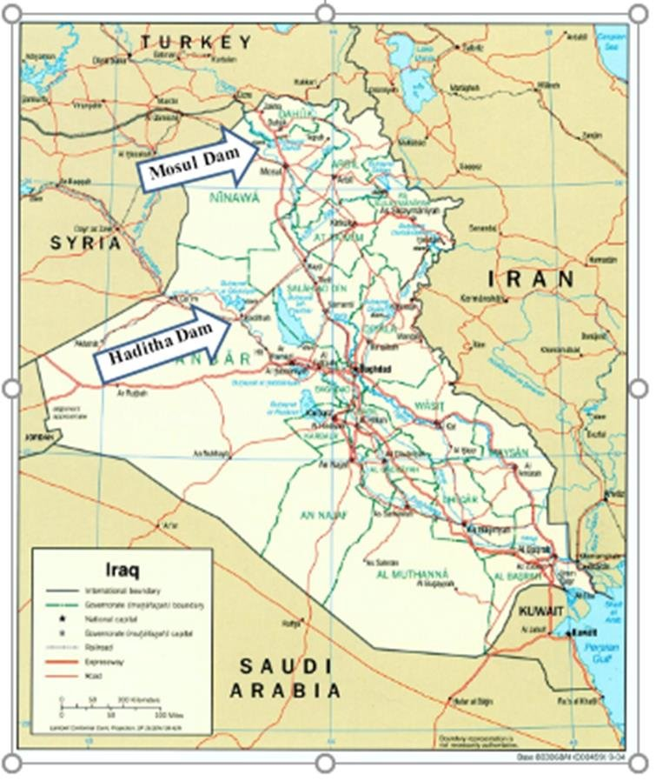

Slide 26
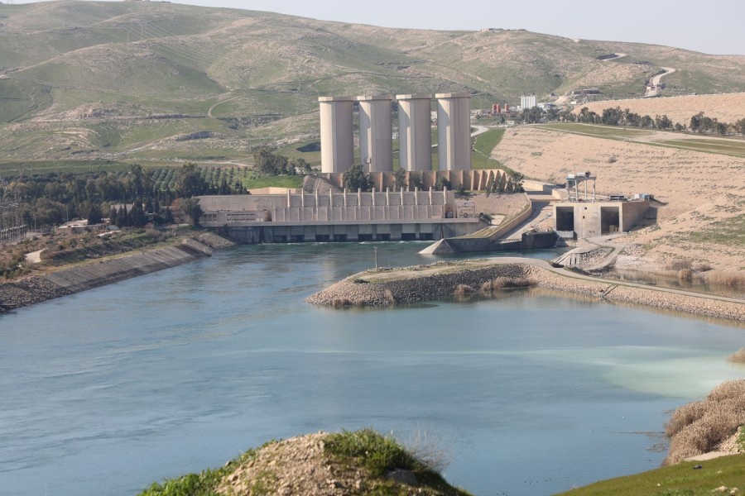
سد الموصل

Slide 27
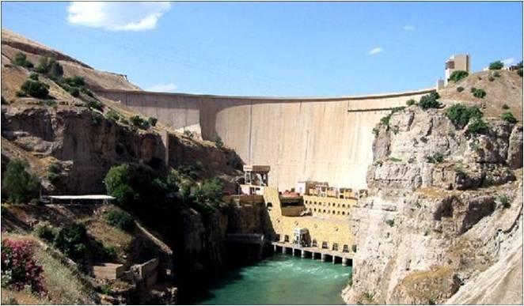
سد دوكان

Slide 28
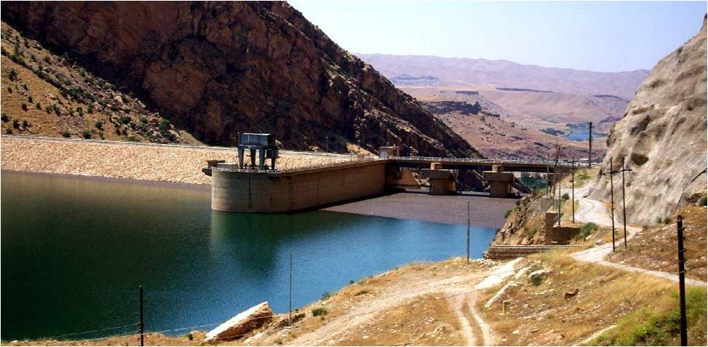
سد دربنديخان

Slide 29
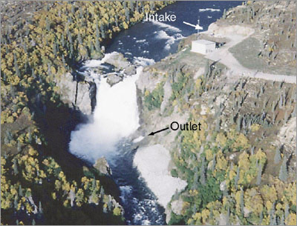
Small power plants
A diversion (small), sometimes called run-of-river, facility channels a portion of a river through a canal or penstock. It may not require the use of a dam.
The Tazimina project in Alaska is a diversion hydropower plant. No dam was required.

Slide 30
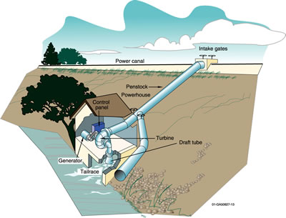
Micropower system
Micro Hydropower
A micro hydropower plant has a capacity of up to 100 kilowatts. A small or micro-hydroelectric power system can produce enough electricity for a home, farm, ranch, or village

Slide 31
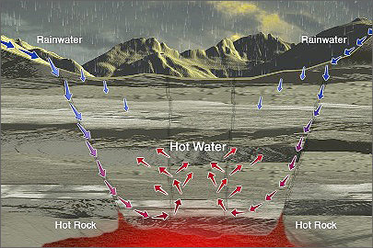
Geothermal Energy Systems
Geothermal ("Earth-heat") energy comes from the residual heat left over from the Earth's formation and from the radioactive decay of atoms deep inside the earth.
This heat is brought up to the earth's crust by molten rock (magma) and by conduction through solid rock. There it raises the temperature of the earth's surface and of groundwater trapped in the fissures and pores of underground rock, forming zones called hydrothermal (hot water) reservoirs.
Geothermal water cycle.

Slide 32
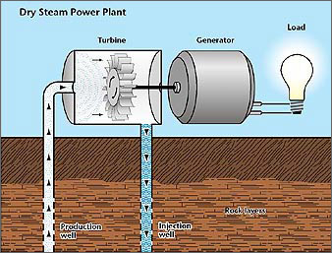
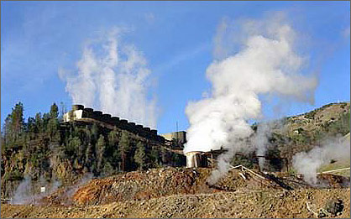
Geothermal electric power system
Steam power plant
With a 750-MW output, The Geysers in California is the largest producer of geothermal electricity in the world. (Photo: David Parsons)

Slide 33
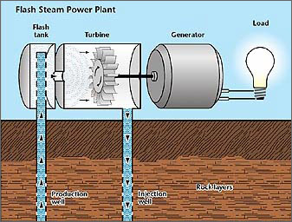
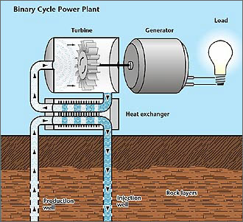
High-Temperature Water power plant
Moderate-Temperature Water power plant

Slide 34
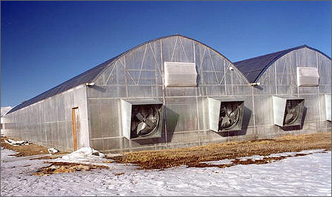
Direct Use of Hydrothermal Resources
Hot water from geothermal resources can be used directly to provide water and space heating.
Direct use applications include crop drying, industrial processes, resorts and spas; and heating buildings, greenhouses, and fish farms.

Slide 35
Solar radiation lines in iraq

Slide 36
New power generation using natural gas
No | المشروع | الموقع | الوقود المستخدم | السعة
1 | محطة الغراف | ذي قار | النفط/الغاز | 125 ميكاواط
2 | محطة الغراف البخارية | ذي قار | الغازالطبيعي | 300 ميكاواط
3 | محطة الخيرات البخارية | كربلاء | النفط/الغاز | 300 ميكاواط
4 | محطة الشمال البخارية | الموصل | النفط/ الغاز | 300 ميكاواط
5 | محطة الشمال البخارية | الانبار | النفط الخام/الغاز | 300 ميكاواط
6 | محطة شط العرب البخارية | البصرة | النفط/الغاز | 300 ميكاواط

Slide 37
........شكرا لكم........

