Slide 1
Principles of Computer-Aided Drug Design
By:
Zaid Al-Obaidi, PhD
Assistant Professor in Medicinal Chemistry

Slide 2
Contents:
Definitions
Advantages
Disadvantages
Examples of current work

Slide 3
Definitions
“Computer-aided drug design” (CADD) refers to the application of computational modelling approaches to drug discovery.
CADD can be separated into ligand identification and ligand optimization, with both Structure-based drug design (SBDD) and ligand-based drug design (LBDD) methods useful in the appropriate context.

Slide 4
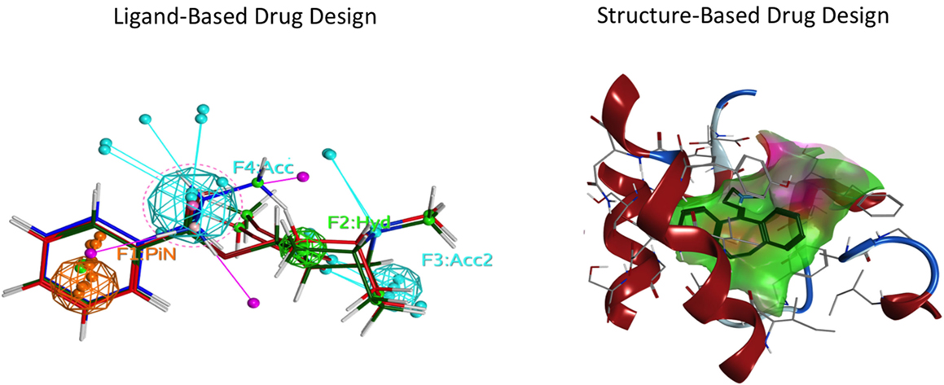

Slide 5
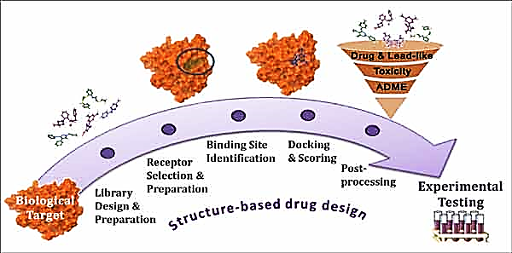
Definitions
SBDD methods analyse macromolecular target 3-dimensional structural information, typically of proteins or RNA, to identify key sites and interactions that are important for their respective biological functions.

Slide 6
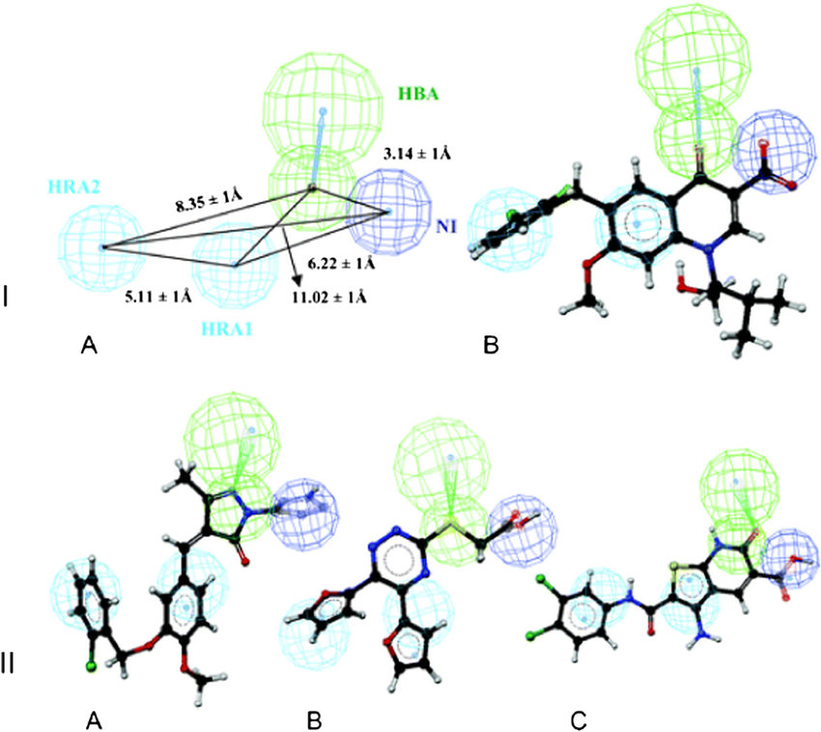
Definitions
LBDD methods focus on known ligand to establish a relationship between the physiochemical properties and drug activity, referred to as a structure-activity relationship (SAR), information that can be used for optimization of known drugs or guide the design of new drugs with improved activity.

Slide 7
Advantages
Classical drug discovery is an expensive and time-consuming process with the average approved drug requiring 10 to 15 years to develop with an estimated cost of 0.8–2 billion USD.
Importantly, CADD can be used in most stages of drug development: from target identification to target validation, from lead discovery to optimization, and in preclinical studies.
It is therefore estimated that CADD could reduce the cost of drug development by up to 50%

Slide 8
Disadvantages
Easy to get wrong! (wrong inputs)
Cost!
Needs special requirements (e.g. super computers)

Slide 9
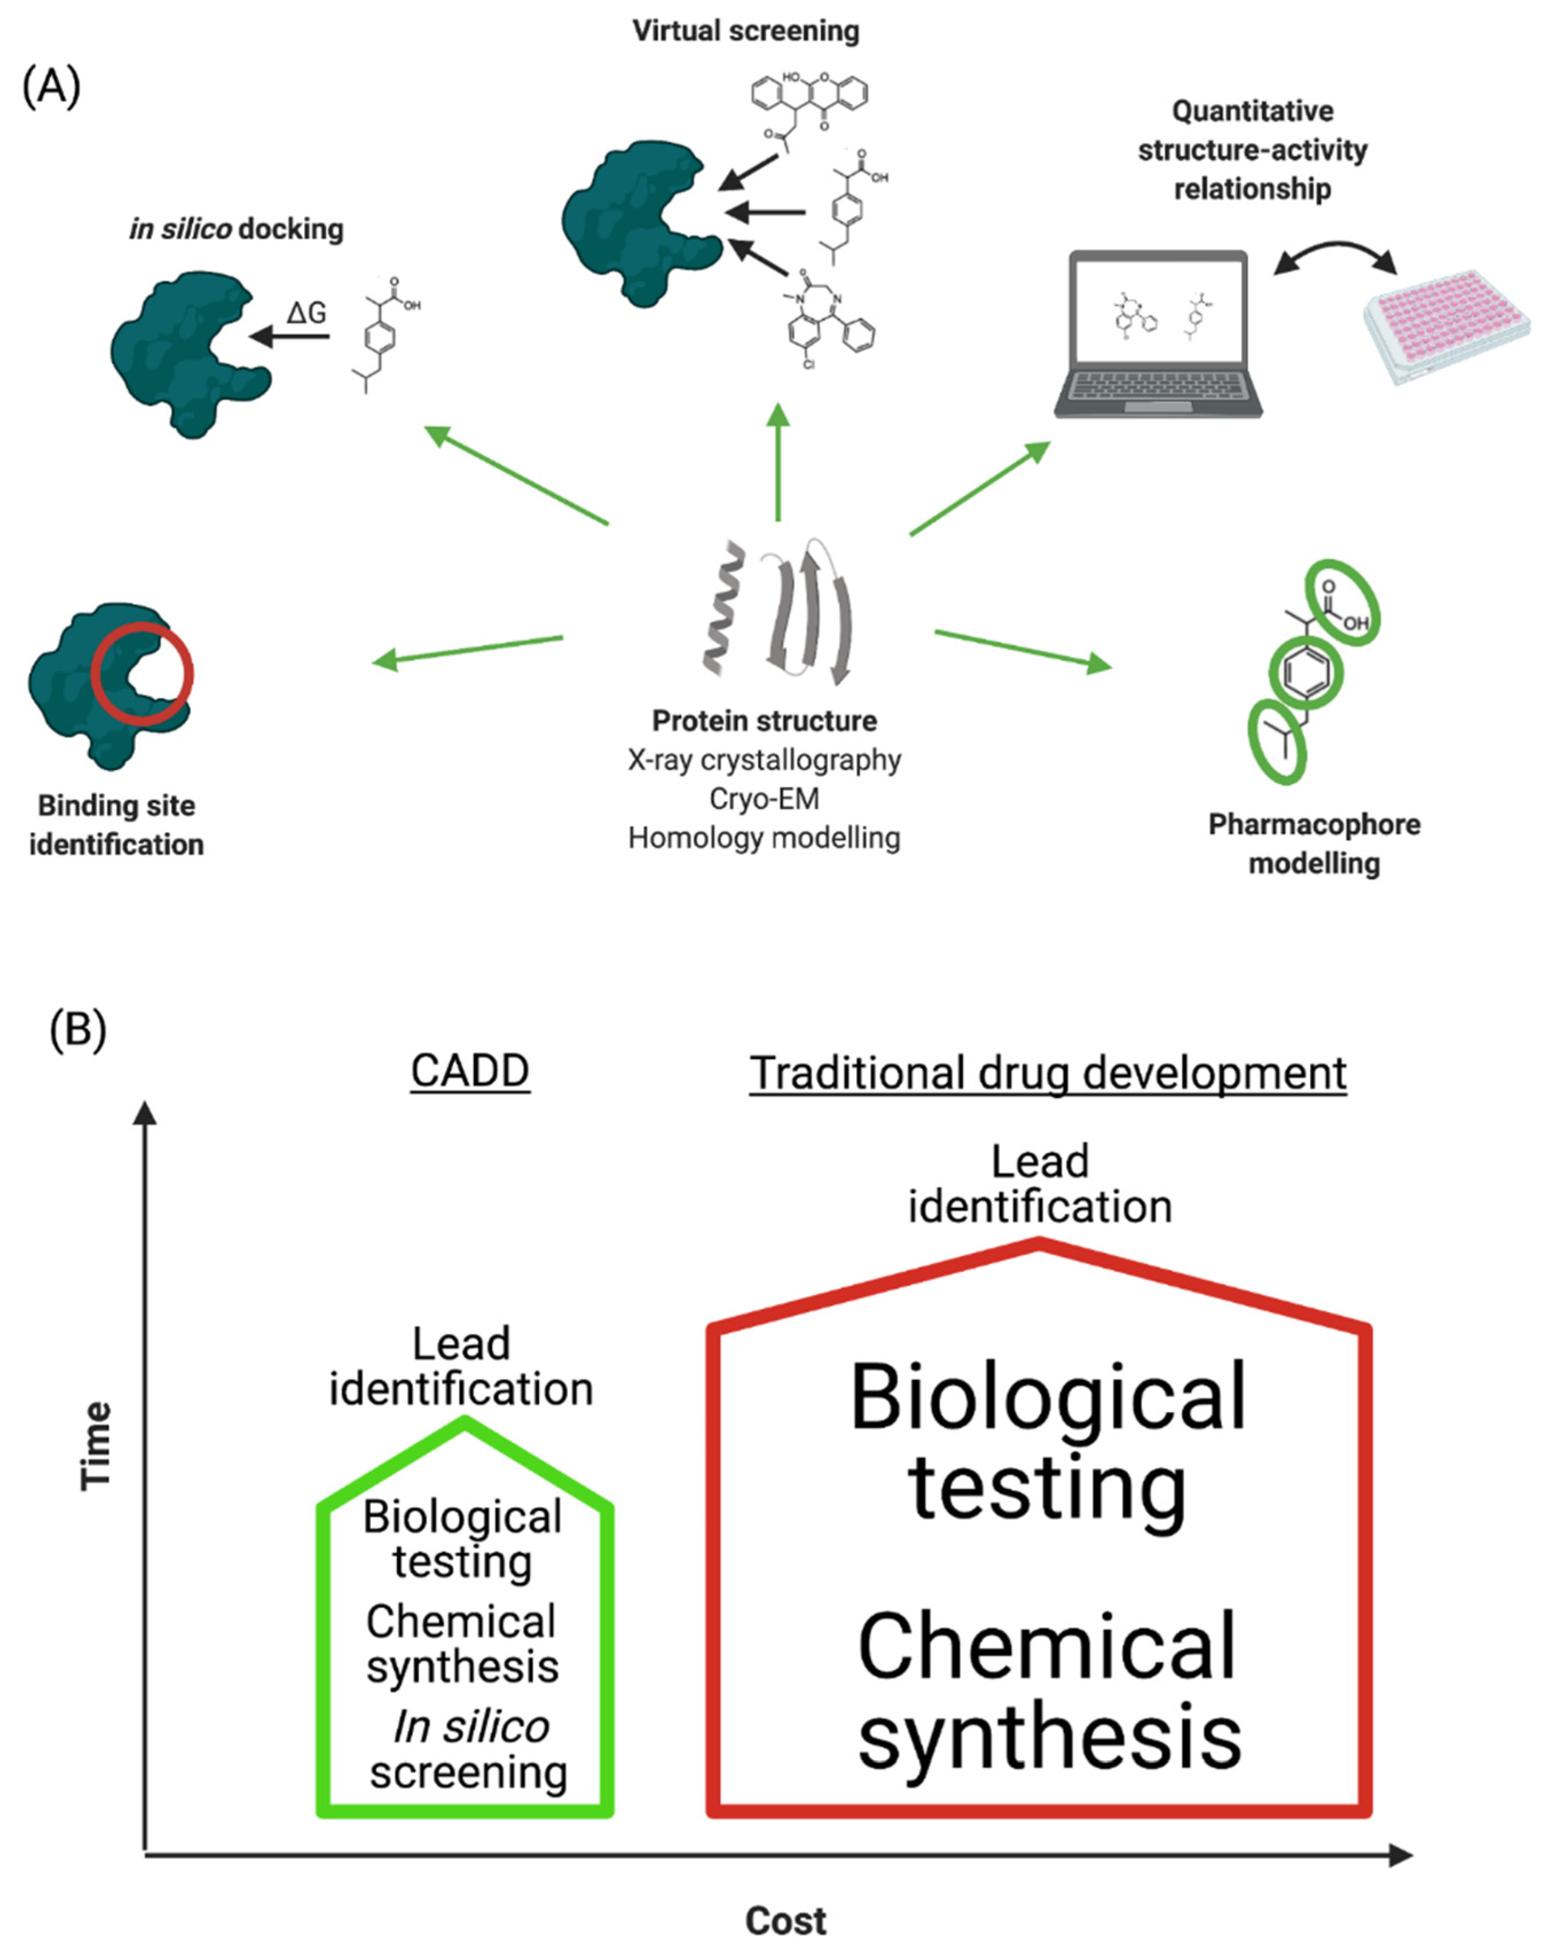
Schematic representation of CADD process.
Comparison of traditional and computer-aided drug development in terms of time and cost investments.

Slide 10
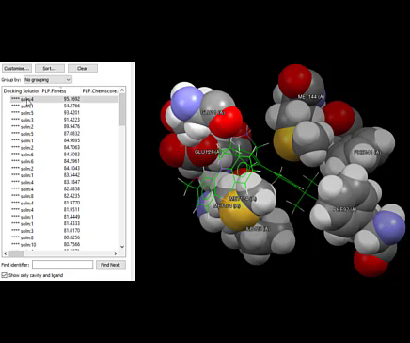
Examples of current work (mixed both LBDD & SBDD)

Slide 11


