Slide 1
Workshop
Sharing Files on Local Network
المدرس المساعد محمد مهدي صالح
قسم هندسة تقنيات الحاسوب
كلية الهندسة التقنية
Twenty-Eighth of June-2021

Slide 2
Aims
The lecture aims:
- Overview of Local Network
- Structure of University of Alkafeel Network
File Sharing
CD Drive Sharing , Printer Sharing
Hotspot Setting , Ad Hoc Network

Slide 3
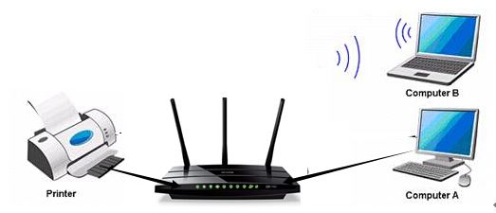
What is Local Network
A Local Area Network (LAN) is a collection of devices connected together in one physical location, such as a building, office, or home.

Slide 4
What is Intranet
An intranet is a computer network for sharing information, collaboration tools, operational systems, and other computing services within an organization, usually to the exclusion of access by outsiders.

Slide 5
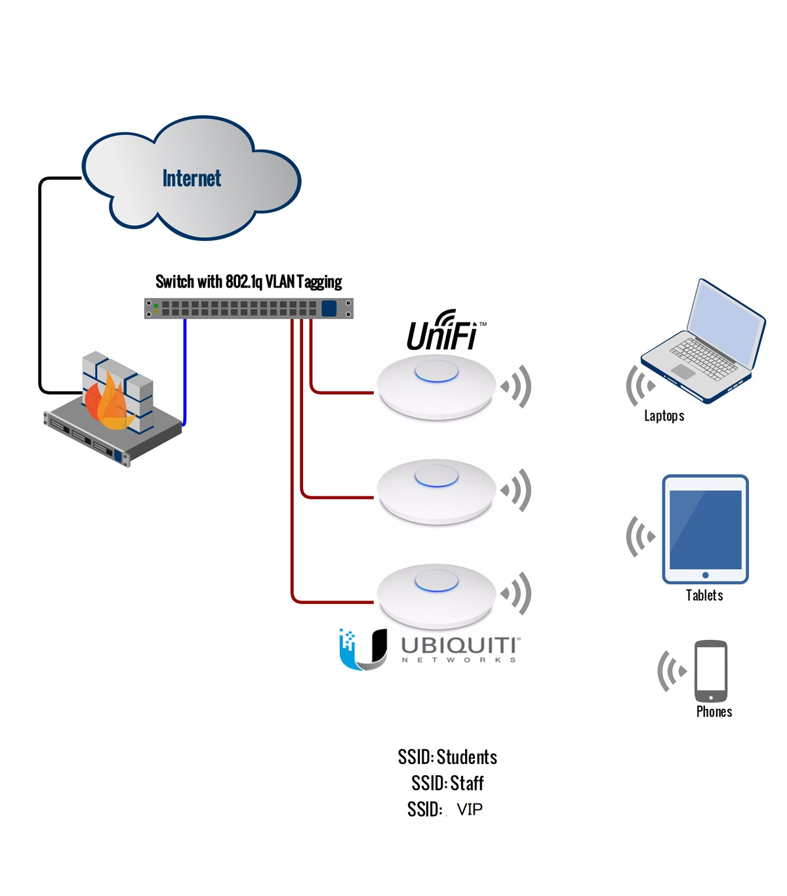
Typical Intranet of University of Alkafeel

Slide 6
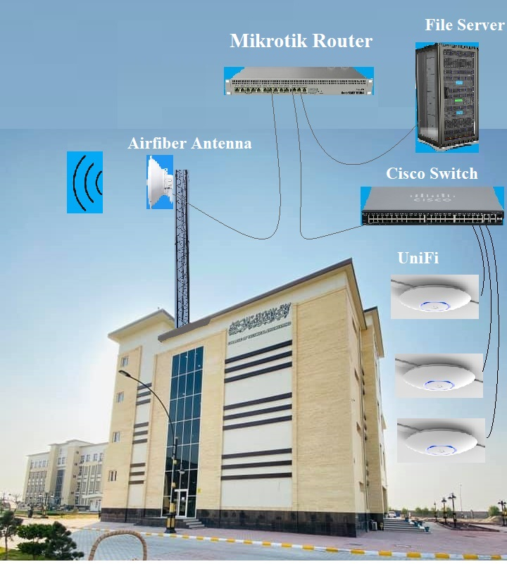
Intranet of University of Alkafeel

Slide 7
In sometimes, it is essential to share a USB printer in a computer, in order to have paper printed from another computer.
1. USB Printer Sharing
Notes:
اعلنت وزارة الاتصالات ،اليوم الثلاثاء، عن بدء المرحلة الثانية من المشروع الوطني للانترنت و المتضمن نصب الكابينات الخاصة بالكيبل الضوئي و التي ستشمل جميع مناطق العراق التي امتد فيها الكيبل الضوئي على طول 4500 كم .

Slide 8
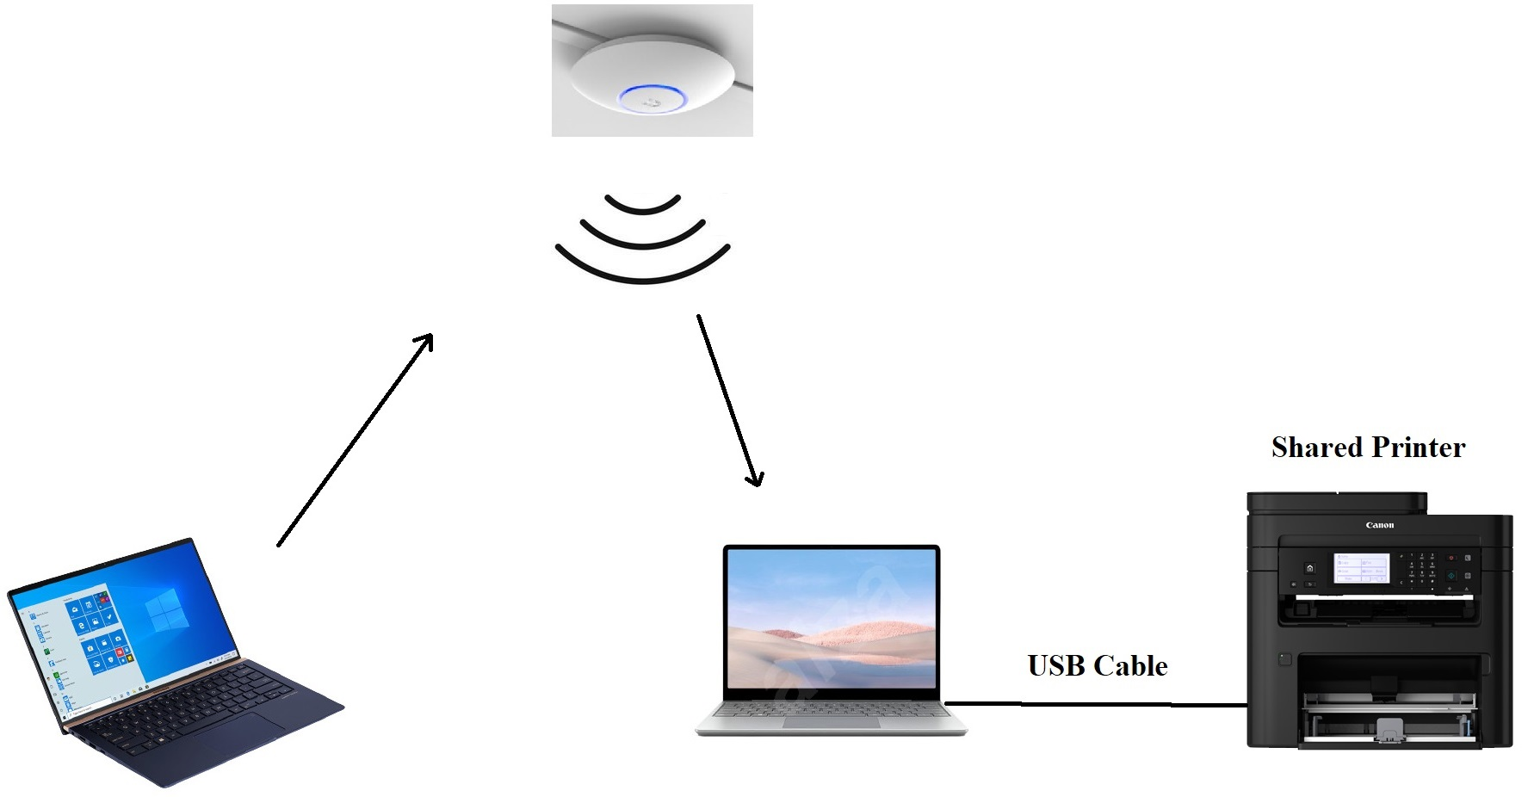
Shared Printer

Slide 9
Steps to Share a printer on Windows 10
Start
Settings
Devices
Devices and printers
Right click on the printer, and then printer properties
Sharing, and then Share this printer
Apply, OK.

Slide 10
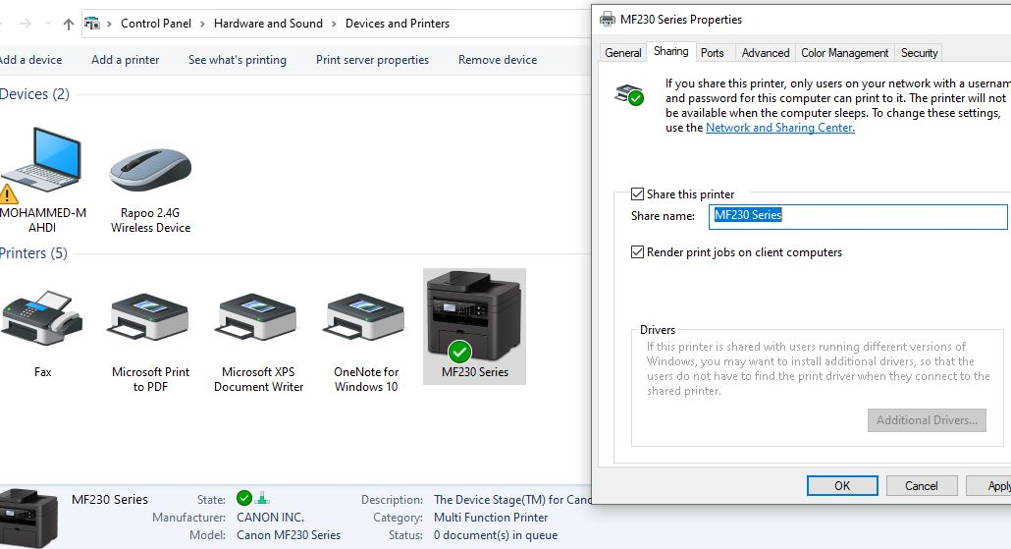

Slide 11
In an imperative conditions, you may need to share a file of any size over local network, regardless of availability of Internet access or not.
You need to have access on local network for both devices.
2. File Sharing
Notes:
اعلنت وزارة الاتصالات ،اليوم الثلاثاء، عن بدء المرحلة الثانية من المشروع الوطني للانترنت و المتضمن نصب الكابينات الخاصة بالكيبل الضوئي و التي ستشمل جميع مناطق العراق التي امتد فيها الكيبل الضوئي على طول 4500 كم .

Slide 12
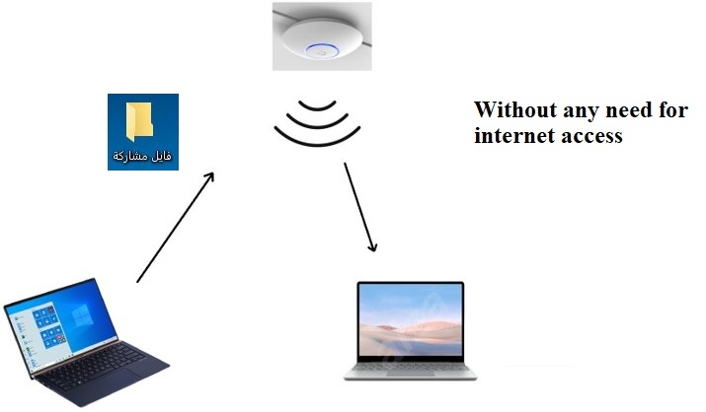

Slide 13
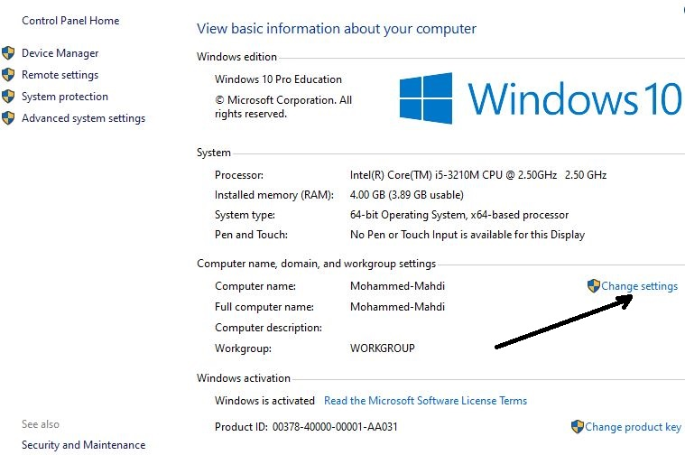
Several steps to share a file
Right click on my PC
and then properties
2. Change settings

Slide 14
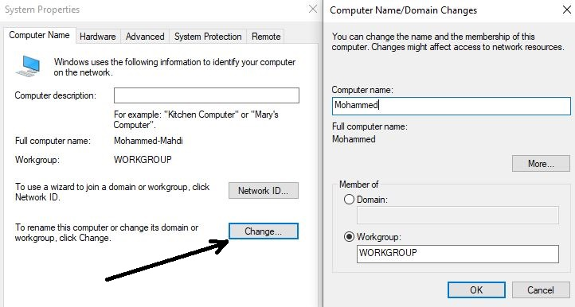
Several steps to share a file

Slide 15
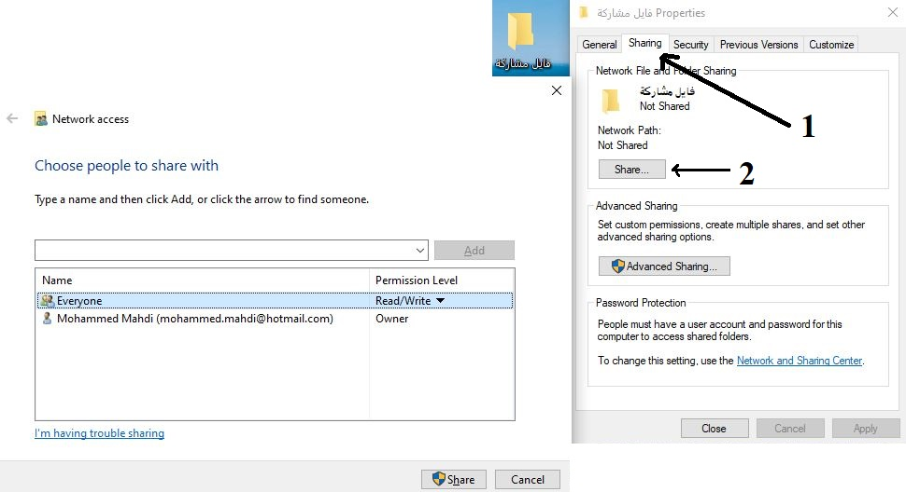
Several steps to share a file

Slide 16
Several steps to share a file
Start Settings

Slide 17
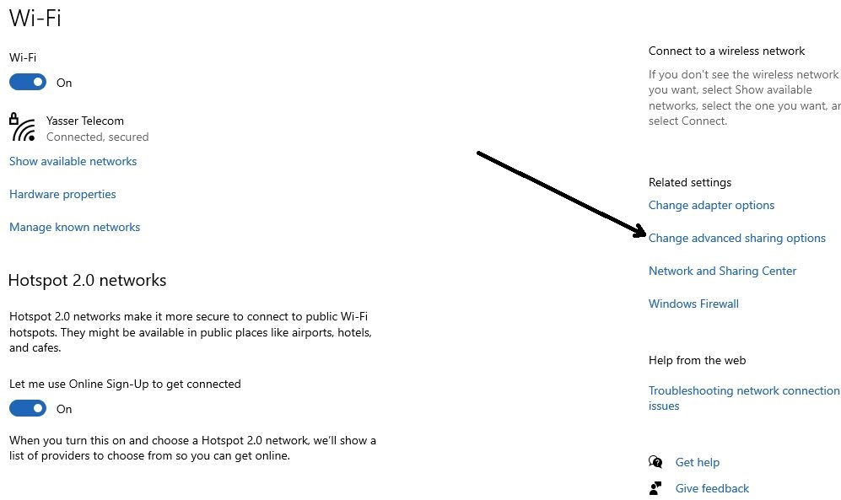
Several steps to share a file

Slide 18
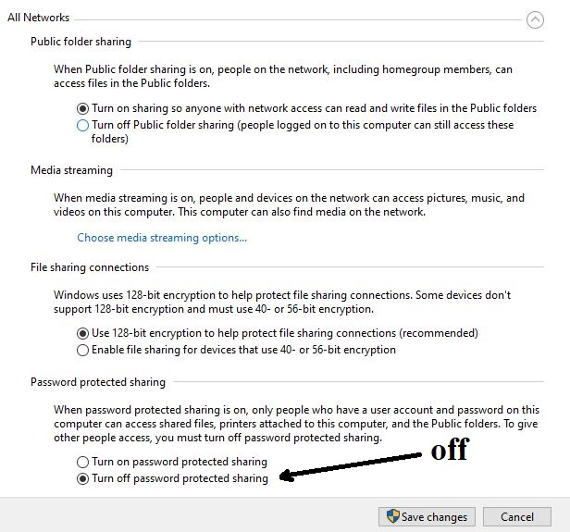
Several steps to share a file

Slide 19
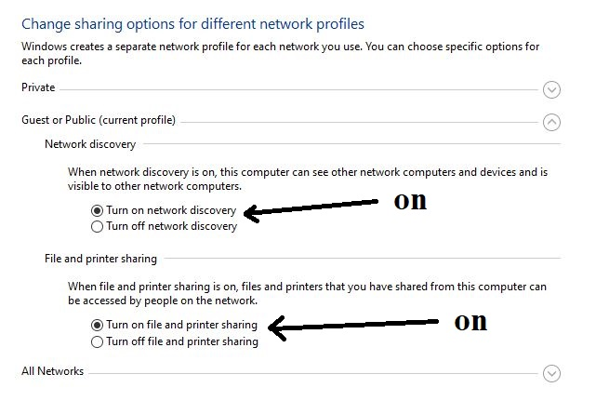
Several steps to share a file

Slide 20
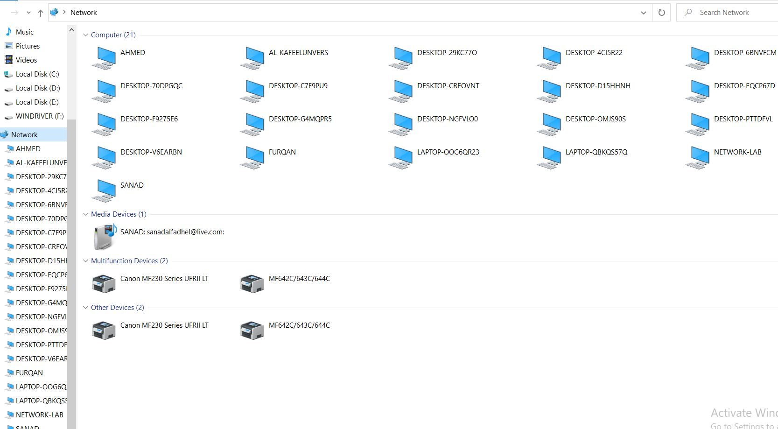
Several steps to share a file

Slide 21
3.Hotspot
If you need to let internet shared among several computers from a PC which already has an access to internet, you can activate hotspot.
Notes:
اعلنت وزارة الاتصالات ،اليوم الثلاثاء، عن بدء المرحلة الثانية من المشروع الوطني للانترنت و المتضمن نصب الكابينات الخاصة بالكيبل الضوئي و التي ستشمل جميع مناطق العراق التي امتد فيها الكيبل الضوئي على طول 4500 كم .

Slide 22
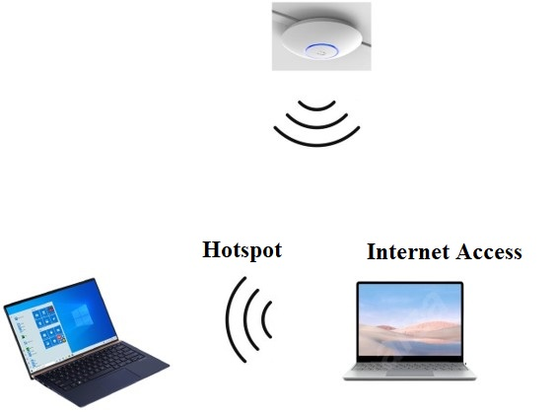

Slide 23
Several steps to Hotspot

Slide 24
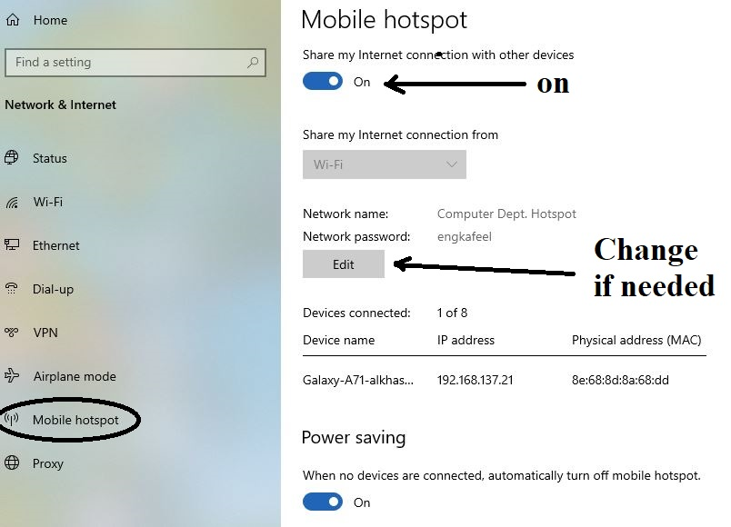
Several steps to Hotspot

Slide 25
4. CD drive Sharing
Occasionally, the CD drive of your computer does not work properly, so you can insert the compact disk in any other computer and install or copy files for your computer.

Slide 26
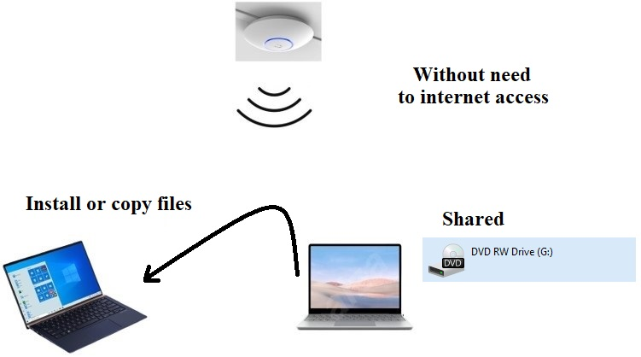
CD Drive Sharing

Slide 27
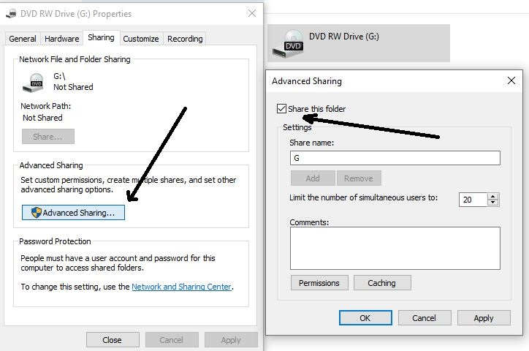
Several steps to CD drive sharing
Right click on CD drive
Sharing
Advanced sharing
Share this drive

Slide 28
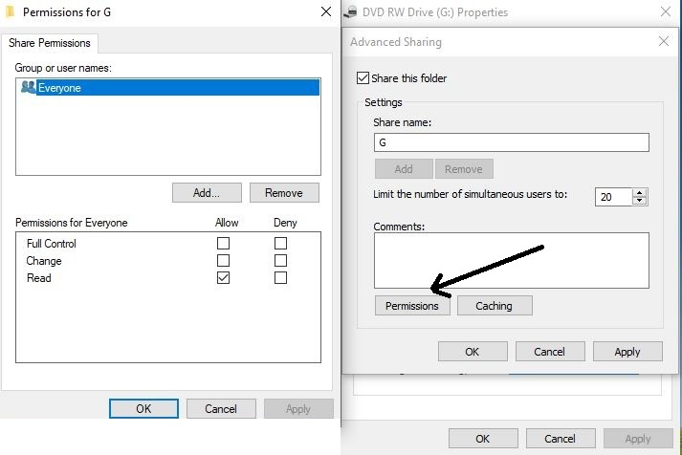
Several steps to CD drive sharing

Slide 29
Recommendations
Recommended for personnel to deal with computer networks doabely .
To be prepared for any inconveniences, such as CD drive, internet disconnect or sharing internet.
Windows 10 and further facilitates access locally without assistive applications.

Slide 30
I appreciate your attendance
Any questionnaires ?

