Slide 1
انواع مفاصل الركب الصناعية
م. فراس ثائر المالكي

Slide 2
Faculty of Engineering
School of Mechanical Engineering
Lower-limb prosthesis components
Materials & Equipment's
Prosthetic Knee Products
Cause of amputation
Outline

Slide 3
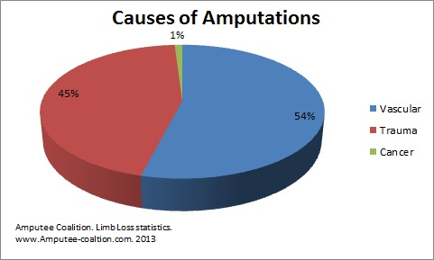

Slide 4
Thirty million in the world have lose their amputation .The loses of amputation is associate with various cases such as disease, traffic accident and war operations which include remove an extremity (arm, leg) or part of it

Slide 5
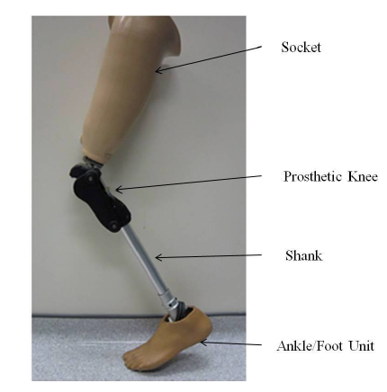

Slide 6
Methods used in experimental analysis of different types of prosthetic knee for transfemoral amputee include
Gait Analysis
Ground Reaction Force GRF Analysis
Prosthetic Alignment Analysis
Interface Pressure Analysis
Photo elasticity Analysis
Ultrasound (US) Analysis

Slide 7
Gait Analysis
Gait analysis plays an important role in show the factors involved in the pathologic prosthetic gait and the selection and effects of available interventions to optimize it. Evaluation in the gait laboratory using kinetic and kinematic data is often necessary to quantify and identify the particular contributions of the variables impacting the gait with confidence and assess the results of such intervention. [5].

Slide 8
The gait lab is equipped with a 12-m walkway and two piezoelectric force plates embedded in the center .A 12-camera optoelectronic system (Vicon MX, Vicon Motion Systems Ltd., Oxford, UK)
was used to measure the kinematic parameters. To determine joint positions in space, reflective markers were attached to the anatomical reference points: for example knee center as defined by (prosthetic side knee axis).[5]

Slide 9
Ground Reaction Force (GRF)
According to Newton's third law the so-called ground reaction force (GRF) is the force exerted by the ground on a body in contact with it. When a person is just standing, the GRF corresponds with the person’s weight. When the body is moving, the GRF increases due to acceleration forces.
The most direct and effective way to measure (GRF) is using a force plate.
Piezoelectric measurement technology ensures that forces and moments are registered accurately in a variety of applications.
In biomechanics force plates are applied to:
characterize walking
characterize running
characterize jumping

Slide 10
Ground Reaction Force (GRF)
Measuring GRFs plays an important role in the areas of:
sports performance analysis
rehabilitation
products ergonomics
clinical research [6].

Slide 11
Prosthetic Alignment Analysis
The L.A.S.A.R. Posture (both Ottobock SE & Co. KGaA, Duderstadt, Germany) was used to check and optimize the static alignment in accordance with established recommendations .
Devices with correct static alignment have a positive effect on users’ posture and mobility: Malpositions are minimised, the body is relieved and users find it easier to maintain their balance [7].

Slide 12
Interface Pressure Analysis
Interface stresses are an important consideration in stump and socket for a prosthetic limb to a person with transtibial amputation. During stance phase of the gait cycle, the prosthetic socket is expected to support and distribute the entire body weight of the patient.
Interface pressure analysis used to measure the maximum forces and pressures between stump and socket during different walking speed and contribute
Improve design and fit of sockets and prosthetics
Increase longevity for wear of socket and use of prosthesis [8]

Slide 13
Photo-elasticity Analysis
The Photo-elastic method is used to analyses stresses experimentally by taking advantage of the birefringence effect that appear on the experimented materials. The very name of this method reflects its nature, where it makes use of the light rays by optical methods. Elasticity not only does it depict the study of deformation and stresses in elastic bodies, but is also able to present solutions to two and three dimensional problems [9].

Slide 14
Ultrasound (US) Analysis
Ultrasound (US) has the advantage over radiographs, fluoroscopy, and scintigraphy of being able to directly evaluate structures.
US is also advantageous in that it allows real-time dynamic evaluation of moving structures such as prosthetic knee joint [10]

Slide 15
3R60
polycentric knee joint with hydraulic swing phase control.
Features
Controlled stance phase flexion of up to 15°
Progressive damping of stance phase flexion as well as stance phase extension
The 5-axis design provides greater protection in high-risk situations
Large knee flexion angle of 175° for greater freedom of movement.
Max body weight 125 kg

Slide 16
3R78
Polycentric knee joint with pneumatic swing phase control
Features
Dust-resistant design that is durable and resistant against environmental impacts
pneumatic swing phase control offers reliable stance phase security for users
Knee flexion angle of 150° for greater freedom of movement.
Max body weight 100 kg

Slide 17
C-Leg 4
The C-Leg is the fully microprocessor-controlled hydraulic leg prosthesis system. The strain gauges in the tube adapter and a knee angle sensor record the anterior and posterior flexion moment and the angular velocity of the knee joint every 0.02 seconds. Based on these measurements, the microprocessors calculate the required movement resistance.
Features
Mechanical and electronic adjustments have resulted in improved swing phase control
Servomotors correspondingly open and close hydraulic valves to provide the required flexion and extension damping.
As Knee flexion angle of 125°
Max. body weight 136 kg

