Slide 1
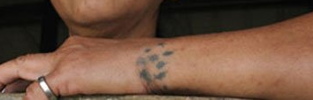
Rationalization of the traditional use of tattoos
م.د سالم فايز كاظم

Slide 2
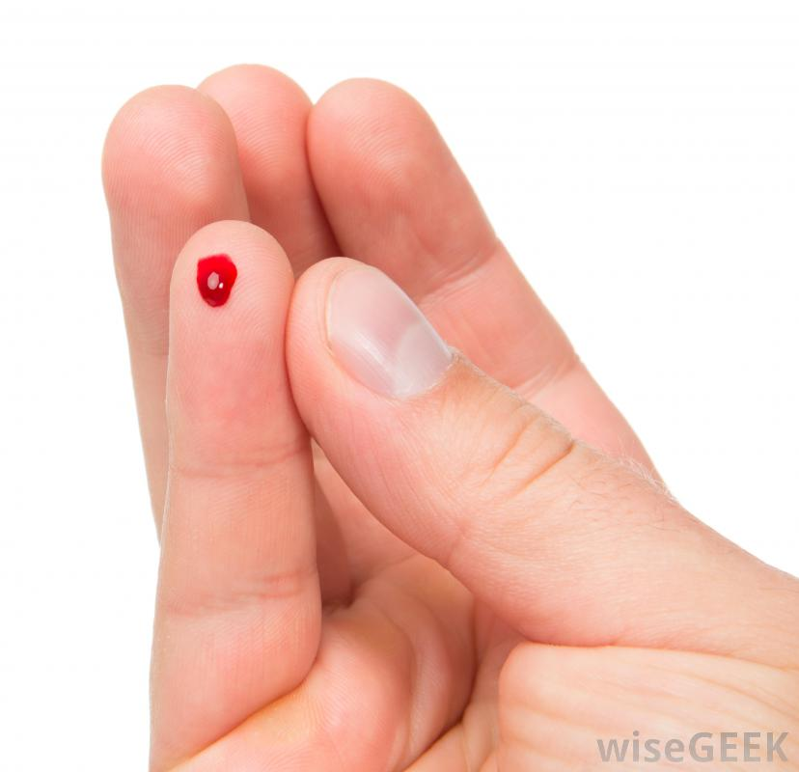
Minor injuries with no pain?!!!!

Slide 3
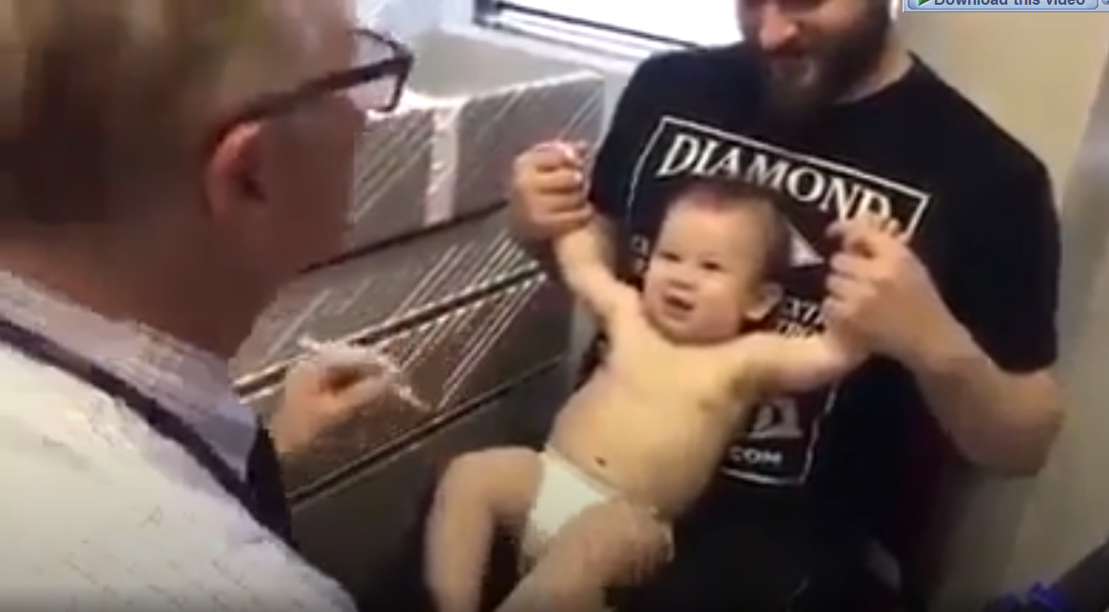
Injection with no pain?!!!!
https://www.youtube.com/watch?v=TfqpXTlLeLE

Slide 4
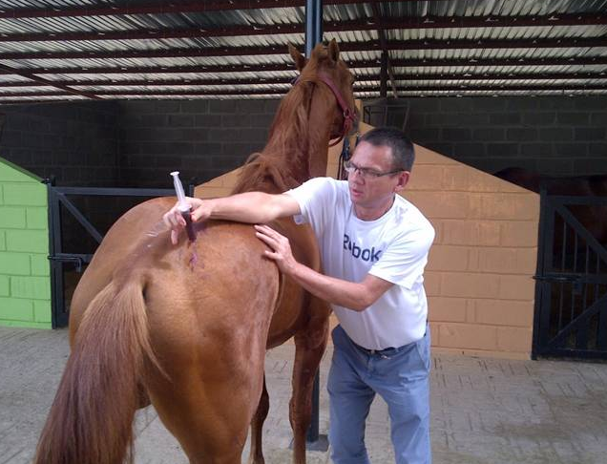
Alternative pain position

Slide 5
Pain masking pain
Pain masking emotion

Slide 6
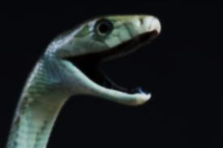
Pain is an unpleasant experience resulting from a response to a harmful stimulus. It helps avoiding or minimizing tissue damage.

Slide 7
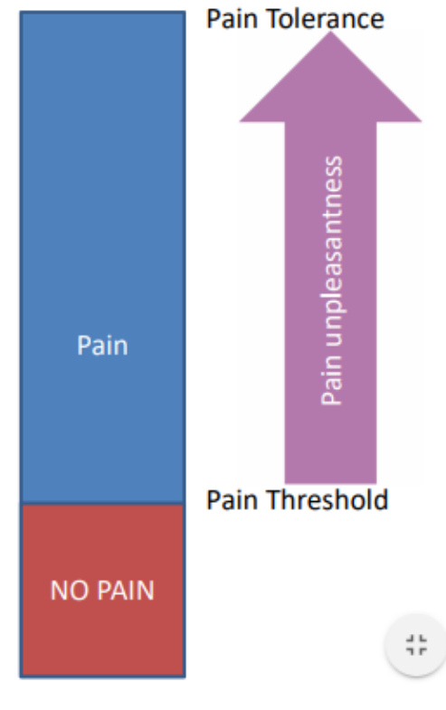
Pain threshold and pain tolerance
Pain threshold
Is the lowest intensity at which a given stimulus is perceived as painful; it is relatively constant across subjects for a given stimulus. For example, most subjects will define a thermal stimulus as painful when it reaches about 50° C.
Is the greatest level of pain that a subject is prepared to endure.
Clinically, pain tolerance is of much more importance than pain threshold.
Pain tolerance

Slide 8
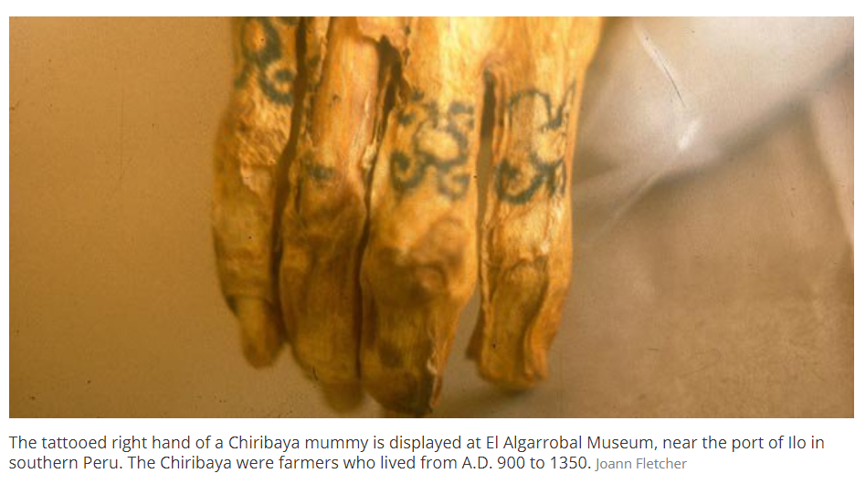
Tattoos

Slide 9
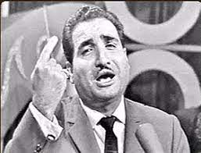
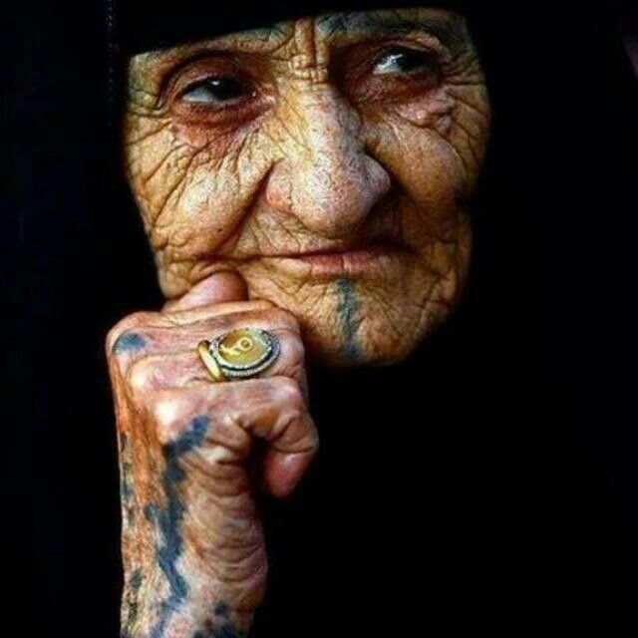
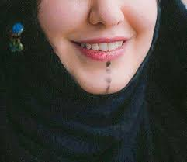
Tattoos

Slide 10
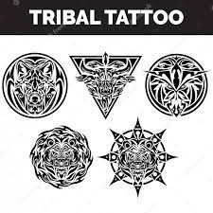
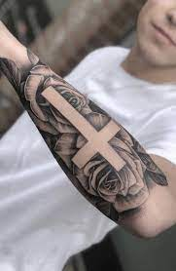
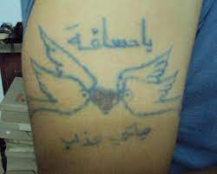
Tattoos could be
Cosmetics, particularly in women.
Of religious origin
Psychological
Medical
Medical/cosmetics

Slide 11
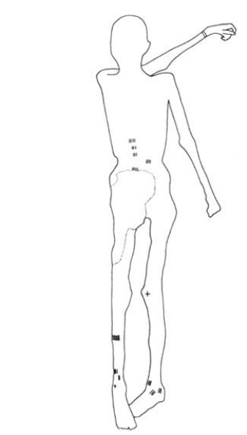
Tattoos could be
Ötzi, the 5,300-year-old mummified “Iceman,”
Discovered in the on the Italy-Austria border in September 1991.
The preserved body has a total of 57 tattoos
The Iceman and his tattoos © Lars Krutak

Slide 12
Tattoos could be
Asymmetric/irregular (not cosmetic).
80 percent of these tattoos overlap with classical Chinese acupuncture points utilized to treat rheumatism
Most of them are close to bone and joint problem.
Other tattoos were found to be located on or near acupuncture meridians that may have had the purpose of relieving other ailments, like gastro-intestinal problems,”.
The Iceman had a whipworm infection, researchers discovered in 2001.
The Iceman and his tattoos © Lars Krutak

Slide 13
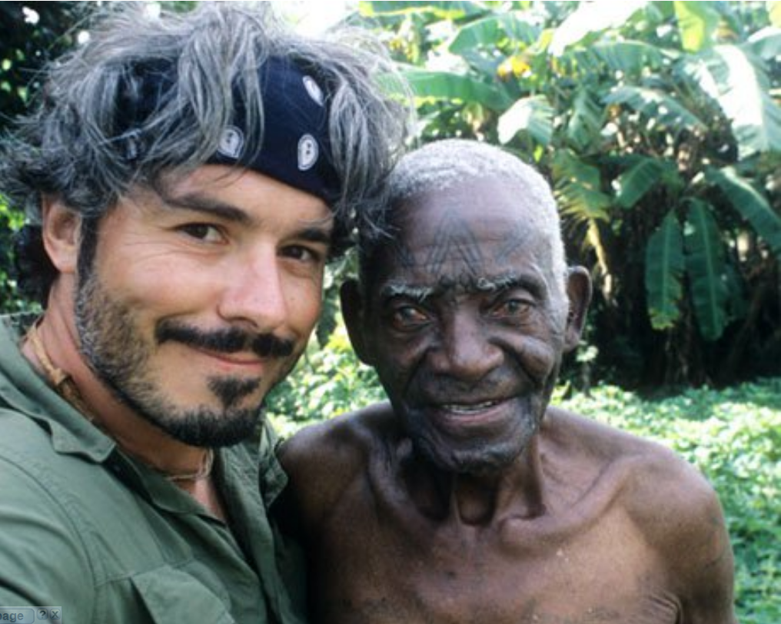
Lars Krutak with Pius, a traditional healer and one of the last Makonde tattooists of Mozambique © Lars Krutak

Slide 14
What are the modern medical uses of tattoos?
In place of alert bracelets for many patients with serious medical conditions.
In some breast cancer treatments involving radiation tattoos are used as guides for where the radiation needs to be administered.
Many types of scars are also able to be covered up with a medical tattoo.

Slide 15
Quick Facebook tiny questionnaire
Types of disease/symptoms treated

Slide 16
Quick Facebook tiny questionnaire
Their feedback

Slide 17
Proposed mechanisms of tattoos
Released/maintained endogenous opioids.
Activation of pain modulation system.
Get rid of pus, waste and dead cells.
Release of anti-inflammatory cytokines.
Elevating threshold of pain.
Psychological factors.

Slide 18
ANY QUESTIONS?

Slide 19
Thank you
for Listing

