Slide 1
MRI HAZARD
م.سرمد محمد حموزي
Lec. Sarmad Hamozi
dr.sarmadh@alkafeel.com

Slide 2
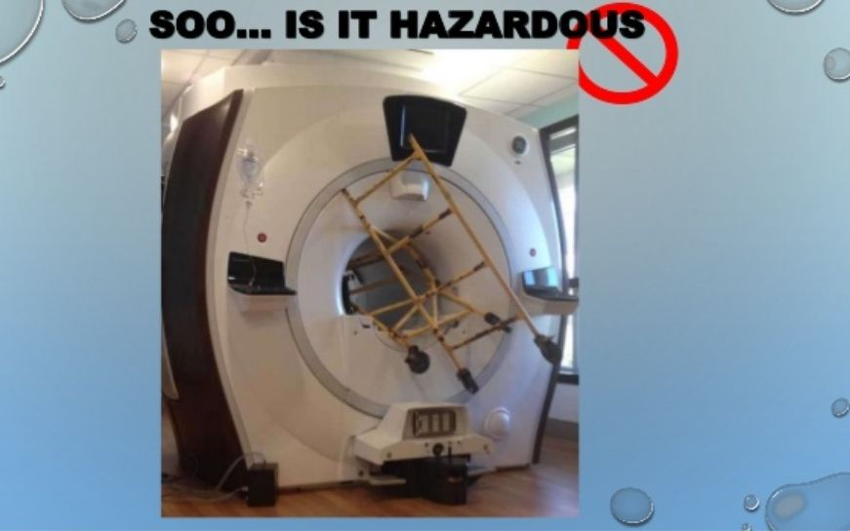
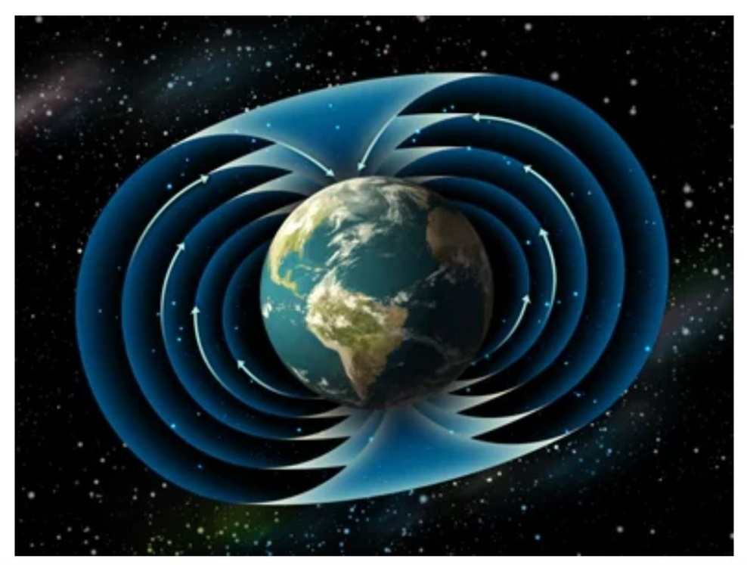
“MRI is safe, but if something goes wrong, it can go very wrong” WHO.
1. Static magnetic field
0.012 T- (2)T- 10 T 0.0000305 T

Slide 3
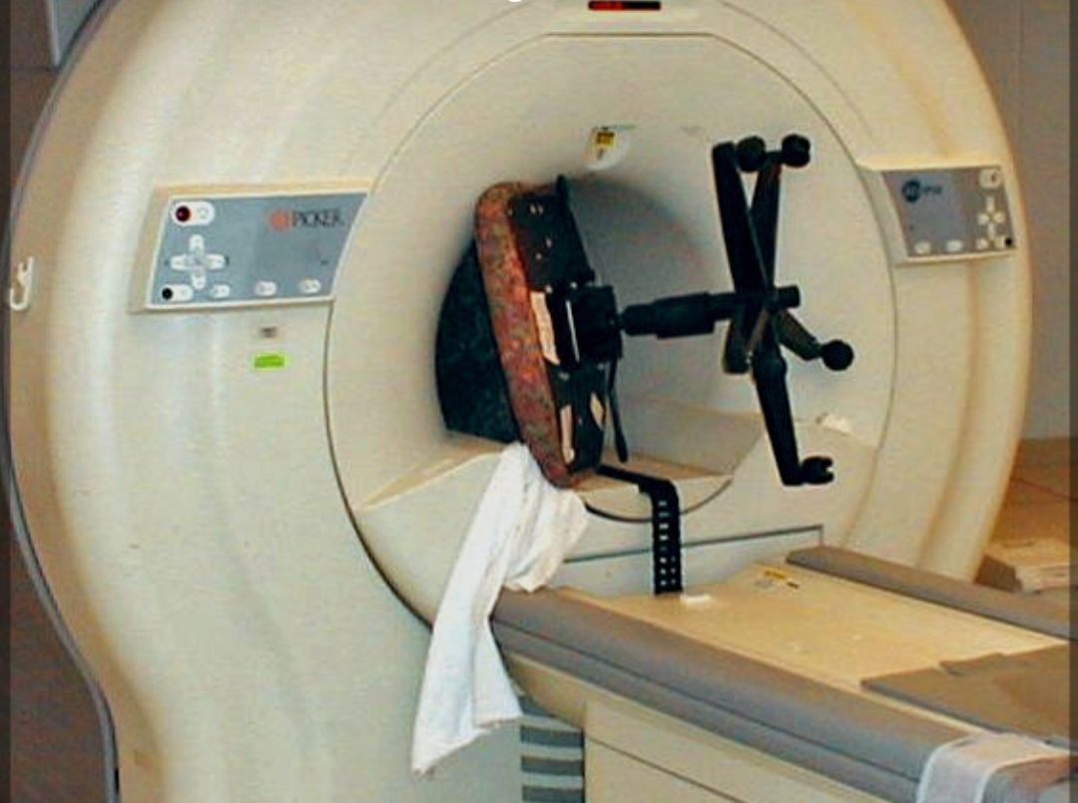

Slide 7
2. Time varying magnetic field
Noise
Flashes of light
Ventricular fibrillation

Slide 8
3. Radiofrequency
Heat production →→→ 1 Celsius
thermo regulator →→→ 1 hour

Slide 9
Thank you

